Slide 1
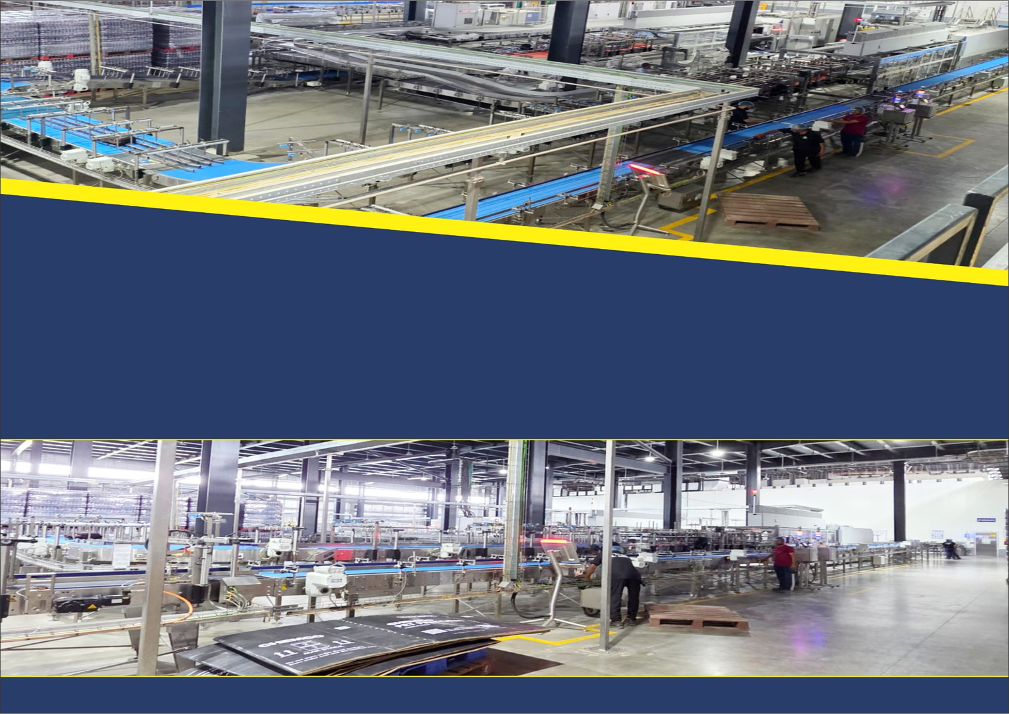

MEP Contractor
From Metro to Industries
ANC SERVICES
Leads the way…
www.ancservices.in
ENGINEERING, PROCUREMENT, CONTRACTING & CONSULTANCY
MEP Contractor
A Complete Solution for Electrical, Fire & Services

Slide 2


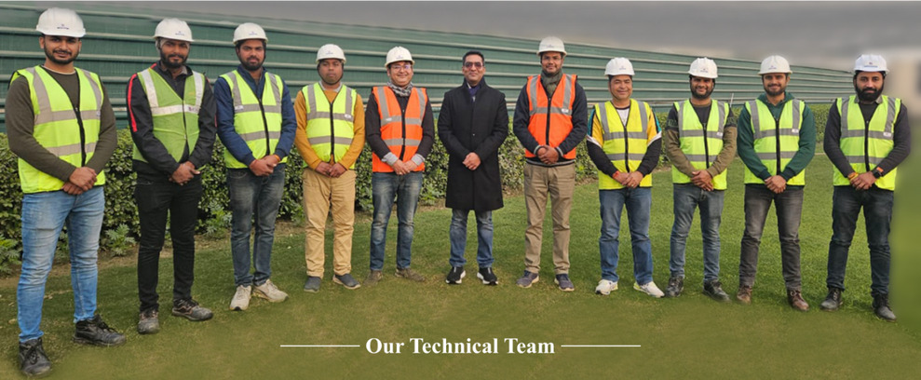
INTRODUCTION
ANC Services is an ‘A’ Class License Contractor Company in the business of providing Detailed Engineering services, Turnkey contracts and O&M services in Electrical and Instrumentation discipline for various types of projects in the field of Beverage Industry, Metro Projects, Distillery Plant, Paper Industries, Petrochemical, Highway Projects, Warehouse and all type of Industries, as well as, Commercial Complex, Residential Complex and Government Tenders in PAN India.
The company has been in this field for carrying out extensively all types of Electrification Work, Plumbing, Fire and IT Solutions. The company has a team of highly qualified and professional Engineers, Draftsman and Site Supervisors and Skilled personnel to complete the project in desired time schedule and still maintain the highest quality work.
Earlier we are doing all EPC contracts work under Vidhyut Control India Pvt. Ltd. which is LT Panel Manufacturing company since 1994. But from past 5 years we have made a separate company by name of ANC Services LLP which does all kind of HT/LT contracting works.
Mr. Madhur Mittal is a seasoned professional with a strong background in commerce, complemented by over 20 years of experience in EPC work & Real Estate industry. As a key figure in the group, he oversees all activities and plays a pivotal role in driving the group forward through his smart and effective approach, leveraging his expertise in taking the group forward and strengthening it's overall success.
Thanking you and assuring you of our prompt and quality services at all times.
Madhur Mittal
Managing Director

Slide 3

OUR EXPERTISE

Slide 4

ORGANISATION CHART

Slide 5
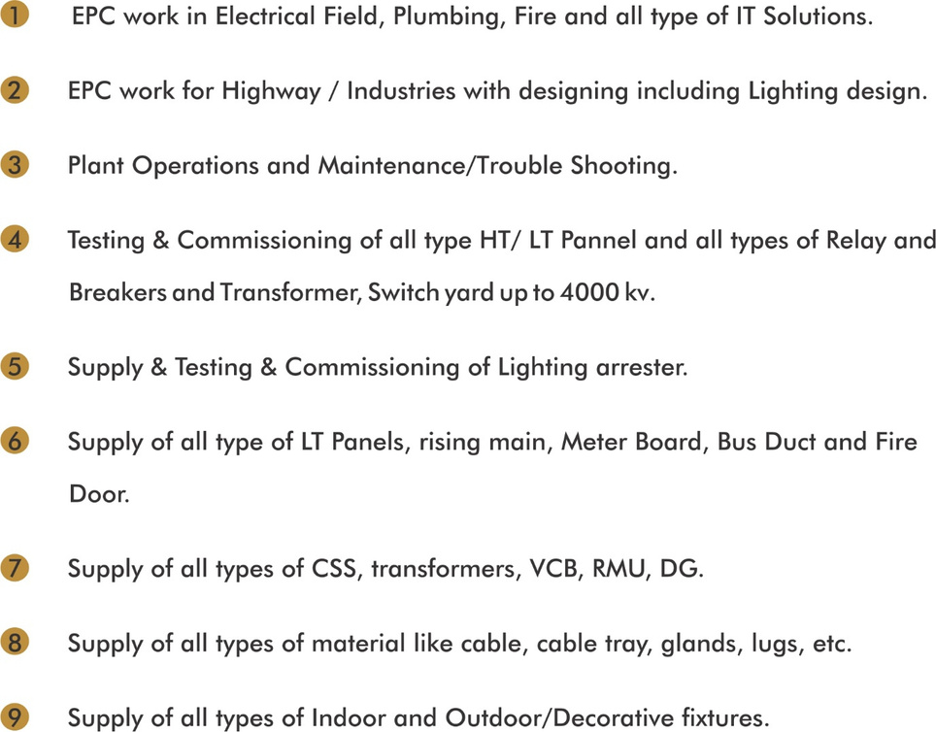
AREA OF OPERATION

Slide 6
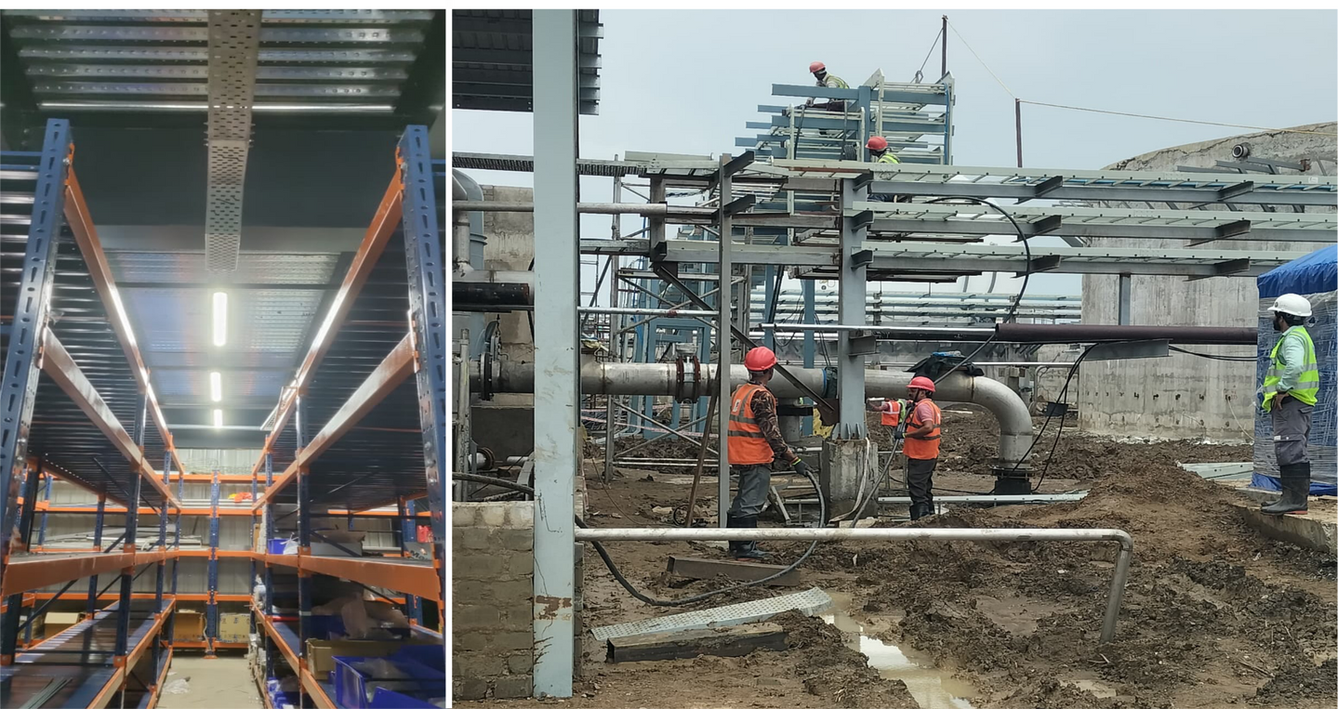
WORK ON SITES

Slide 7
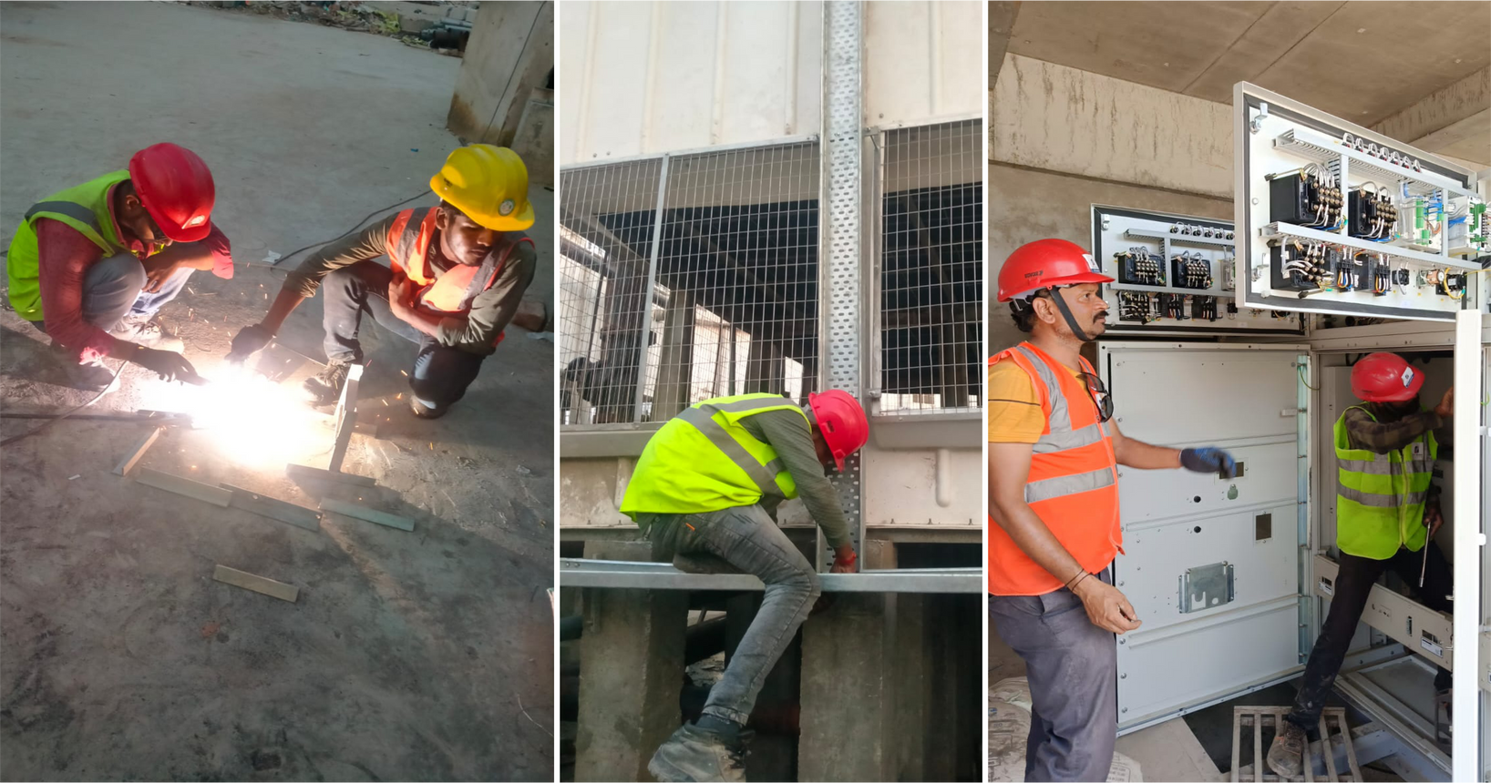
WORK ON SITES

Slide 8
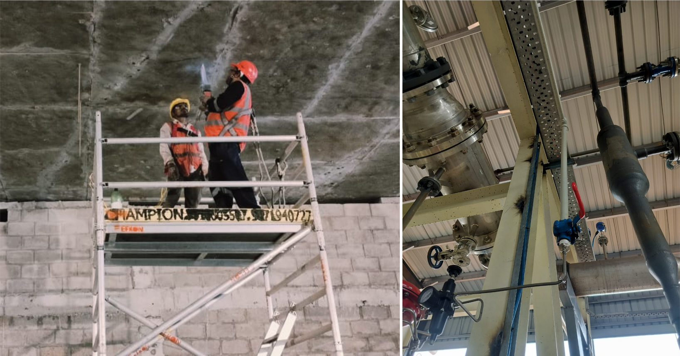
WORK ON SITES

Slide 9
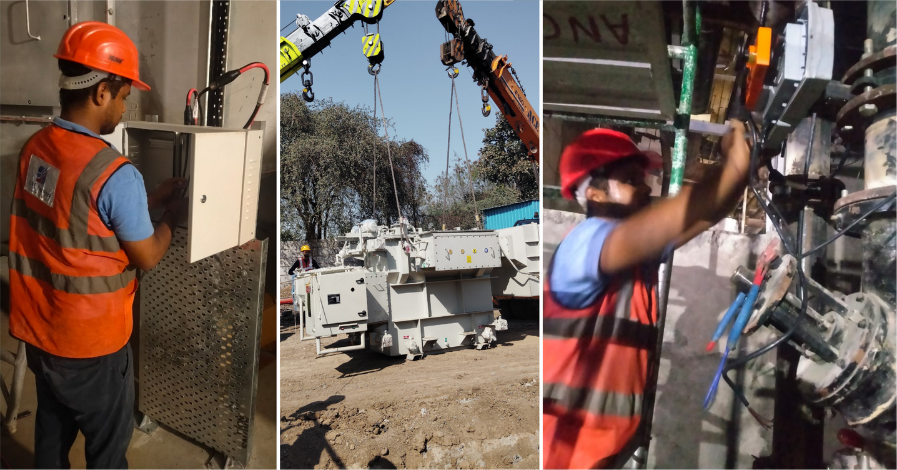
WORK ON SITES

Slide 10
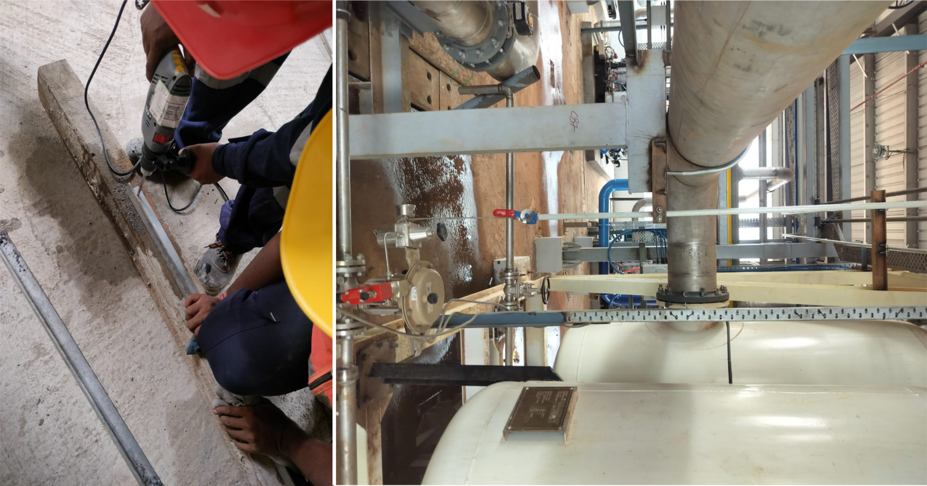
WORK ON SITES

Slide 11
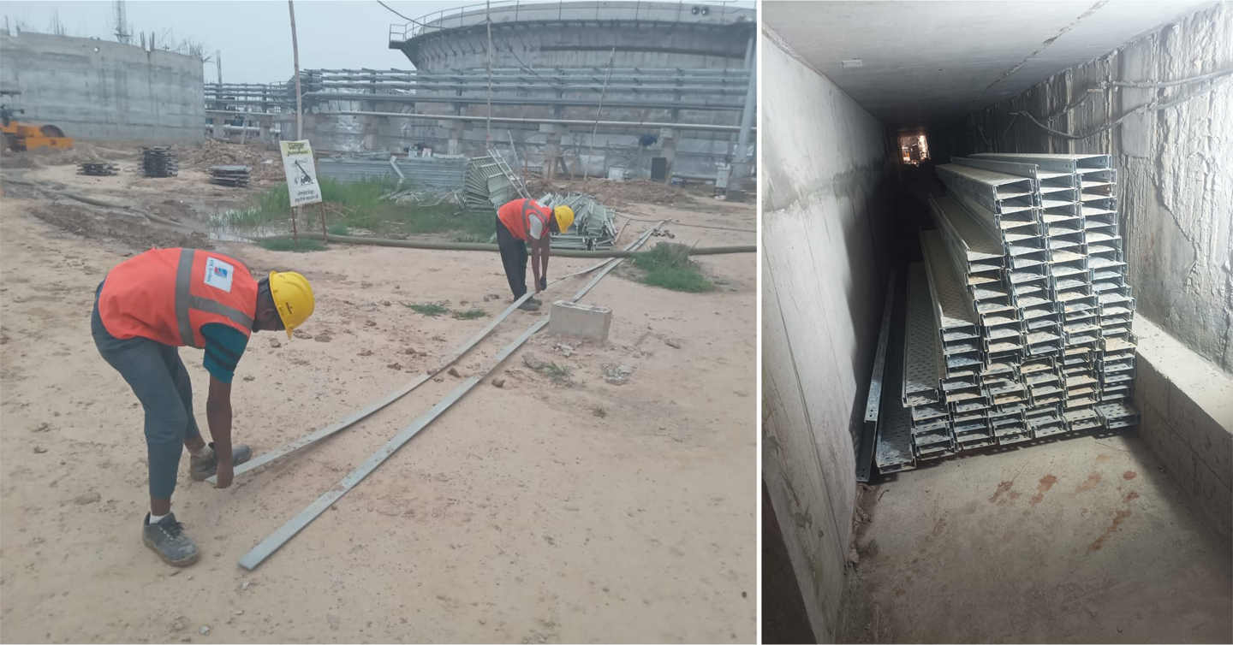
WORK ON SITES

Slide 12
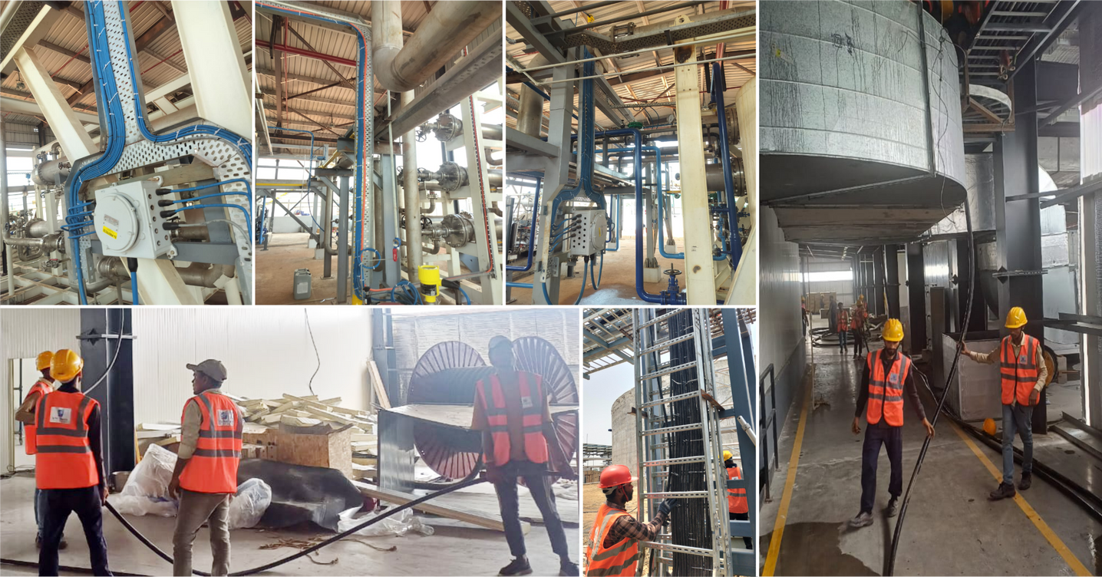
WORK ON SITES

Slide 13
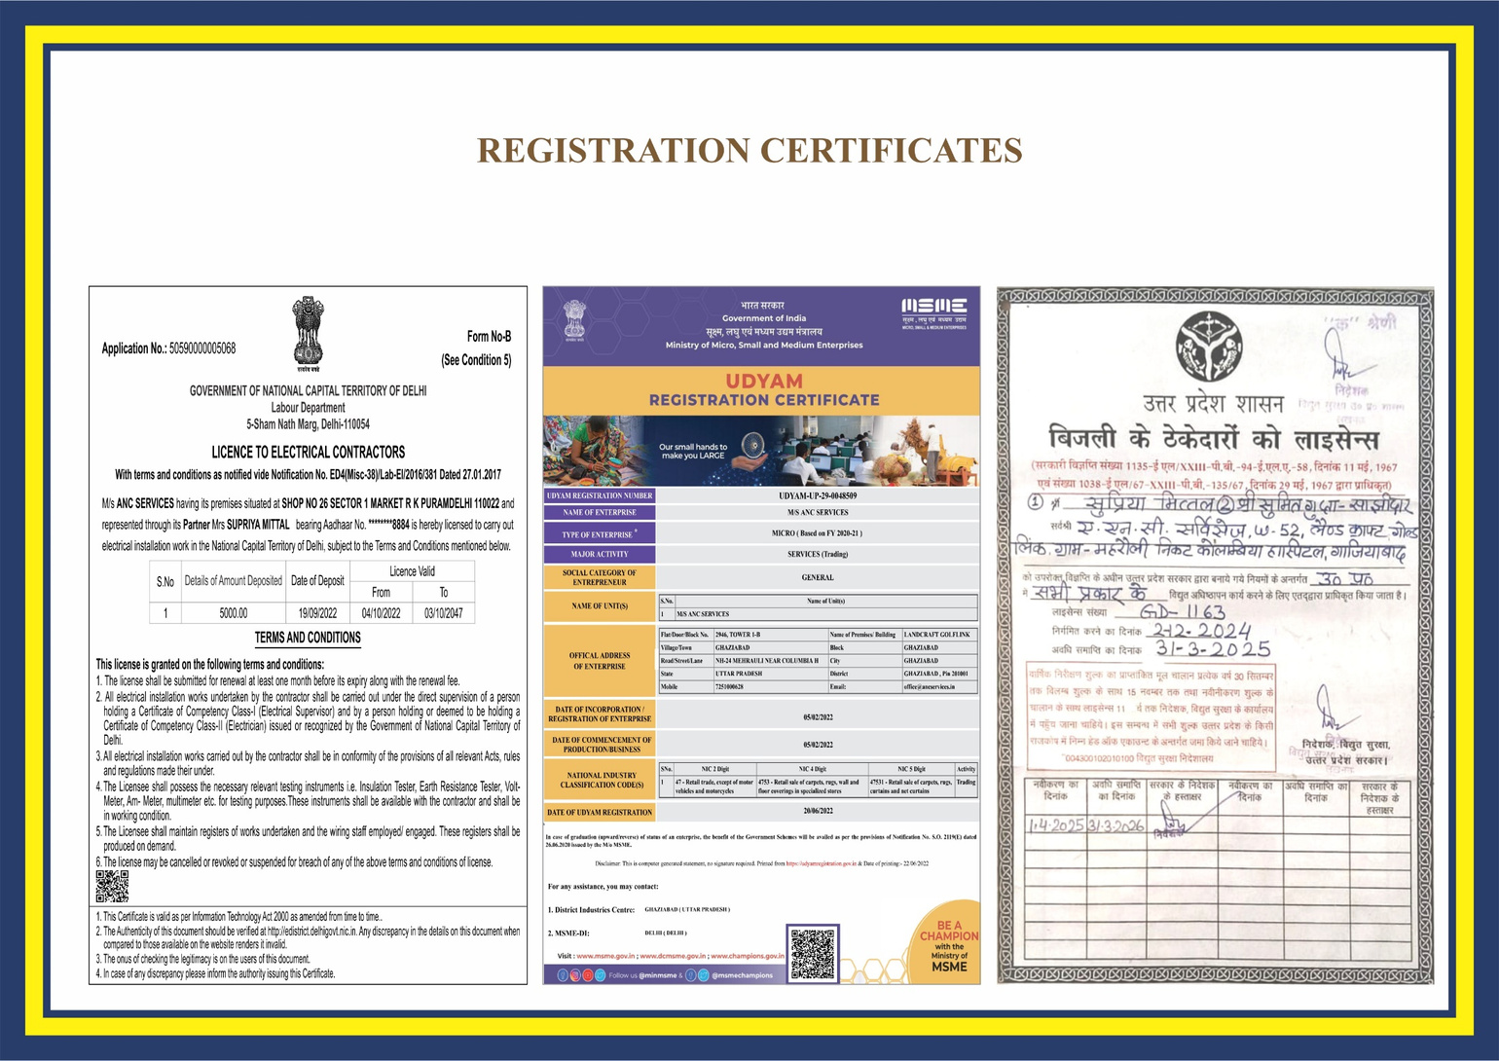

Slide 14
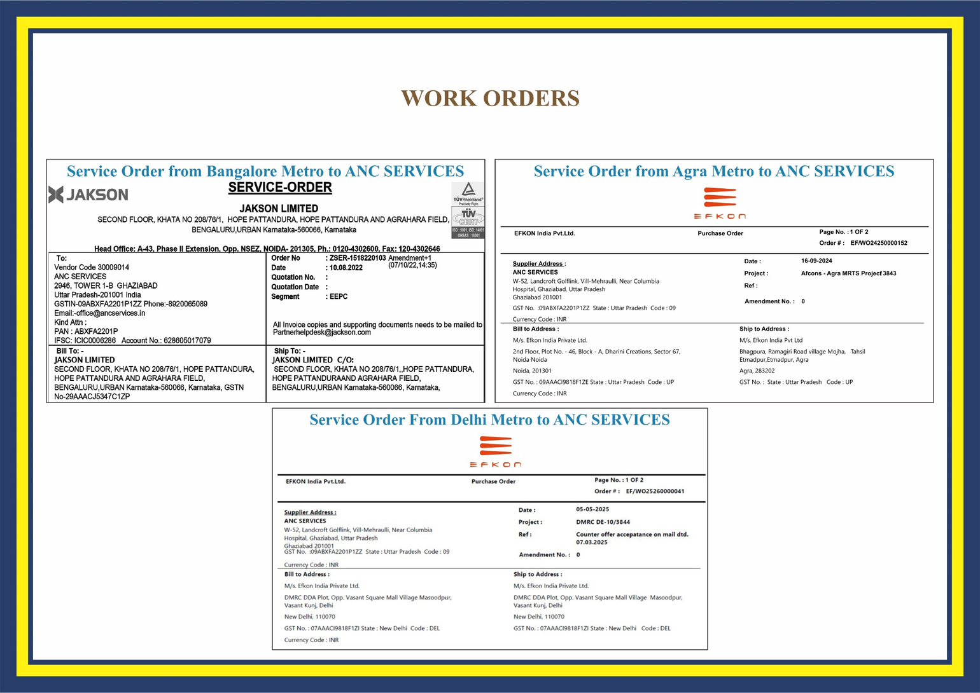

Slide 15
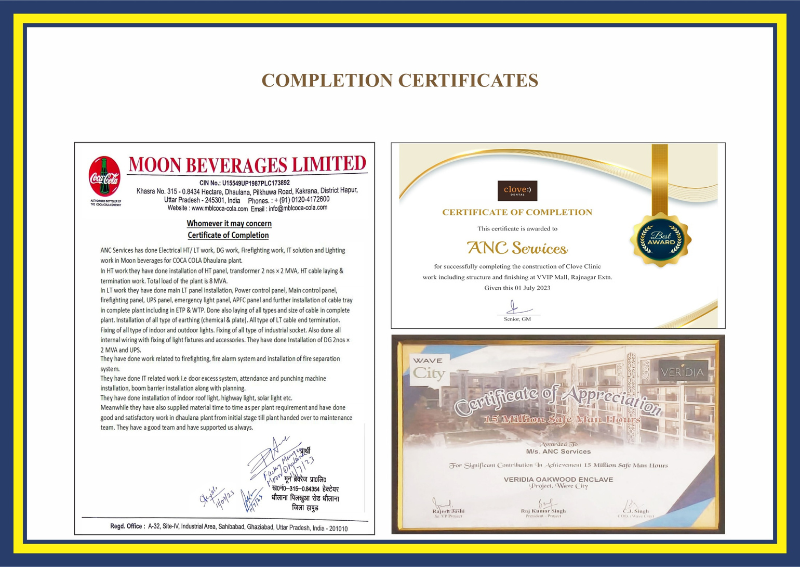

Slide 16
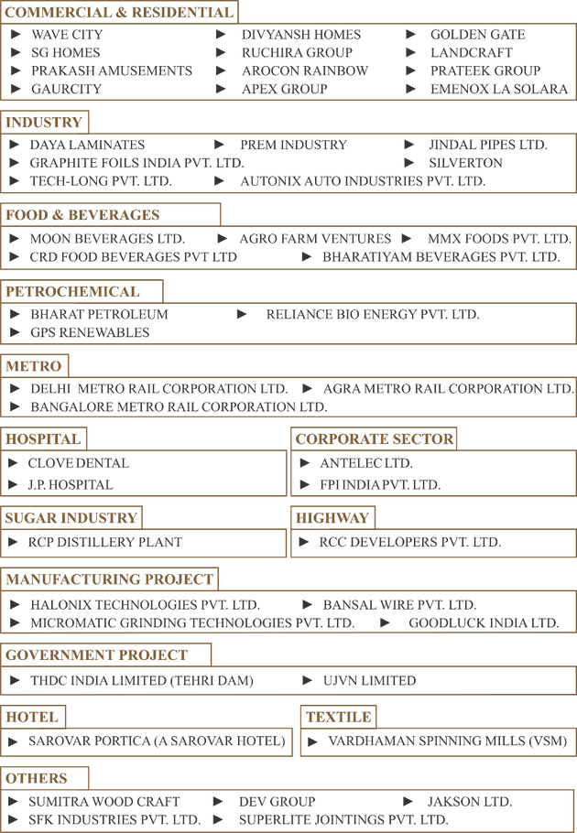
MAJOR PROJECTS

Slide 17
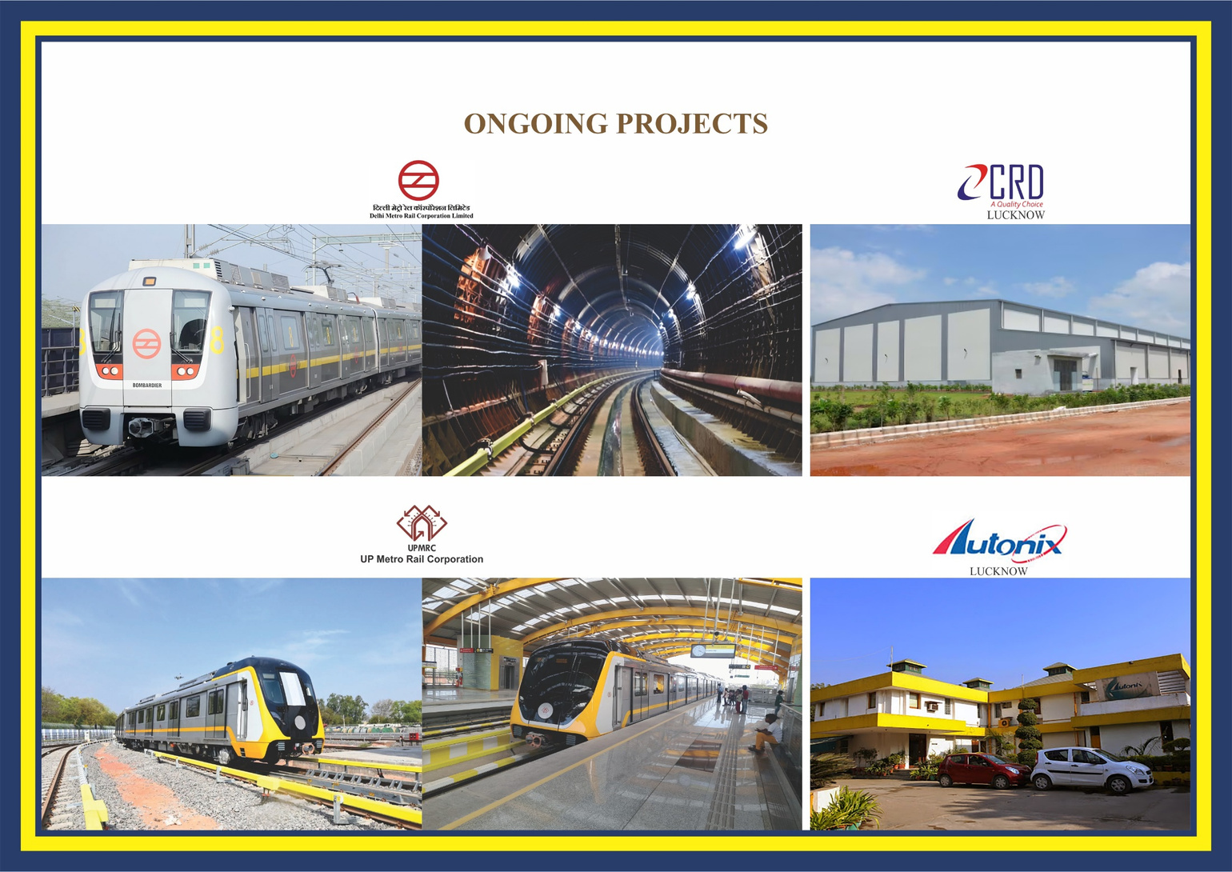

Slide 18
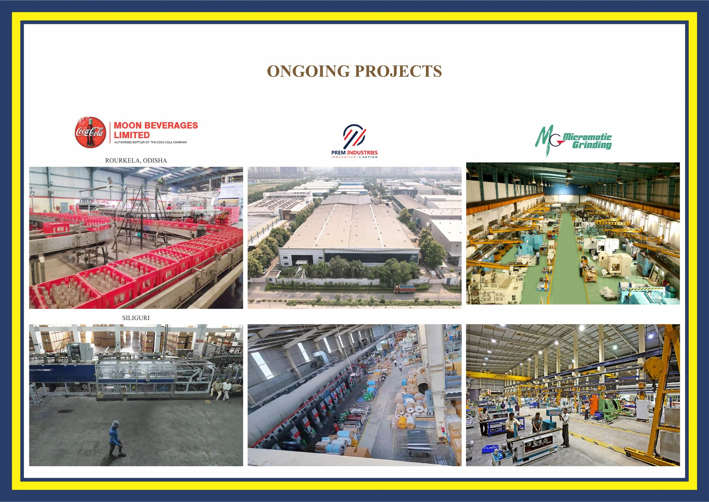

Slide 19
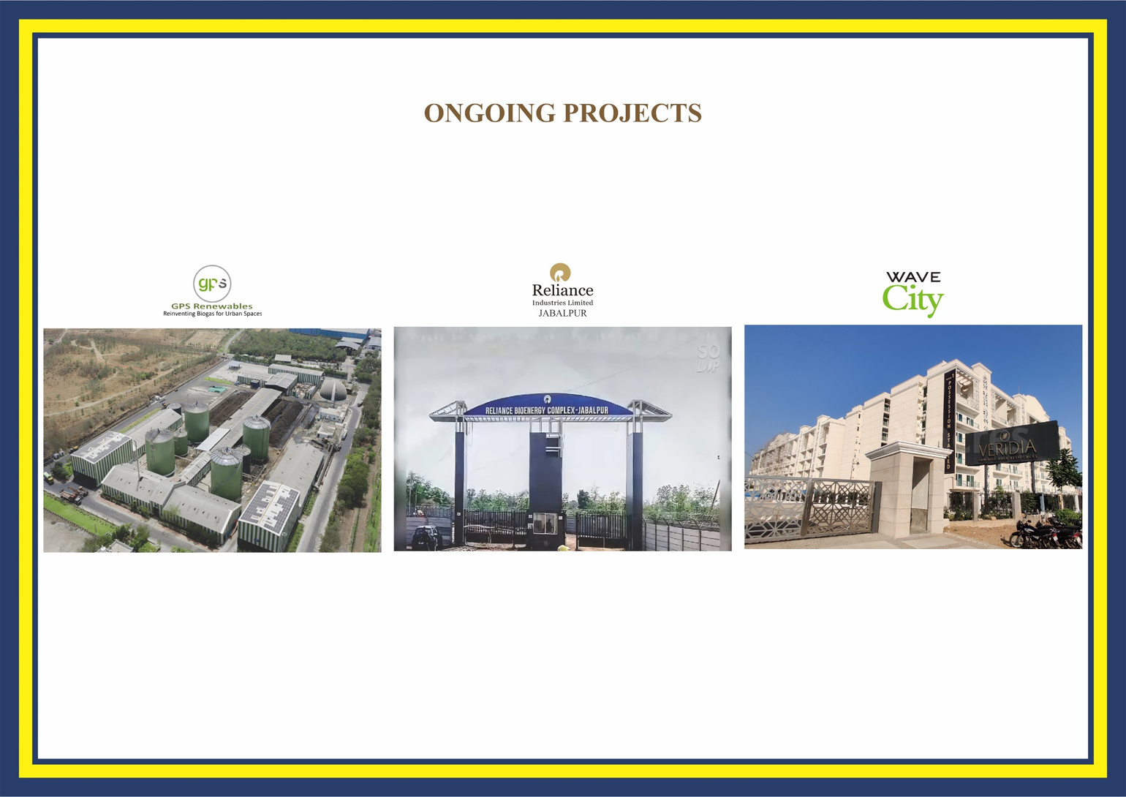

Slide 20
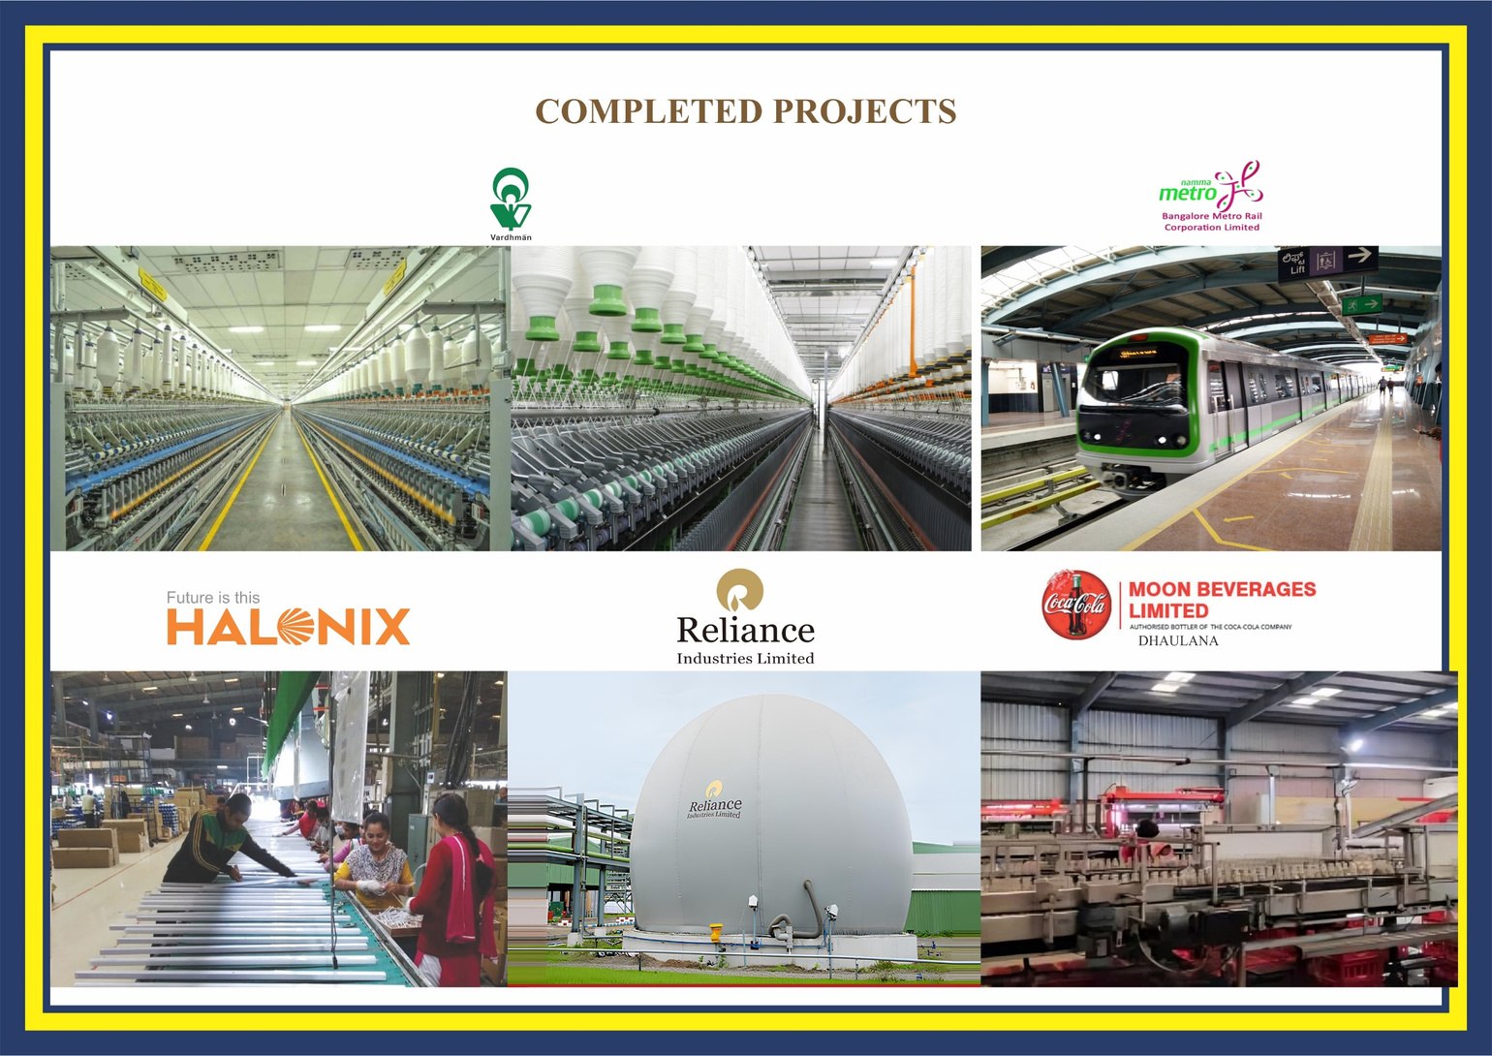

Slide 21
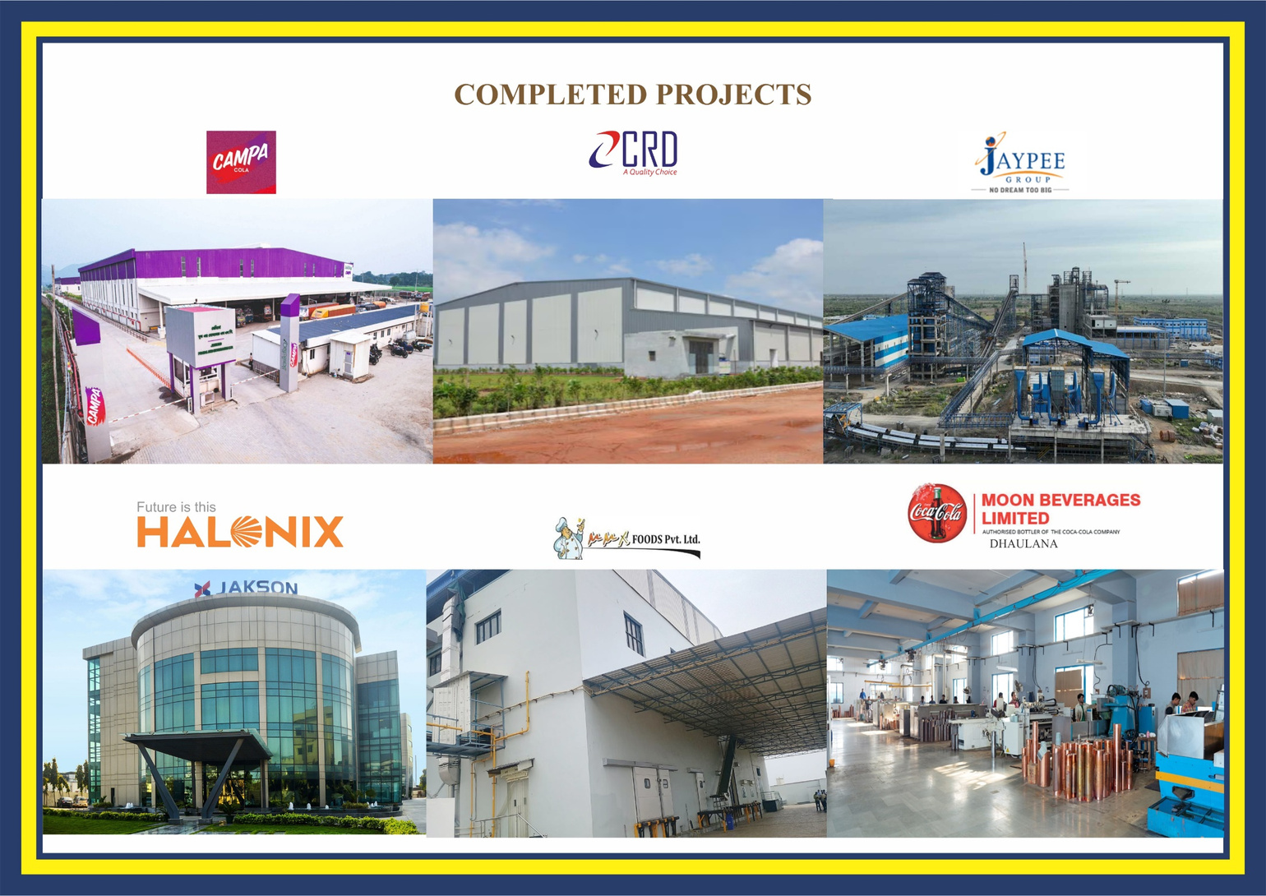

Slide 22
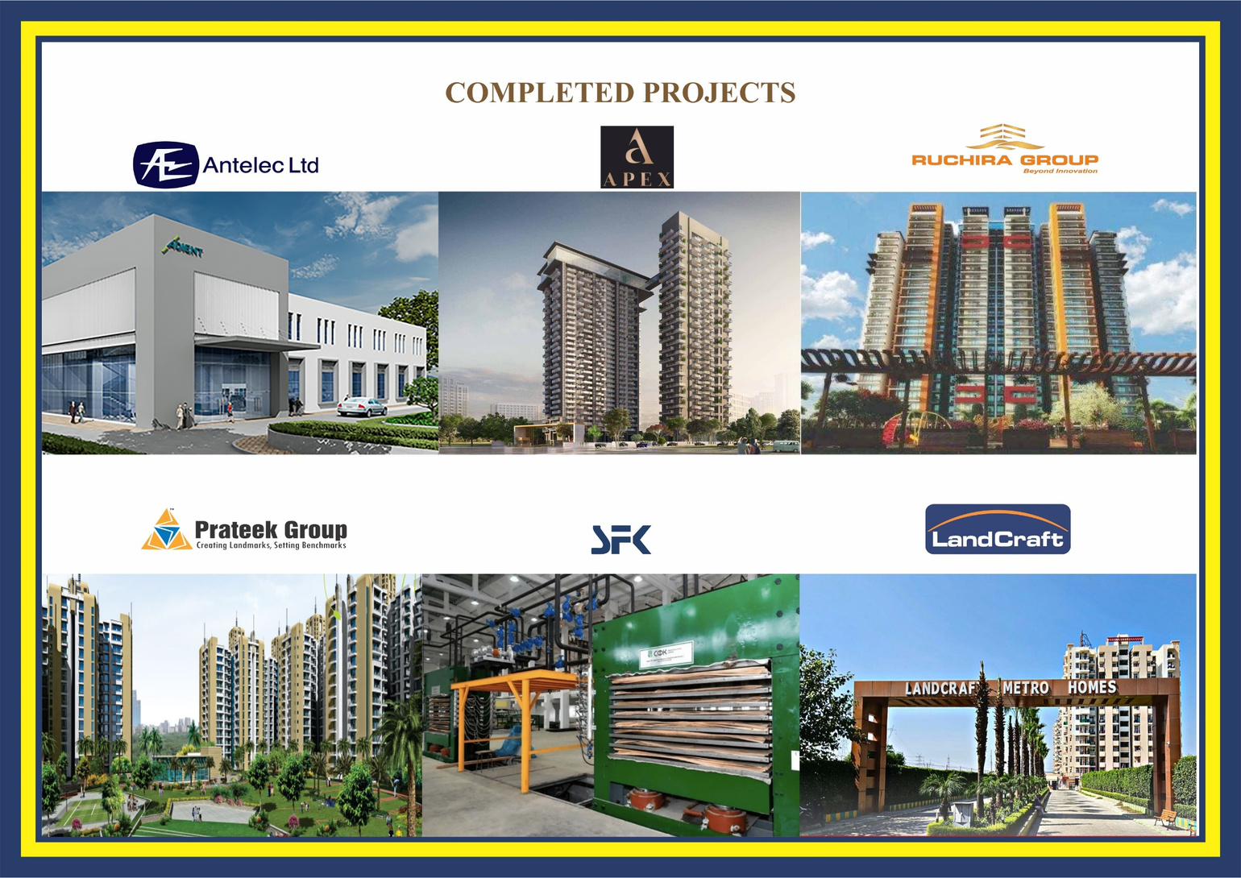

Slide 23
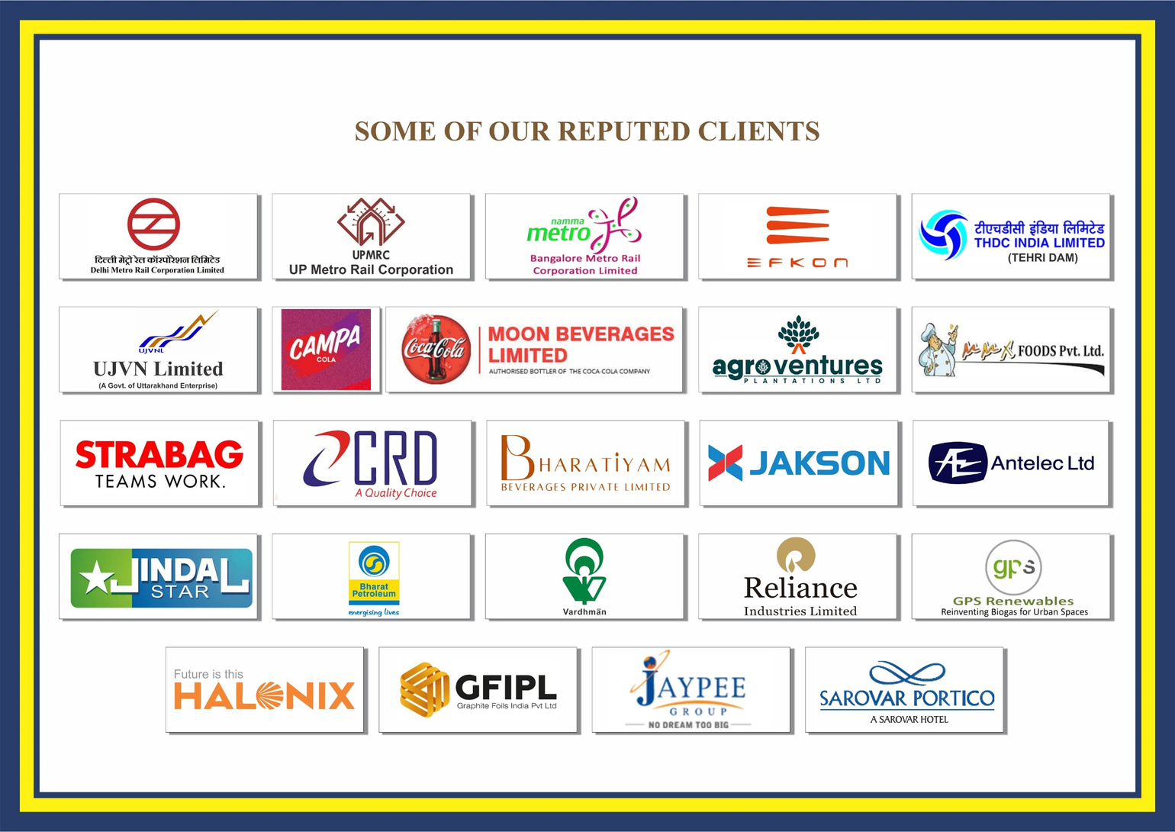

Slide 24


Slide 25
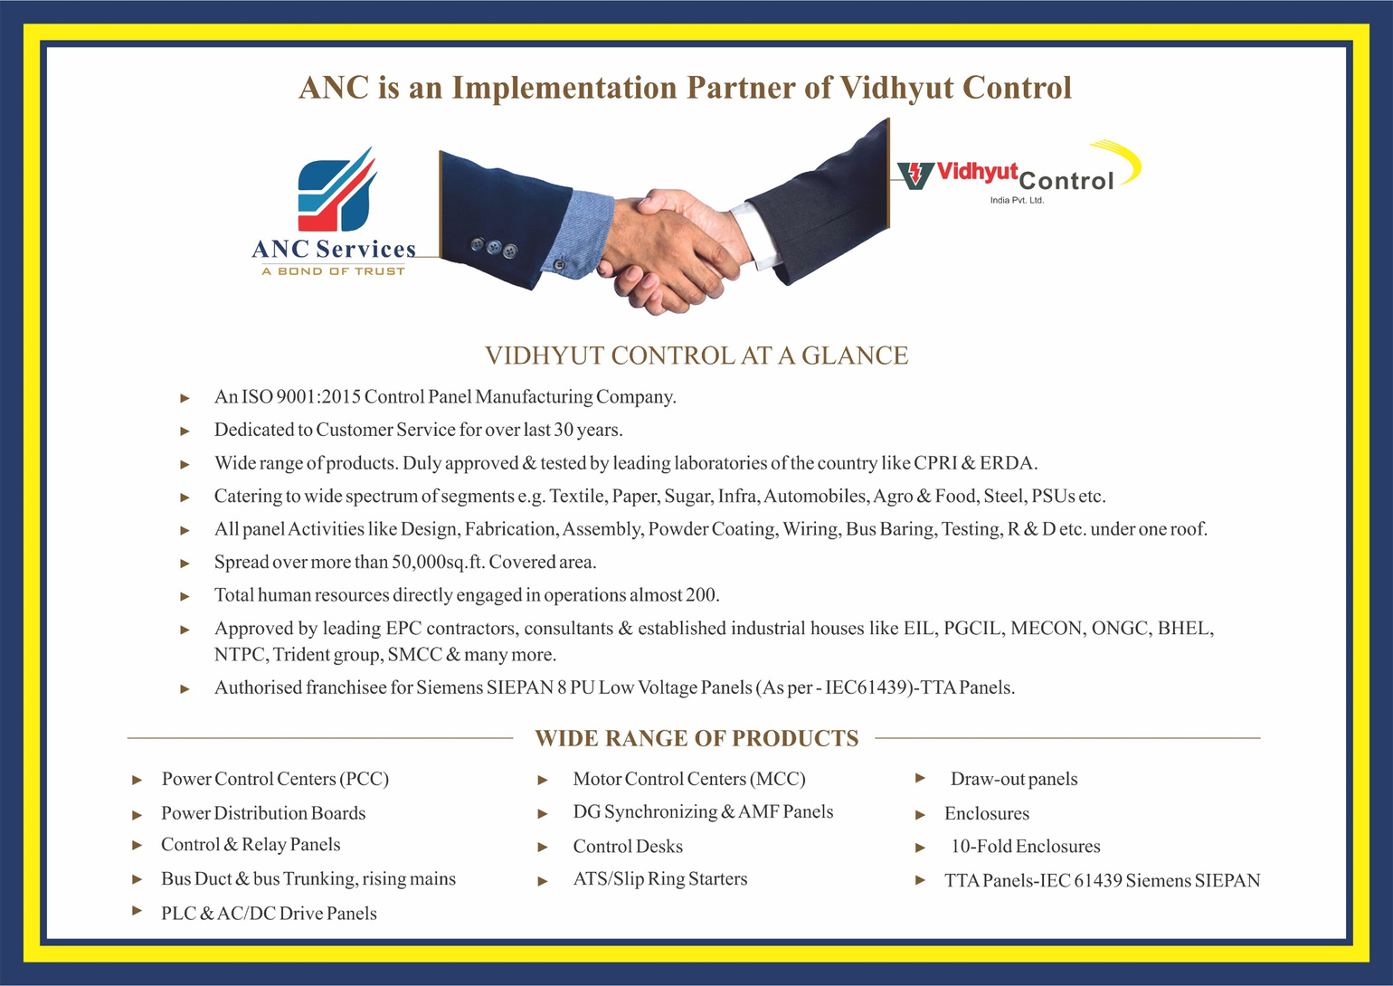

Slide 26

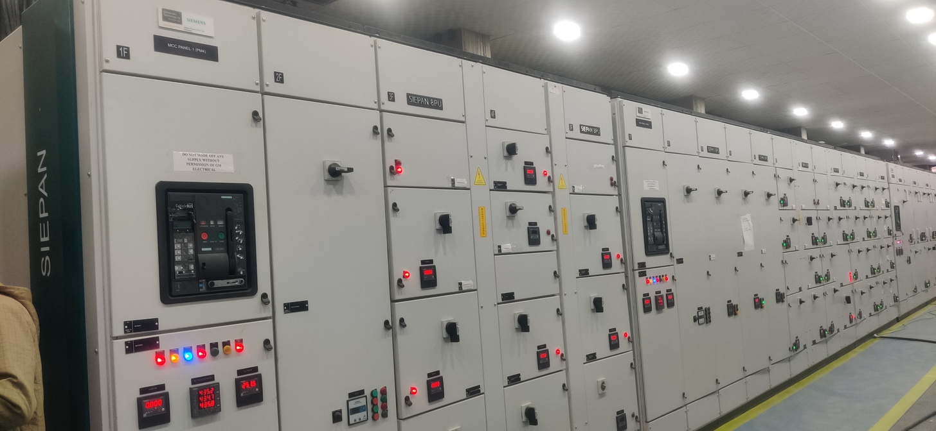
an introduction…

Slide 27


  An ISO 9001:2015 Control Panel manufacturing company
  Dedicated to customer service for over last 25 years
  Wide range of Products. Duly approved & tested by leading laboratories of the country like CPRI & ERDA
  Catering to wide spectrum of segments e.g. Textile, Paper, Sugar, Infra, Automobiles, Agro & Food, Steel, PSUs etc
  All Panel activities like Design, fabrication, assembly, Powder Coating, wiring, Bus baring, Testing, R&D etc. under one roof
  Spread over more than 50,000 sq ft covered area
  Total human resources directly engaged in operations: almost 200
  Approved by leading EPC contractors, consultants & established industrial houses like EIL, PGCIL, MECON, ONGC, BHEL, NTPC, Trident Group, SMCC & many more…
  Authorized franchisee for Siemens SIEPAN 8 PU Low Voltage Panels (As per – IEC61439)- TTA Panels
VIDHYUT CONTROL AT A GLANCE

Slide 28
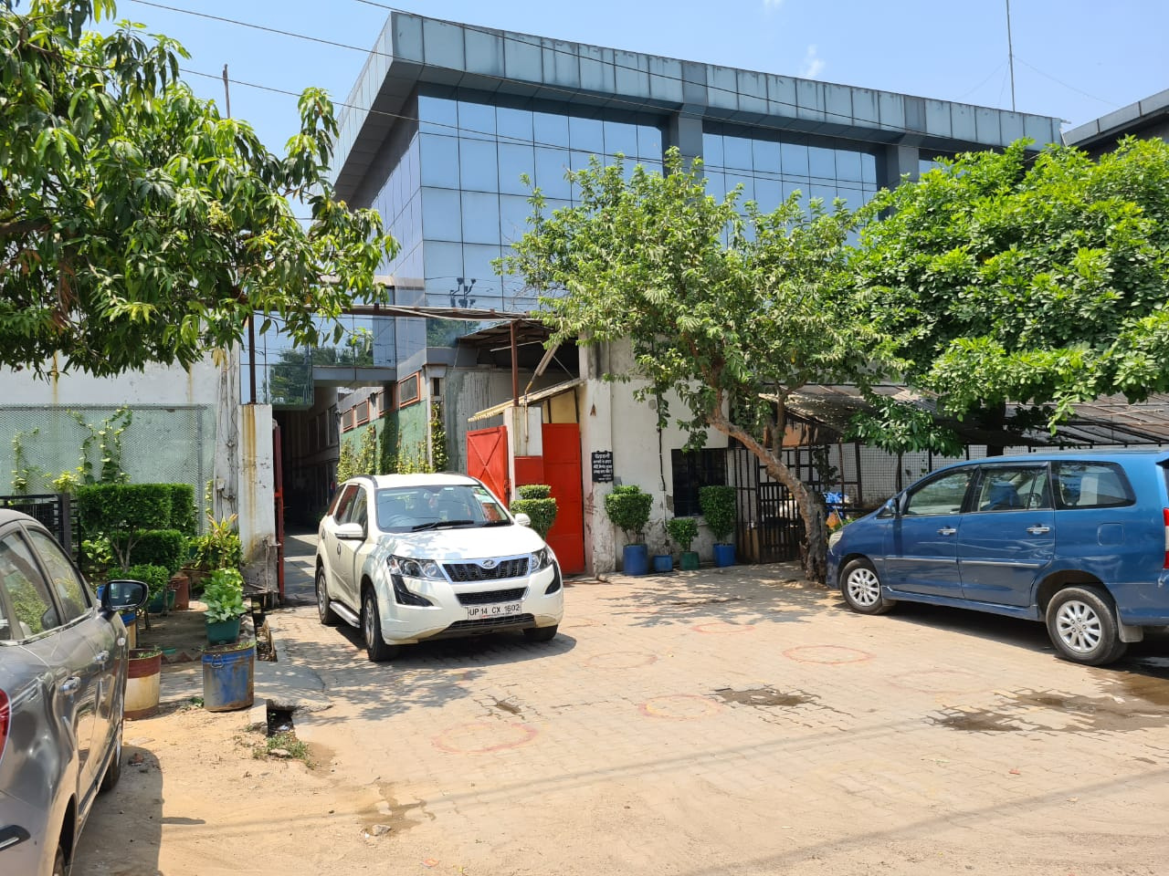
OUR WORKS

Slide 29
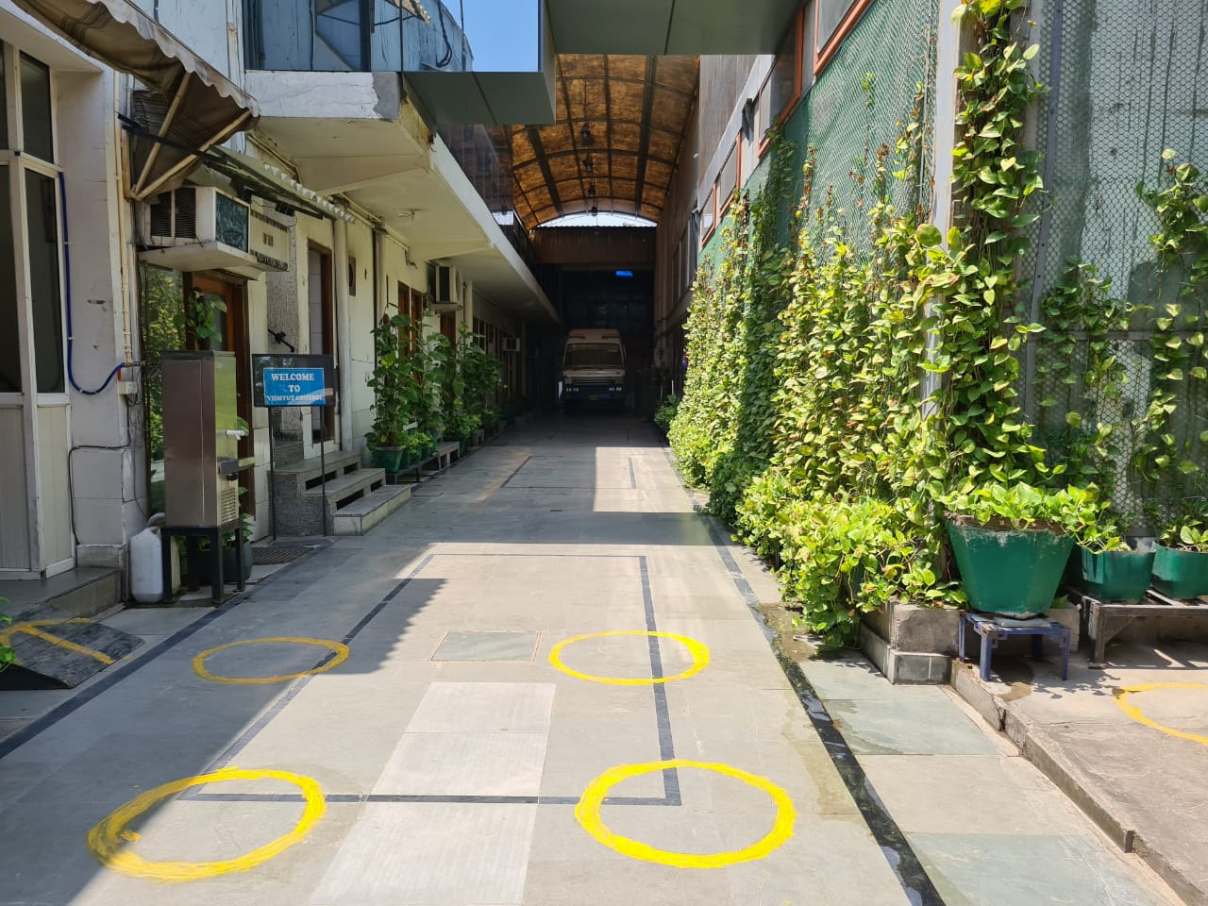
OUR WORKS

Slide 30
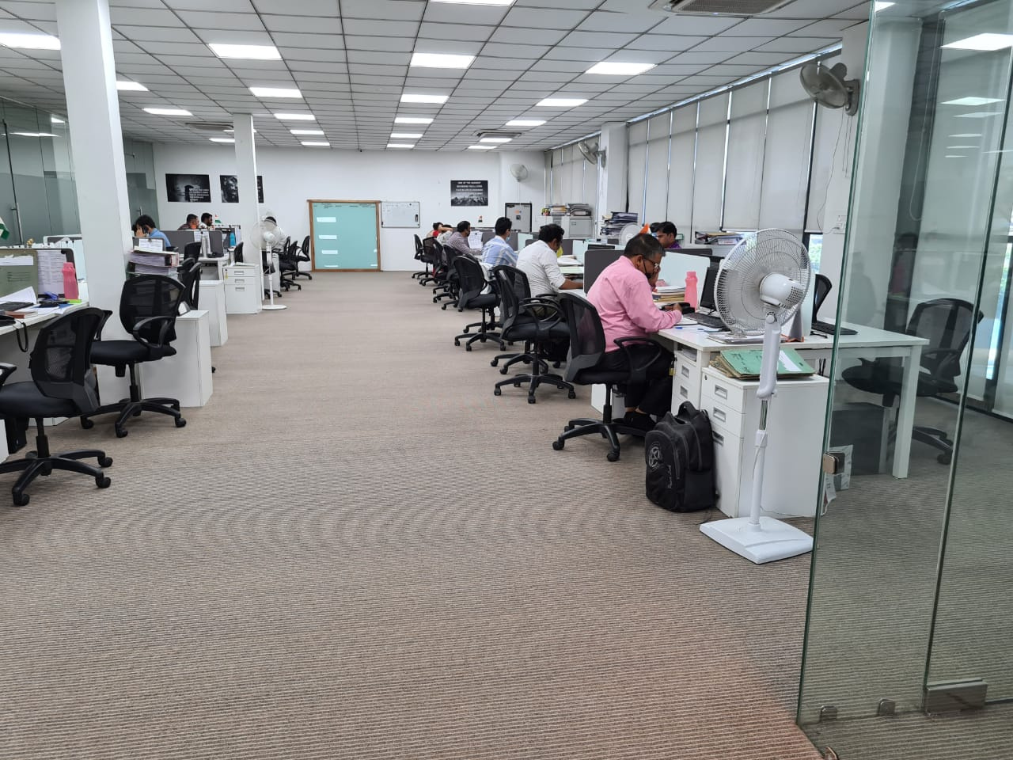
OFFICE AREA

Slide 31
WIDE RANGE OF PRODUCTS
Power Distribution Boards
DG Synchronizing &
AMF Panels
Power Control Centers (PCC)
Motor Control Centers (MCC)
APFC Panels
Control & Relay Panels
Bus Duct & Bus Trunking, Rising Mains
ATS/Slip Ring Starters
PLC & AC/DC Drive Panels
Control Desks
Draw-out Panels
10-Fold Enclosures
TTA Panels-IEC 61439 Siemens SIEPAN
Enclosures

Slide 32
Departments
Design, Research & Development
Fabrication
Surface Treatment
Powder Coating
Bus Bar
Wiring
Assembly/Production
Quality Control
After Sales/Site Support
Support Departments - Costing & Estimation; Marketing; Finance; HR; IT

Slide 33
FABRICATION
SHOP

Slide 34
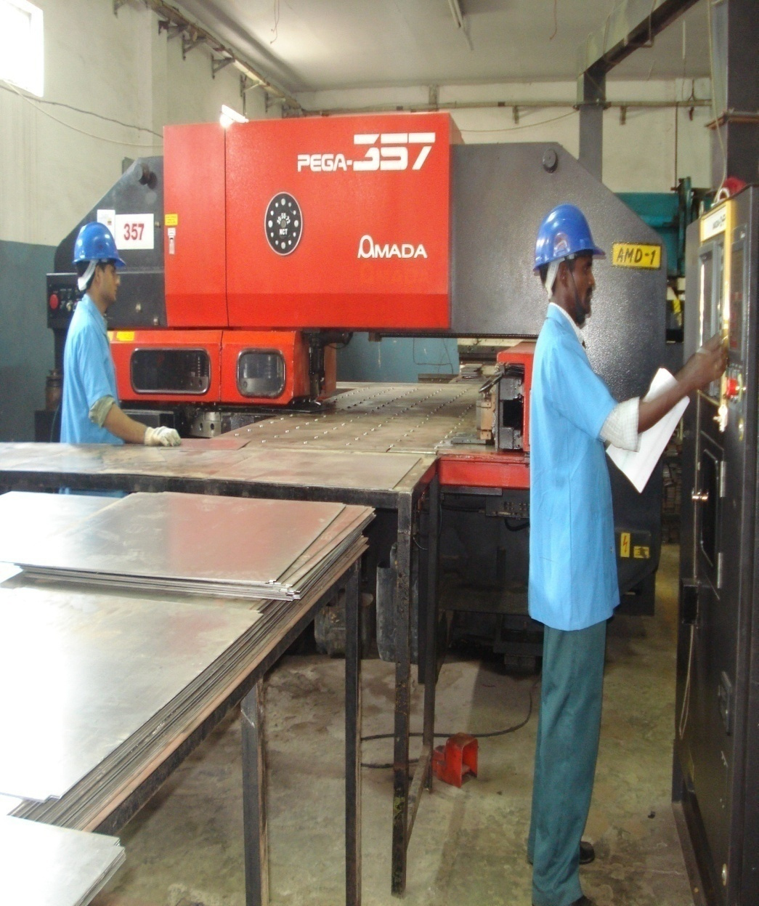

AMADA PEGA-357 PUNCHING MACHINE
  CAPACITY – 30 TON
  NO. OF STATIONS- 44
  WORKABLE MAX. SHEET SIZE- 1270x 4000MM
  MAX. MATERIAL THICKNESS- 6.5MM & WEIGHT – 100 KG

Slide 35
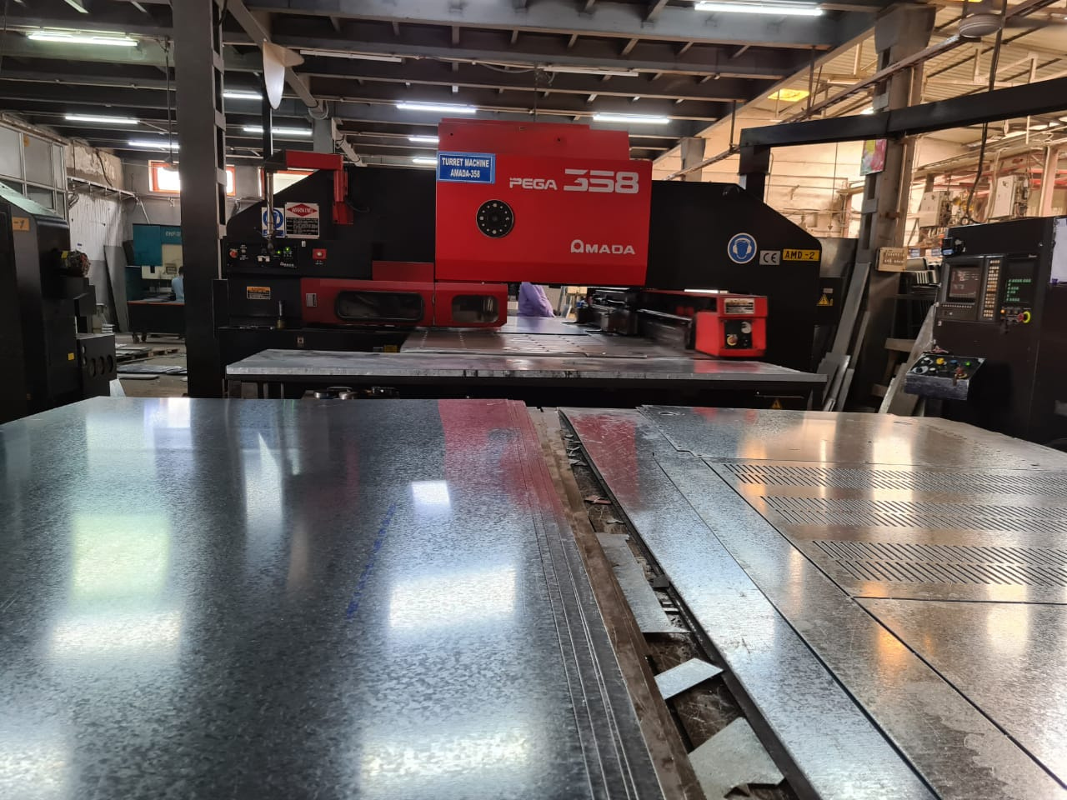
AMADA PEGA-358 PUNCHING MACHINE
  CAPACITY – 30 TON
  NO. OF STATIONS- 45
  WORKABLE MAX. SHEET SIZE- 1270x 4000MM
  MAX. MATERIAL THICKNESS- 6.5MM & WEIGHT – 100 KG

Slide 36
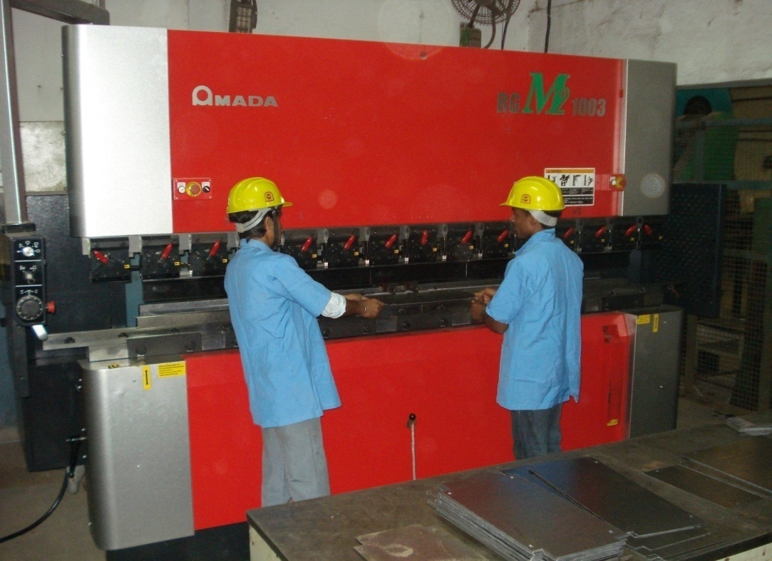
AMADA RGM2-1003 BENDING MACHINE
  CAPACITY – 100 TON
  MAX BEND LENGTH- 3100MM
  STROKE LENGTH- 100MM
  BENDING SPEED- 13MM/S

Slide 37
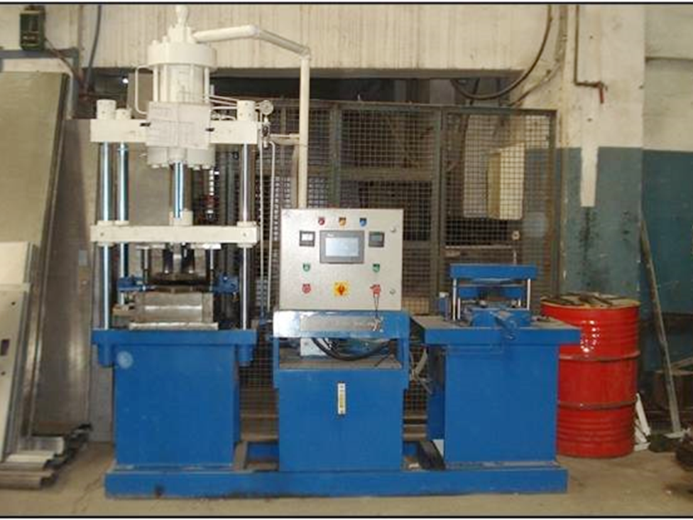
CORNER FORMING MACHINE
  Inhouse developed corner forming
  machine to provide jointless corners
  Better mechanical strength of doors
  Better ip degree protection

Slide 38

SURFACE TREATMENT
&
PAINTING

Slide 39
Metal pretreatment is done with ‘Seven Tank Treatment Process’ prior to powder coating of the metal surface
DEGREASING: These are necessarily acidic chemicals which help in removal of dust, oil & grease from surface.
SEVEN TANK TREATMENT PROCESS
RUNNING WATER: To remove unwanted chemical particles
WATER RINSING: Surface is water rinsed to remove unreached conversion coating chemicals
ACTIVATION (PREPHOSPHATING): This is done to prepare the surface for phosphating
PHOSPHATING: Zinc Phosphate coating is crystalline heavy coating gray in color. It provides exceptional painted part durability in corrosive requirements
WATER RINSING: To remove unwanted chemical particles
PASSIVATION: This process is to maintain the zinc phosphate layer on metal so that powder coating layer can be implemented on it.

Slide 40
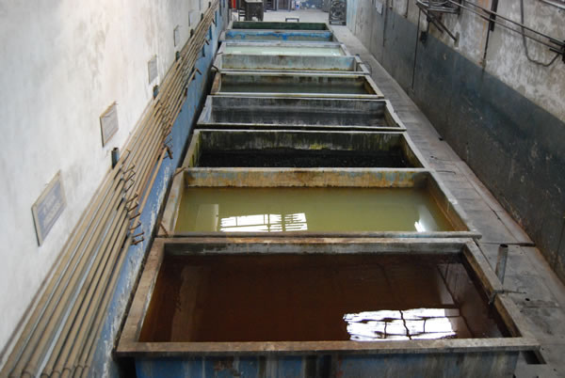
SEVEN TANK PROCESS

Slide 41
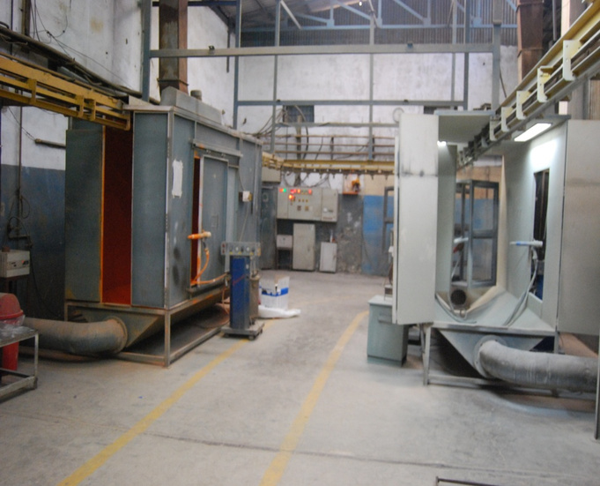
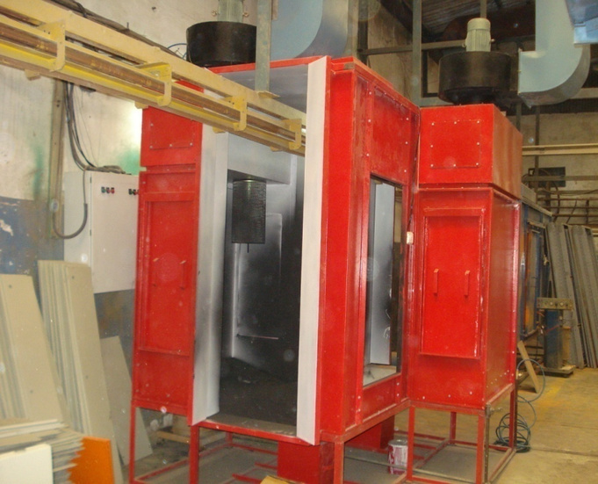
POWDER COATING BOOTH
  3 booths to paint different colors at a time
  Most modern spray guns for better powder spraying
  Conveyorized system for handling powder coated parts

Slide 42
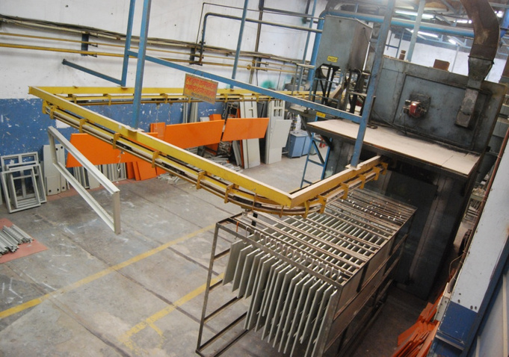
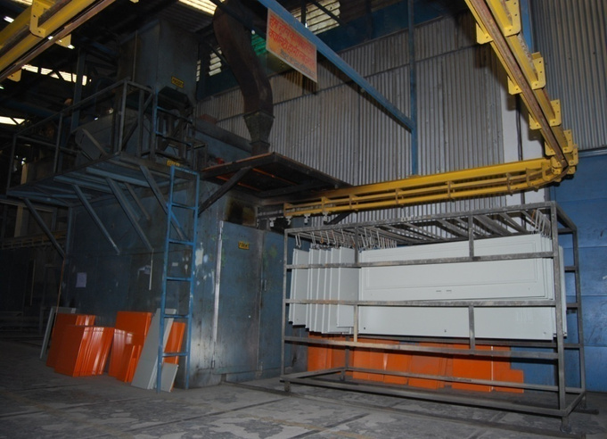
OVEN & CONVEYR LINE FOR POWDER COATING

Slide 43
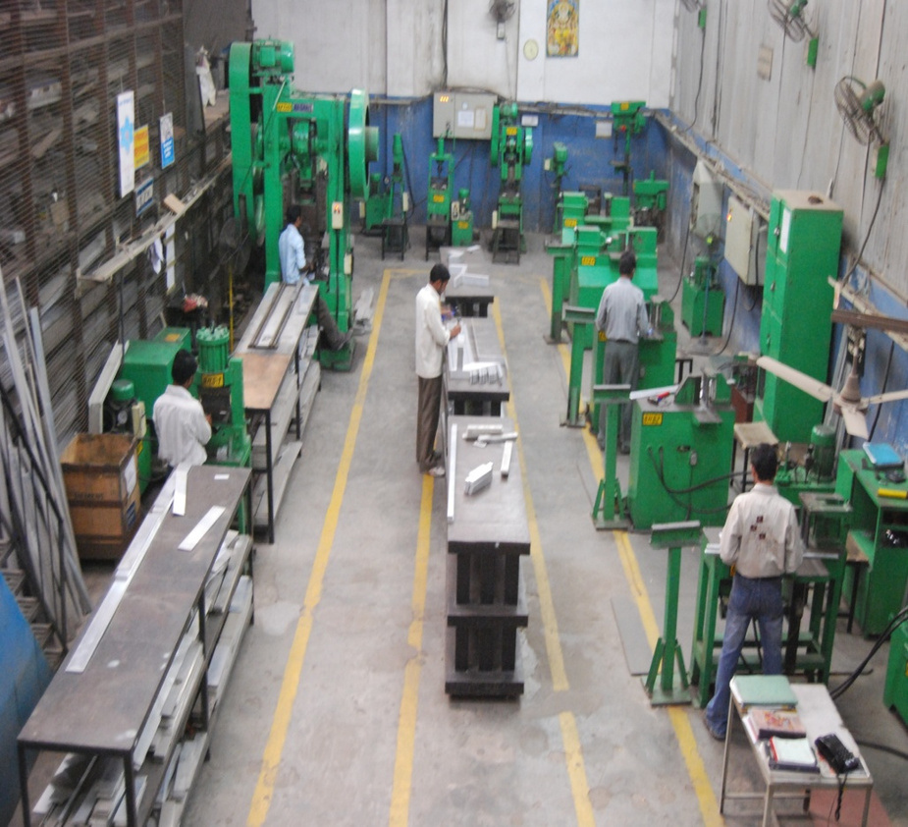
BUSBAR FABRICATION SECTION
  Fully equipped busbar section with all the modern machines like power press, bending etc.
  Busbars are powder coated with black epoxy powder in place of heat shrink sleeve for better insulation
  More number of conductors used resulting into better current carrying capacity
  Inhouse developed polyamide supports & FRP supports on request
  Polyamide supports give better mechanical strength & less water absorption

Slide 44
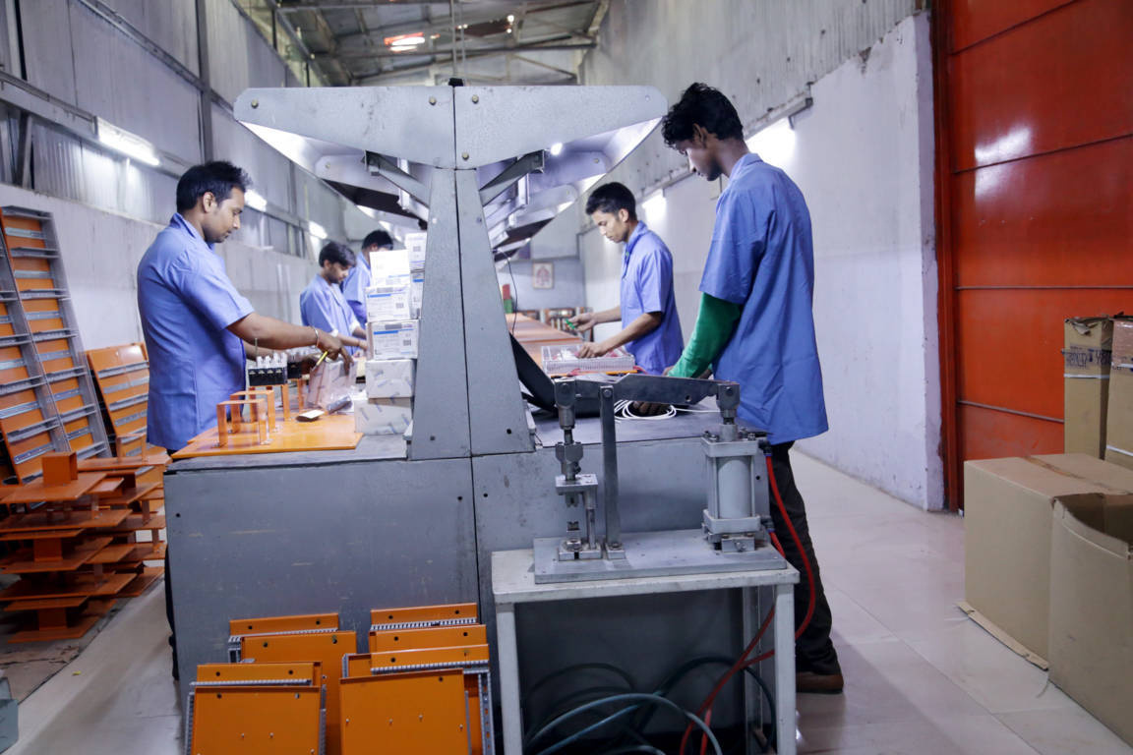
C & P WIRING SECTION
  Full fledged pneumatic wiring section with precision tools
  Wiring done using inhouse developed plastic grommet & flexible conduits resulting into better insulation from sharp edge & improved IP degree
  Printed ferrule for proper identification

Slide 45
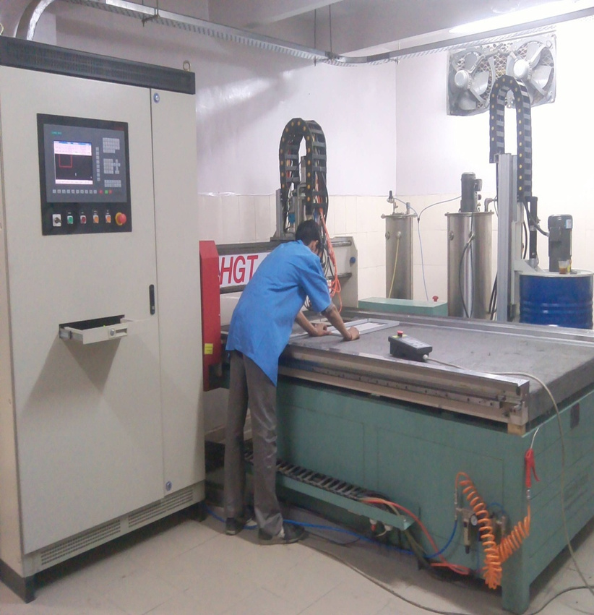
PU FOAM LIQUID GASKET MACHINE
  Jointless gasket resulting in dust proof enclosure, gives improved ip degree protection
  Polyurethene is poured in liquified form & then hardens in seconds
  It fuses with metal door and is unremovable resulting in much improved ip protection
  For different heating & cooling cycles as well as the repeated opening & closing of doors, the gasket remains fused with the panel door. Gasket has long life.

Slide 46
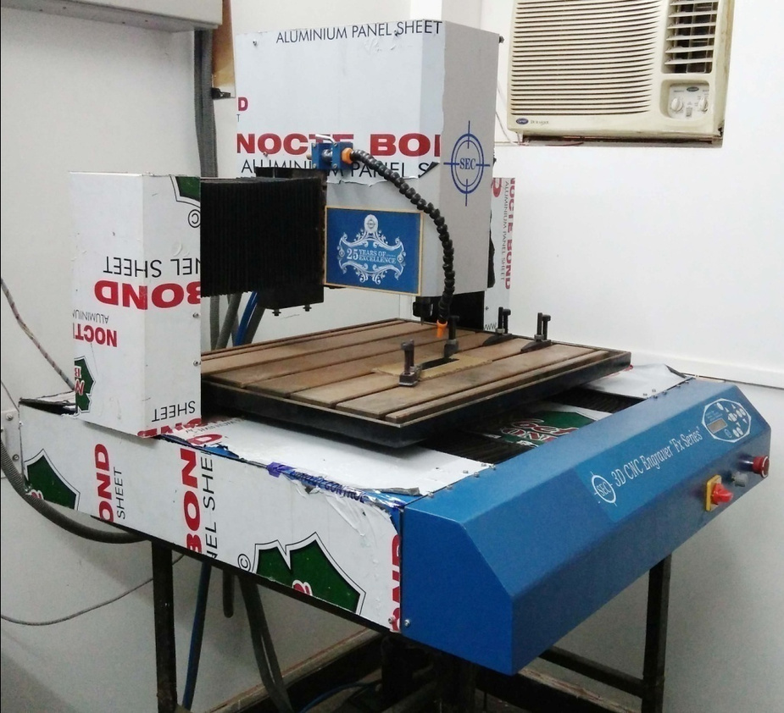
ROUTER MACHINE (ENGRAVING)
  For making legend plates through engraving text on plate
  Improved quality of legends & looks attractive
  Faster process

Slide 47
ASSEMBLY SECTION

Slide 48
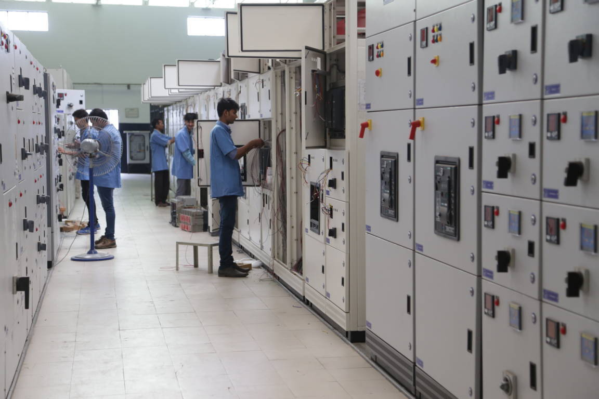
ASSEMBLY SECTION
  Very large assembling area (15,000 sq. Feet)
  Overhead cranes from assembly to dispatch area
  Equipped with pneumatic tooling
  Specially laid process & floor rails are fully leveled thus giving better quality panels

Slide 49
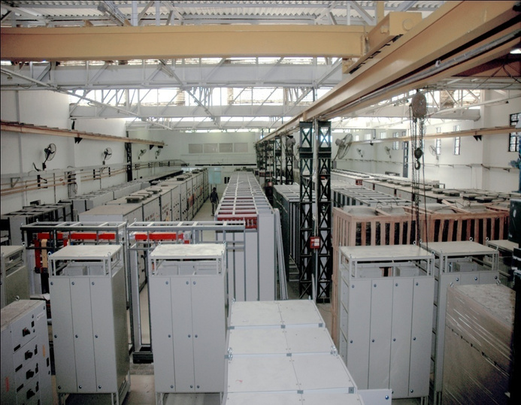
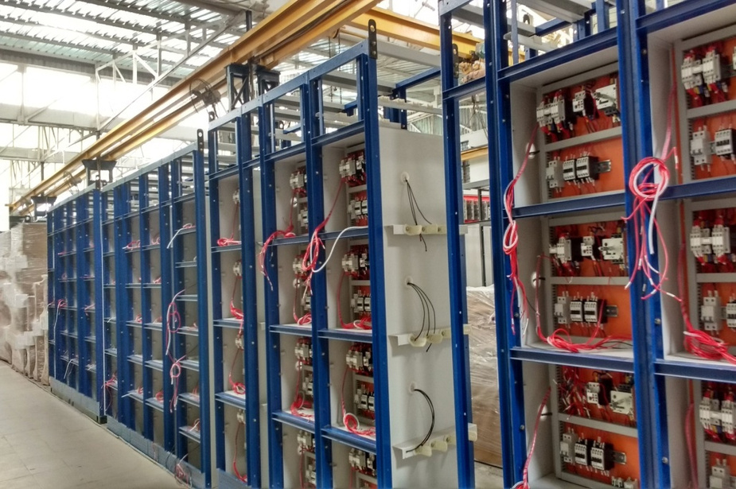
ASSEMBLY SECTION

Slide 50
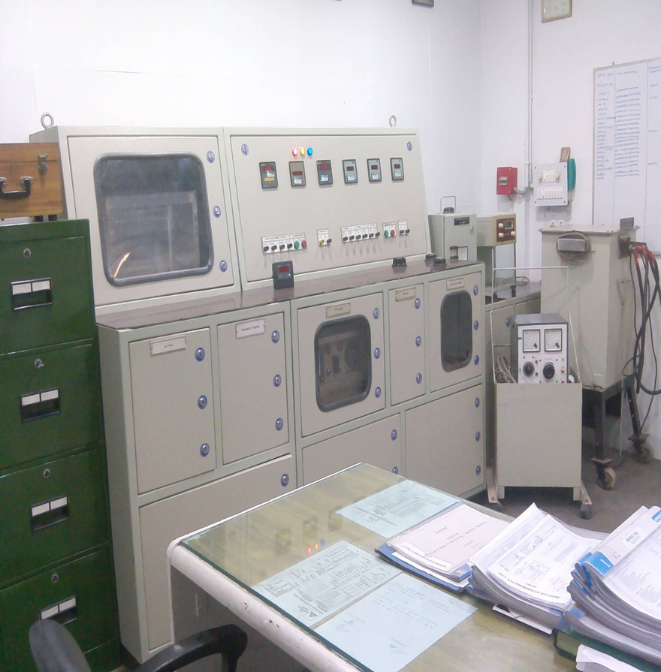
QUALITY CONTROL LAB
  Fully equipped quality lab to test from raw material to stage inspection up to final product testing
  Primary injection up to 6000a
  Insulation with 1000V megger
  High voltage test at 2.5 kV for 1 sec

Slide 51
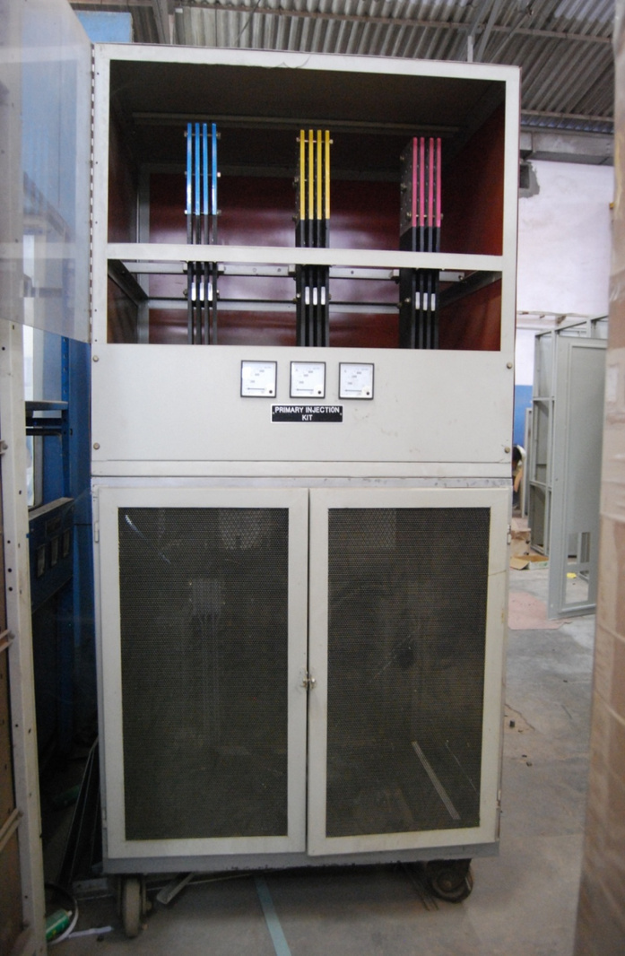
6000 A PRIMARY
INJECTION KIT

Slide 52
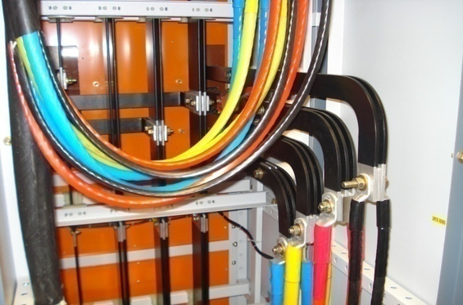
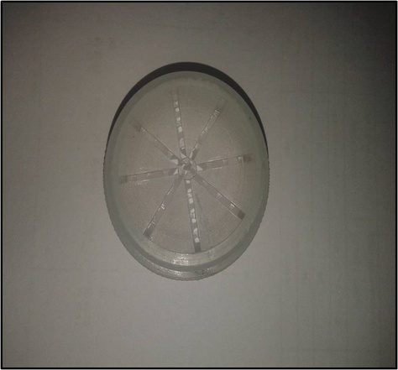
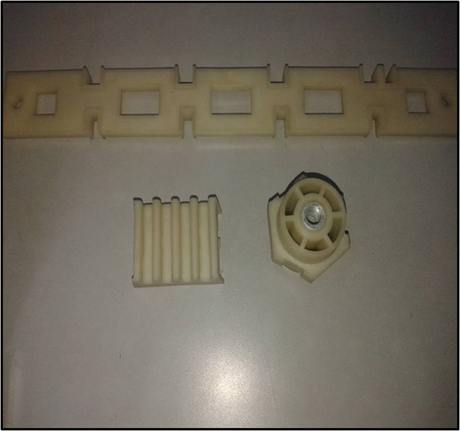
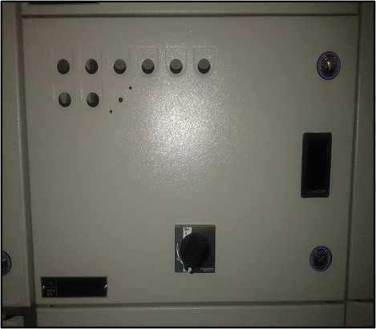
INNOVATIONS
BUSBAR WITH EDGE BENDING
WIRE GROMMET
POLYMIDE SUPPORTS
DEEP DRAW SECTION FOR LEGEND PLATES

Slide 53
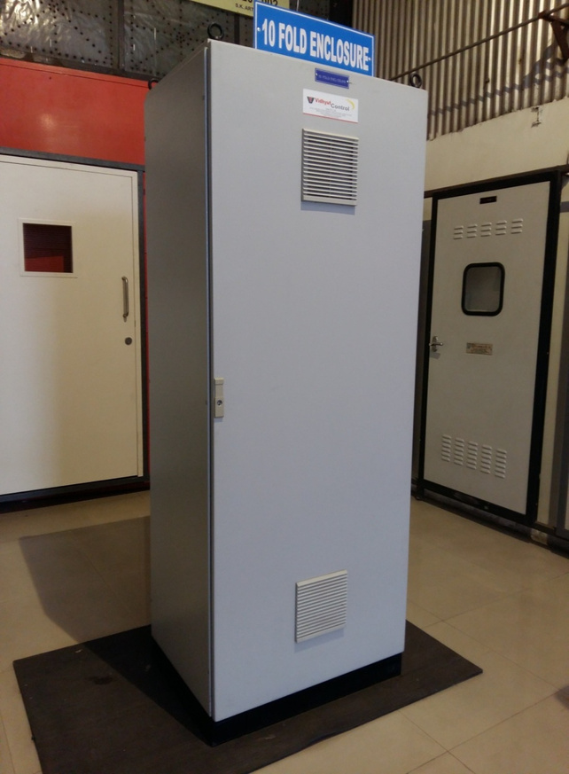
10-FOLD ENCLOSURE
  Advanced series of modular Industrial Enclosures with high class 10-fold frame construction
  Very robust Frames, comprising of liquid polyurethane gasket & special corner forming process
  Higher weight bearing capacity than ordinary enclosure
  Higher component density resulting into less no of panels

Slide 54
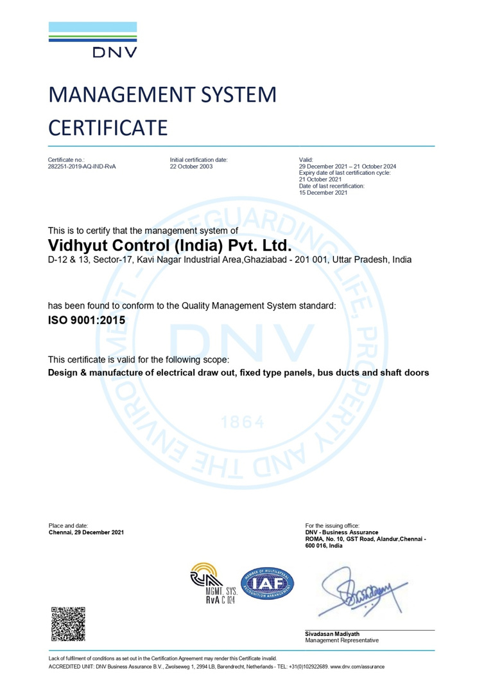
ISO CERTIFICATE

Slide 55
CUSTOMERS

Slide 56

GAUR CITY MALL, GAUR CHOWK, GREATER NOIDA (W)
CLIENT- GAURSONS LTD.

Slide 57

C N AUTOMATION, GUJARAT
DRIVE PANEL

Slide 58

SATIA INDUSTRIES LTD., PUNJAB
SIEMENS SIEPAN TTA PANELS

Slide 59

ESTER FILMTECH LTD., TELANGANA SIEMENS SIEPAN TTA PANELS

Slide 60
REPUTED CLIENTS
Textiles
  Trident Ltd.
  Siyaram Silk Mills Ltd
  Golden Fiber, Amravati
  Vardhman Yarns & Thread Ltd.
  Arihant Spinning Mills
  Auro Dying
  Amko Exports
  Satluj Textiles
  Ester Industries
  Suryodaya Textile Pvt.ltd.
  Nahar Spinning Mills
  Alps Industries Ltd.
  Birla Textiles Ltd.
  Weavetex Overseas Ltd.
  TT Ltd.
  Oswal Group
  Gopeshwar Spinning Mills
  Ashi Export
  Dwarkadheesh Industries Ltd.
Paper & Packaging
  Ruby Macons Ltd.
  Mehali Papers Pvt. Ltd.
  Anand Duplex Board Ltd.
  Anand Triplex Board Ltd.
  Anand Tissue Ltd.
  Bindal Duplex Ltd.
  Bindal Paper Ltd.
  Khatima Paper Ltd.
  Nikita Paper Ltd.
  Daman Ganga Paper Ltd.
  Kalpatru Papers Ltd.
  Rainbow Papers Ltd.
  Devpriya Industries
  Dev Agro Paper Ltd.
  Dev Priya Products Ltd.
  Dev Fibbers Ltd.
  MBD Printographics
  J.B Daruka Papers
  Shree Bahvani Paper Mill Ltd.
  Everest Polymers Pvt. Ltd.
Paper & Packaging
  Shamli Paper Ltd.
  Siddhomal Paper Mill
  Sikka Paper
  P. N. Paper Ltd.
  Orient Paper Ltd.
  Pragati Paper Mill Ltd.
  Ved Cellulose Ltd.
  Shri Sitaram Paper Mill Ltd.
  Mohit Paper Mills
  Centuary Paper Mills
  Uflex Ltd.
  Montage Enterprises Pvt. Ltd
  Ultimate Flexipack Pvt. Ltd.
  Polyplex Corporation Ltd.
  Vacmet India Ltd.
  Ester Industries Ltd.
  Everest Polymers Pvt. Ltd.
  MAX INDIA LTD.
  HJI GMMCO LTD.

Slide 61
REPUTED CLIENTS
Automobile
  Rico Auto Industries Ltd.
  Toyota Ltd.
  Tata Motors
  Honda Motorcycle & Scooter (i) Ltd.
  Hero Honda Motors Ltd.
  Honda Siel Ltd.
  Maruti Suzuki Ltd.
  Yamaha Motor India Pvt. Ltd.
  Shri Ram Pistons & Rings Ltd.
  Rico Auto Industries Ltd.
  Bharat Gear Ltd.
  Galio Indiahi Tech Gears Ltd.
  Unitech Machines Ltd.
  Keihin Fiysubros Ltd.
  Amtek Diamond
  Omax Autos Ltd.
Automation
  Rockwell Automation A/c Maithan Ispat
  Indigenous Control
  Tycon Automation
  Word Technology (Dev Priya)
  C. N. Automation
  ATC Automation
  AEAB Automation
  Rhythm Automation
Cement
  Ambuja Cememnts Ltd.
  Jaiprakash Associates (Ddala)
  Jaiprakash Associates (Bhuj)
  Jaiprakash Associates (Chunar)
  Jaiprakash Associates (Panipat)
  Jaiprakash Associates (Baga, Solan)
  Jaiprakash Associates (Bagheri)
  Jaiprakash Associates (Siddhi. M.P.)
  Gujrat Anjan Cement Ltd.
  Shree Cement Ltd.
  Dalmia Cement Bharat Ltd.
  Calcom Cement India Ltd.
Food & Beverages
  Harvest Gold Industries
  Ready Roti India
  Britannia Industries
  Heinz Ltd.
  Yakult Danone
  Nestle Ltd.
Footwear
  Relaxo Footwear Ltd.
  Diamond Footwear Ltd.

Slide 62
REPUTED CLIENTS
Sugar & Distillery
  Tikaula Sugar Mills Ltd.
  Bajaj Hindustan Sugar Ltd. (Gola)
  Bajaj Hindustan Sugar Ltd. (Palia)
  Bajaj Hindustan Sugar Ltd. (Kinouni)
  Bajaj Hindustan Sugar Ltd. (Saharanpur)
  Bajaj Hindustan Sugar Ltd. (Lakhimpur)
  Bajaj Hindustan Sugar Ltd. (Thanabhawan)
  Bajaj Hindustan Sugar Ltd. (Budhna)
  Bajaj Hindustan Sugar Ltd. (Pilibhit)
  Bajaj Hindustan Sugar Ltd. (Utraula)
  Bajaj Ecotech Ltd. (Kinouni)
  Khaitan India Ltd.
  Triveni Engineering & Industries
  DSCL Sugar Ltd.
  Oudh Sugar Ltd.
  Simbhauli Sugar Mill
  Harinagar Sugar Mills
  Titavi Sugar
  Eastern Sugar Mills Ltd., Nepal
  Sweet Crystalphilippnes
  Mawana Sugar Mill Ltd.
  Dhampur Sugar Mill
College & Hospitals
  AKG Engineering College
  Krishna Engg. Institute of Technology
  Krishna Dental College
  Krishna Engineering College
  JP Hospital
  Chadha Charitable Trust Naturopathy Hospital
  Garg Heart & Multispecialty Hospital
  G.S. Medical College Hospital
  ESIC Hospital, Varanasi
  Shreya Medicare
  Ram Saran Indo-German
  Mohan Swaroop Hospital
  Manyavar Kashiram Hospital
IT & Software
  Industrial IT Solution
  Fact Software
  Hughes Software

Slide 63
REPUTED CLIENTS
Infrastructure
  Purvanchal Construction Pvt. Ltd.
  Gaursons India Ltd.
  Ajnara India Ltd.
  Wave Infratrade
  Samridhi Reality Homes
  Ats Infrastructure Ltd.
  Avarthnah Infrastructure Pvt. Ltd.
  Exotica Housing Pvt. Ltd.
  K World Group
  Mahagun India Pvt. Ltd.
  Prateek Group
  Sare Homes Project Services Pvt. Ltd.
  Sds Infratech Pvt. Ltd.
  Stellar Group
  Vasu Infrastructure Pvt. Ltd.
Infrastructure
  Supertech Ltd.
  Victory Infra Projects Pvt. Ltd
  Sikka Group
  Mahalaxmi Group
  Today Homes
  Anthem Infrastructure Pvt. Ltd.
  Fusion Builtech Pvt. Ltd.
  GLR Real Estate Pvt. Ltd.
  Skardi Realtech Pvt. Ltd.
  Emenox Group
  S G Estates Ltd
  Landcraft Developers
Chemicals & Minerals
  Continental Rico Hydraulic
  Riddhi Siddhi Gluco Biols Ltd.
  Kanoria Chemicals & Industries
  Laxmi Chemical Ltd.
  Sharda Energy & Minerals Ltd.
  Sharda Solvent Ltd.
  Ved Cellulose Ltd.
  DCM Chemical Ltd.
  SRF Ltd
EPC/PSUs
  EIL
  PGCIL
  MECON
  NTPC
  BHEL
  ONGC/IOCL/BPCL/
  HPCL/GAIL

Slide 64
REPUTED CLIENTS
Steel & Ispat Companies
  Bhilai Steel Plant
  Maithan Ispat
  Shri Rathi Steel Pvt Ltd
  Jindal Saw Pipe Ltd
  Ace Hardware
  Advance Steel Tubes
  Shree Nath Ji Ispat
  Shri Nath Ji Motor
  Goa Sponge Iron
  KVS Steels Ltd.
  Monnet Ispat Ltd
  IFE Iron & Steels Ltd
  Radha Madhav Exim
  Shree Radhe Ispat
  Bhushan Steels Ltd
  Amba Steels Ltd
  Kei Industries Ltd.
  Flat China
  Kalpatru Alloys Ltd.
  Sharda Energy Minerals Ltd.
Food & Beverages
  Cadbury Ltd.
  Nestle India Ltd.
  Pepsico Ltd.
  Parle Biscuits (P) Ltd.
  Yakult Danone (I) Pvt. Ltd.
  Britania Industries Ltd.
  Harvest Gold Industries Ltd.
  Heinz Ltd.
  Tetra Pak India Pvt. Ltd.
  A.b. Mauri India (P) Ltd.
  Ready Roti India Pvt. Ltd.
  Riddhi Siddhi Gluco Boils Ltd.
  Motherboon Food (P) Ltd.
  Dharampal Satyapal Ltd.
  Dharampal Premchand Ltd.
  Paras Dairy
  Universal Dairy
  Fryo
  Rei Agro Ltd
  Sourcewell Foods Agro Pvt Ltd.
Hotels
  Hotel Taj Mahal, New Delhi
  Hotel Oberoi, New Delhi
  Hotel Jaypee Basant, New Delhi
  Hotel Eros, New Delhi
  Marriot Courtyard, Gurugram
  The Khyber Himalyan Resort & Spa, Gulmarg
  Ginger, Noida
  Ginger, Greater Noida
  Ginger, Chandigarh
  Ginger Hotel Bhubaneshwar
  Corbett Hideaway, Ramnagar, U.k.
  Taj Gateway Hotel, Varanasi
  Crystal Hotel Agra
  Mahagun Sarovar Portico Suites, Vaishali
  Fairfield & Courtyard By Marriott, Bangalore
  Sidartha Palace

Slide 65


