Slide 1


From Metro to Industries
ANC SERVICES
Leads the way…
ENGINEERING, PROCUREMENT, CONTRACTING & CONSULTANCY
MEP Contractor

Slide 2


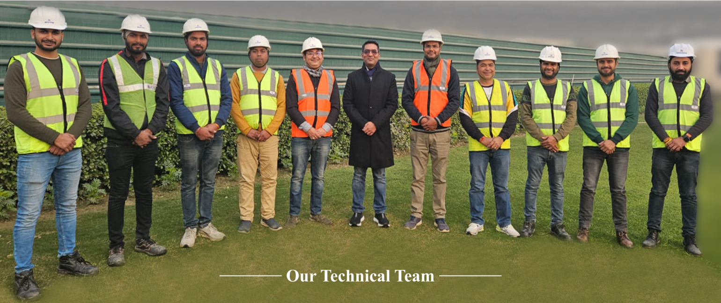
ANC Services is an ‘A’ Class License Contractor Company in the business of providing Detailed Engineering services, Turnkey contracts and O&M services in Electrical and Instrumentation discipline for various types of projects in the field of Metro Projects, Highway Projects, Petrochemical, Warehouse, Distillery Plant, Beverage Industry, Paper industries and all type of Industries, as well as Commercial Complex, Residential Complex and Government Tenders in PAN India.
The company has been in this field for carrying out extensively all types of Electrification Work, Plumbing, Fire and IT Solutions. The company has a team of highly qualified and professional Engineers, Draughtsmen and Site Supervisors and Skilled personnel to complete the project in desired time schedule and still maintain the highest quality work.
Earlier we are doing all EPC contracts work under Vidhyut Control India Pvt. Ltd. which is LT Panel Manufacturing company since 1994. But from past 3-4 years we have made a separate company by name of ANC Services which does all kind of HT/LT contracting works.
Madhur Mittal is MD of ANC Services who is in business from past 18 years and also associated in below mentioned projects:
REAL ESTATE : Landcraft Developers Pvt. Ltd., RS Landcraft LLP, Platina Real Estate Pvt. Ltd., Coral Infrastructure Pvt. Ltd.
PUBLICATIONS : ReMadhav Publications Pvt. Ltd.
MANUFACTURING SECTOR : LGSUS Industries Pvt. Ltd., Dhanad International Pvt. Ltd.
Thanking you and assuring you of our prompt and quality services at all times.
Madhur Mittal
Managing Director

Slide 3

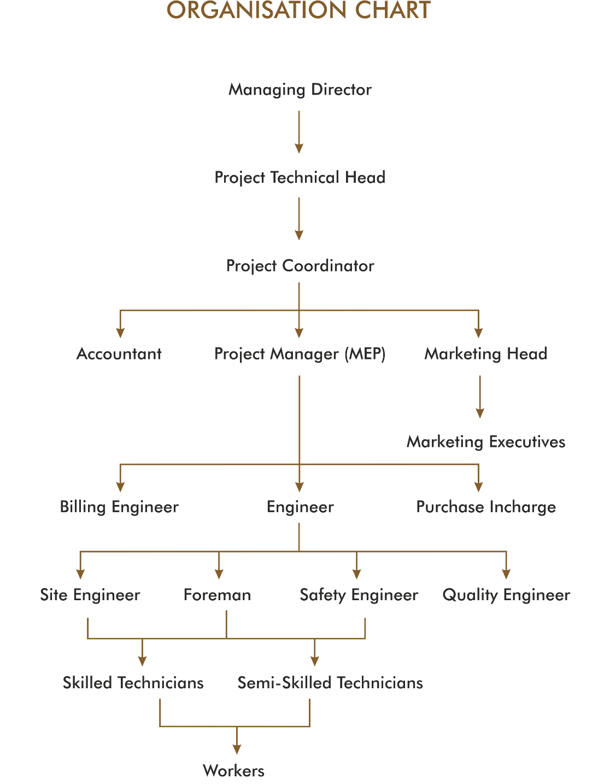

Slide 4


Slide 5
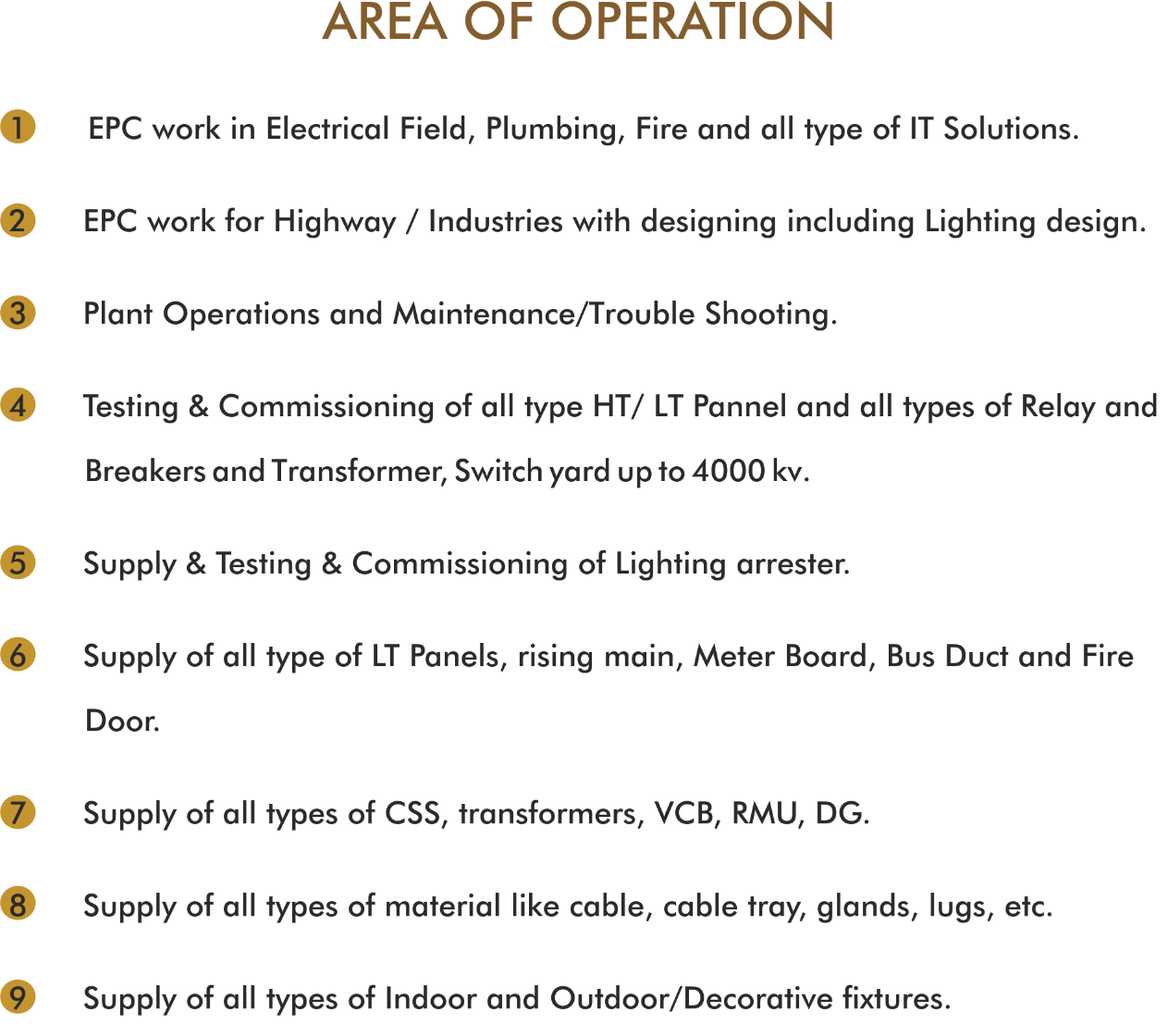

Slide 6
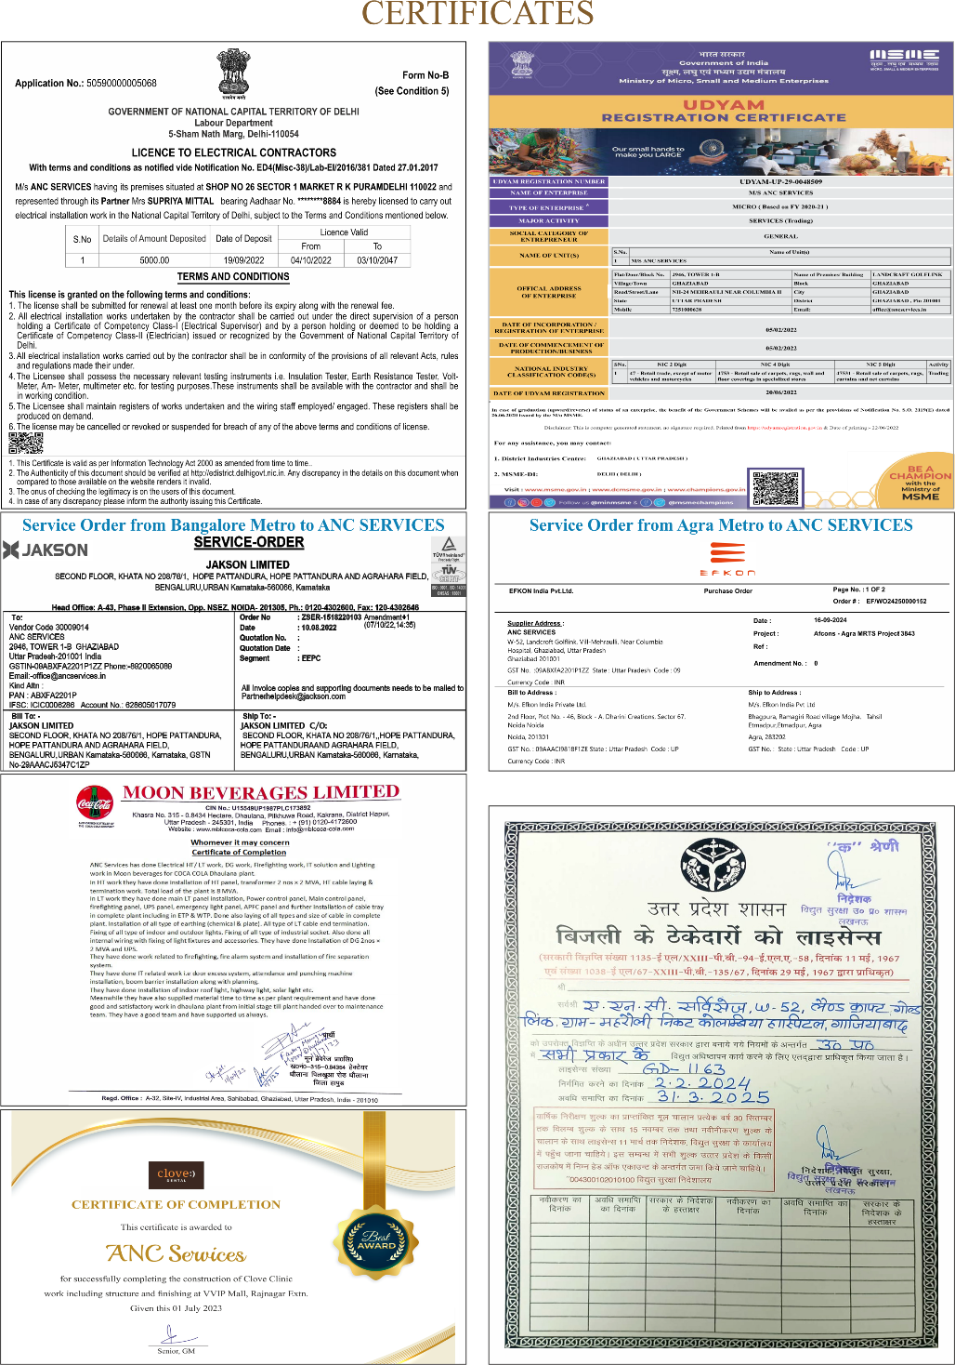

Slide 7
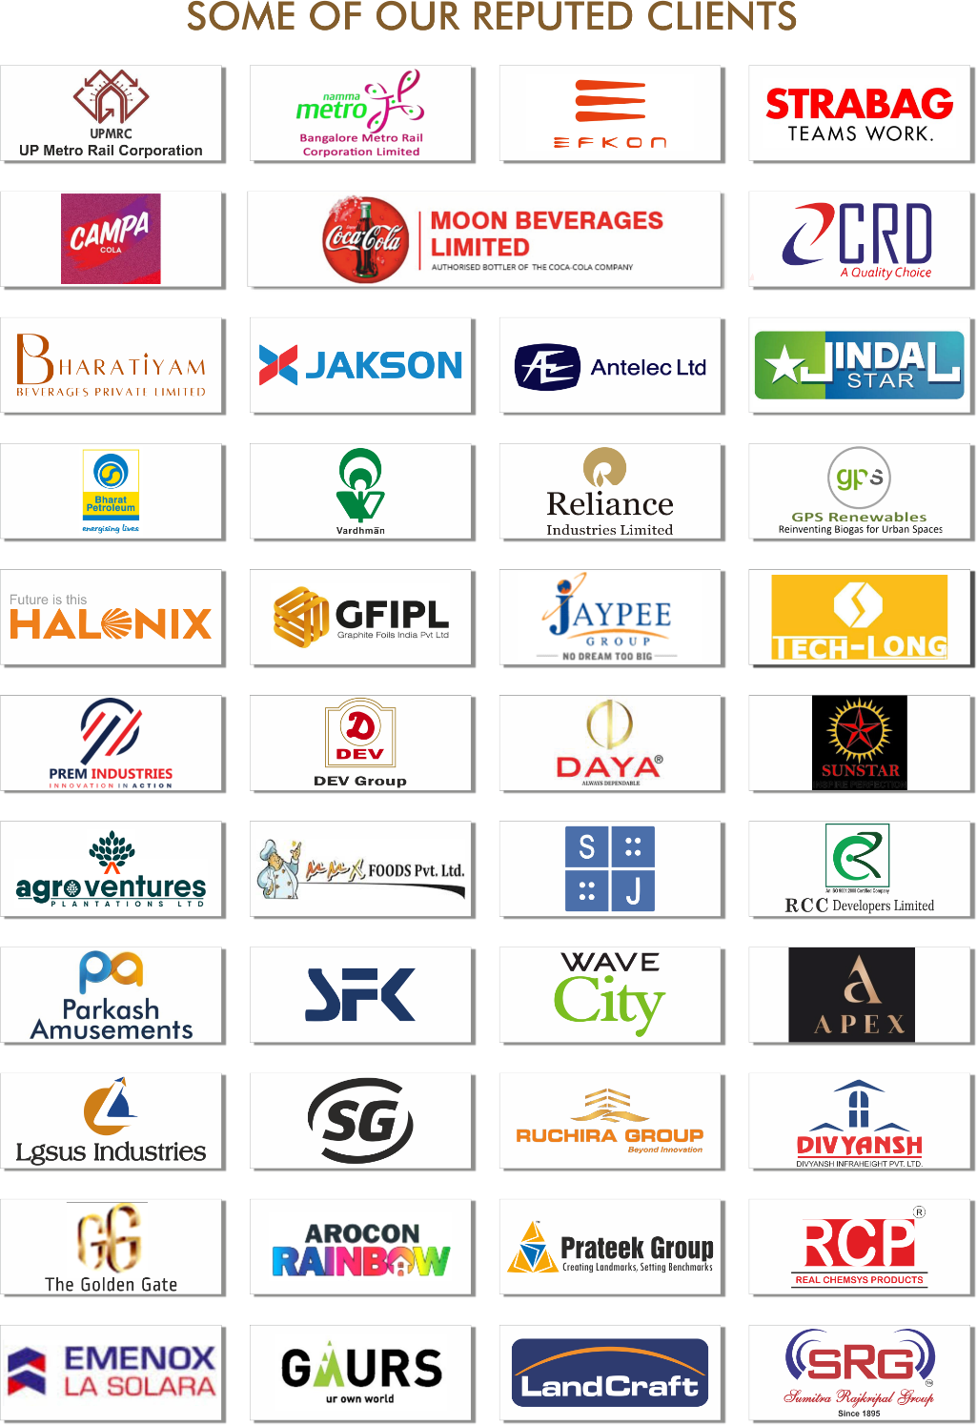

Slide 8
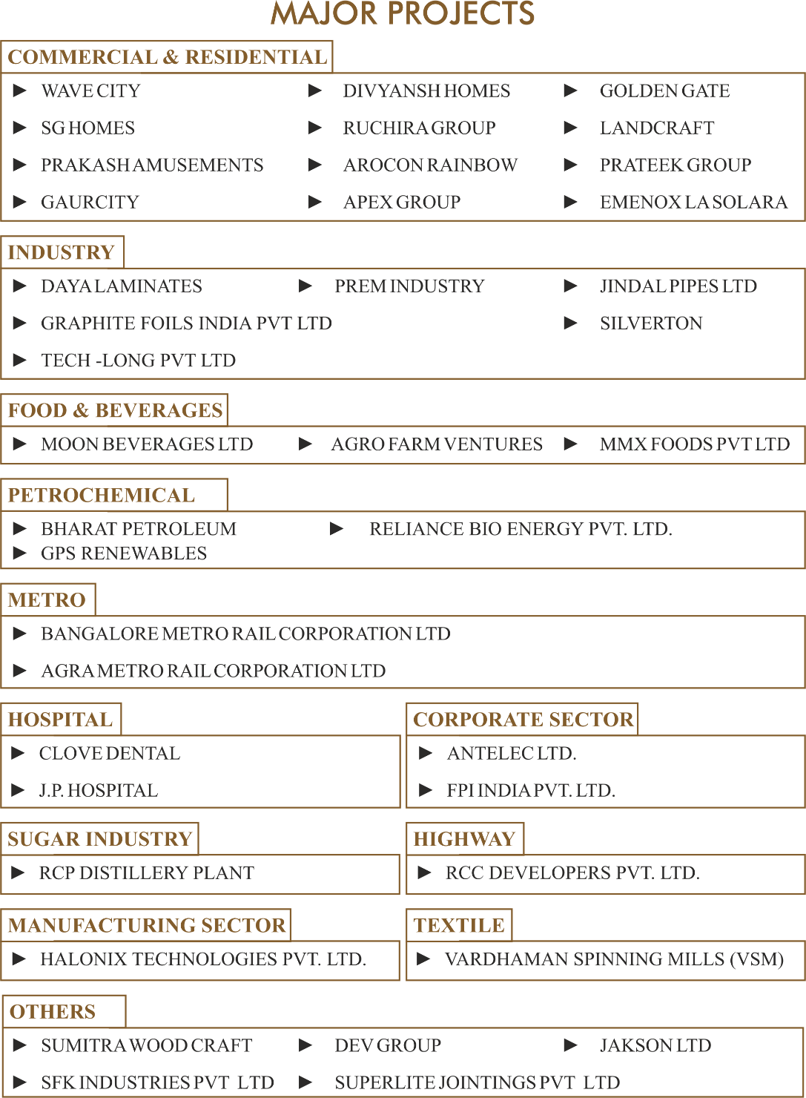

Slide 9
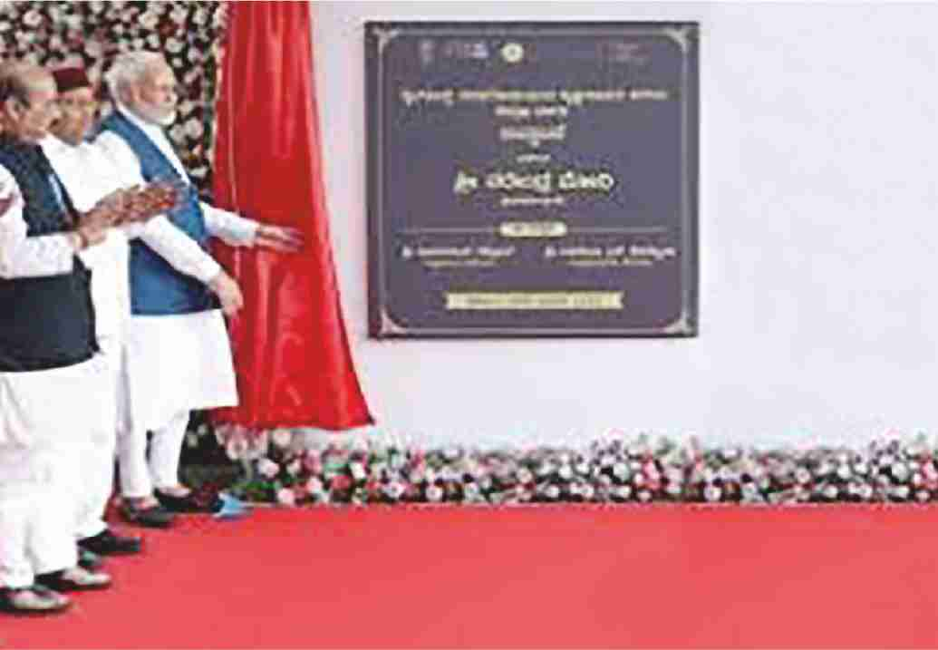
HON’BLE PM MODI JI INAUGURATED
BENGALURU METRO RAIL CORPORATION LIMITED, KARNATAKA

Slide 10
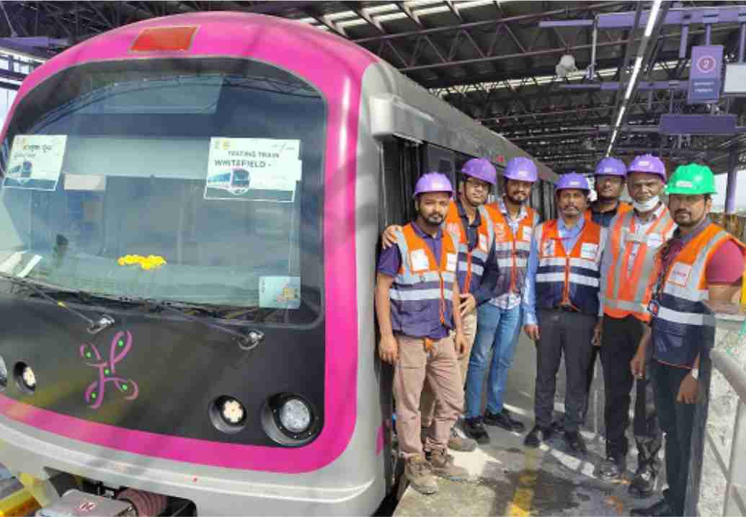
BENGALURU METRO RAIL CORPORATION LIMITED

Slide 11
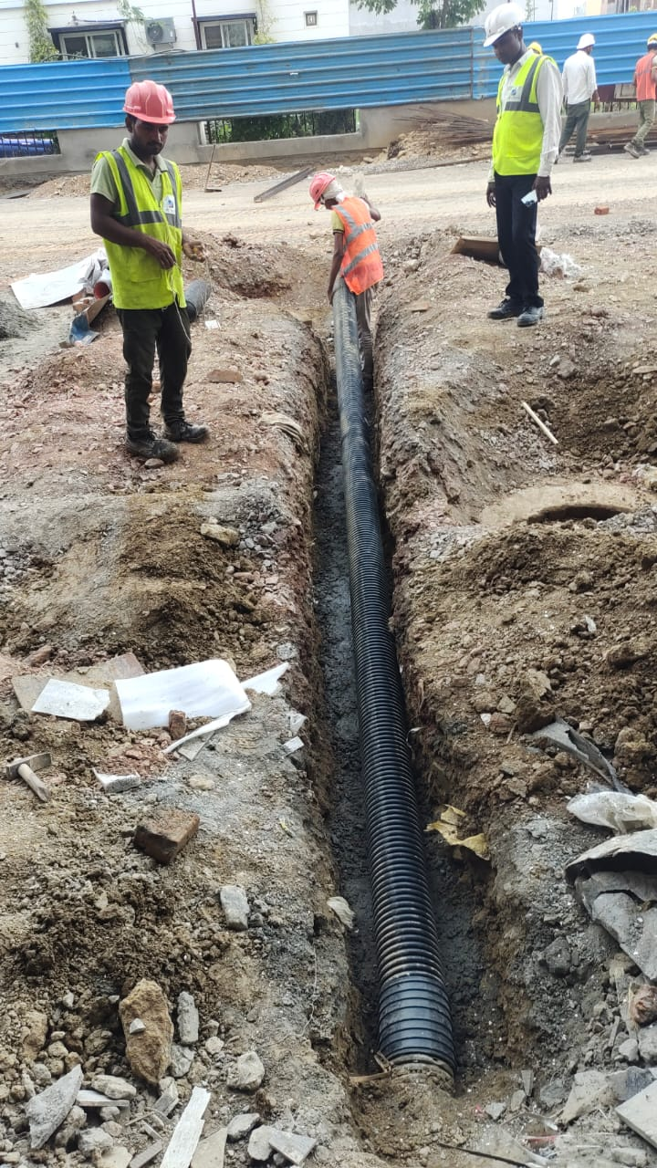
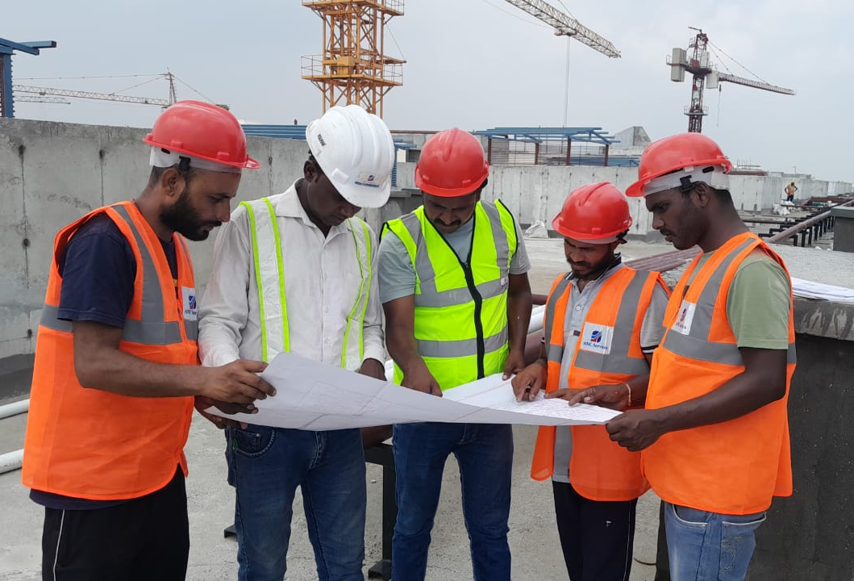
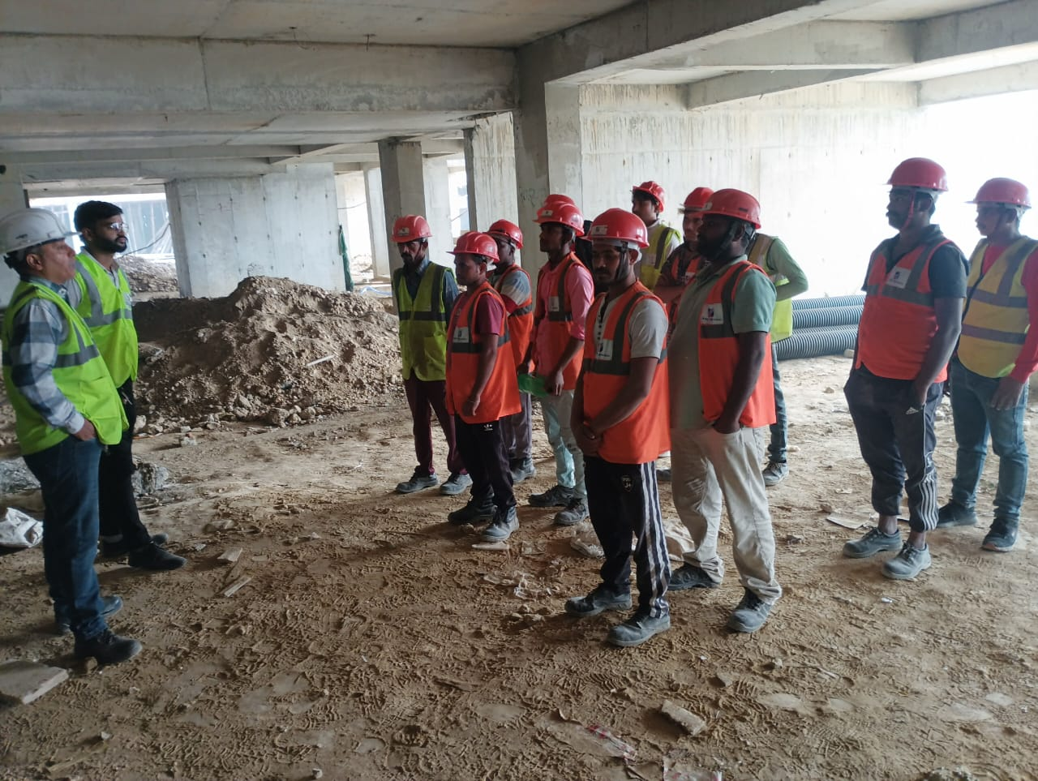
WAVE CITY, Ghaziabad

Slide 12
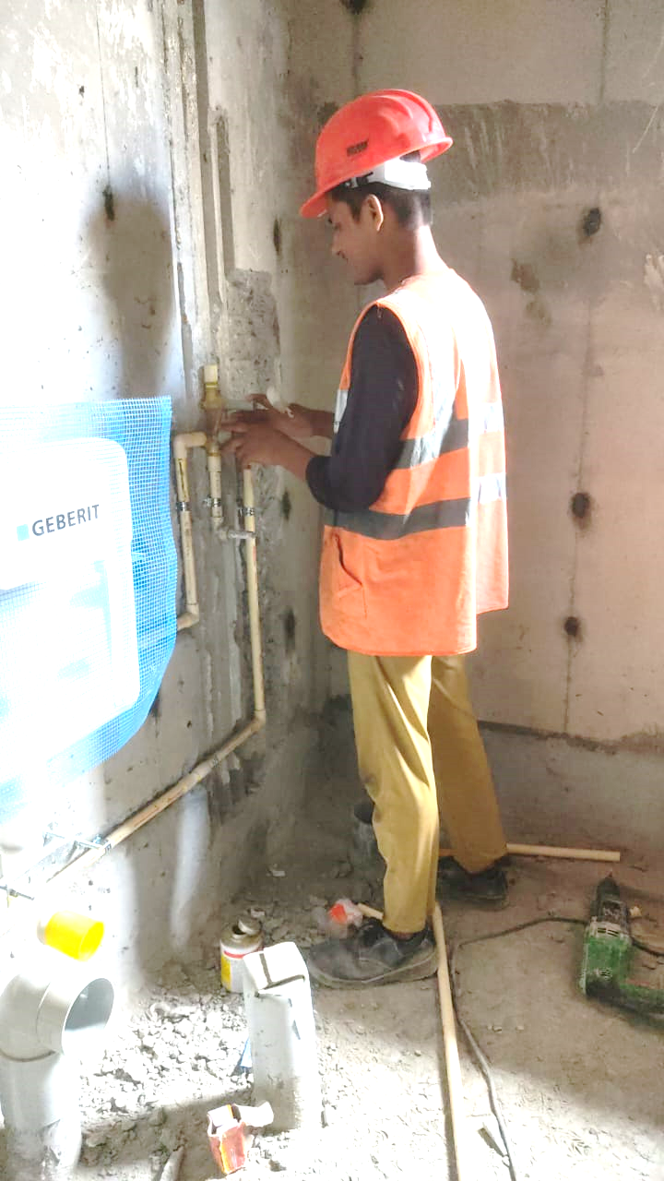

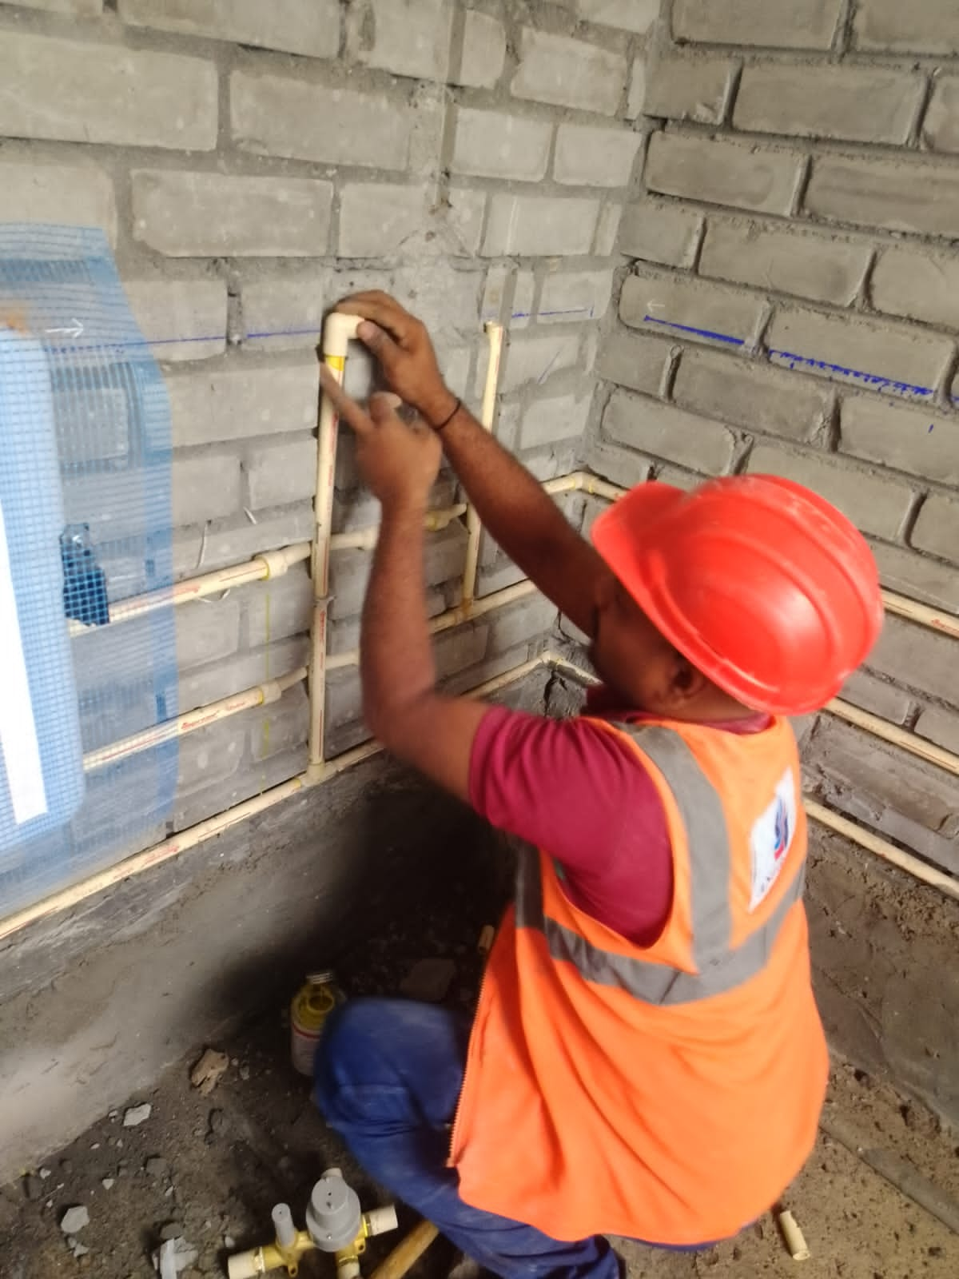
WAVE CITY, Ghaziabad

Slide 13
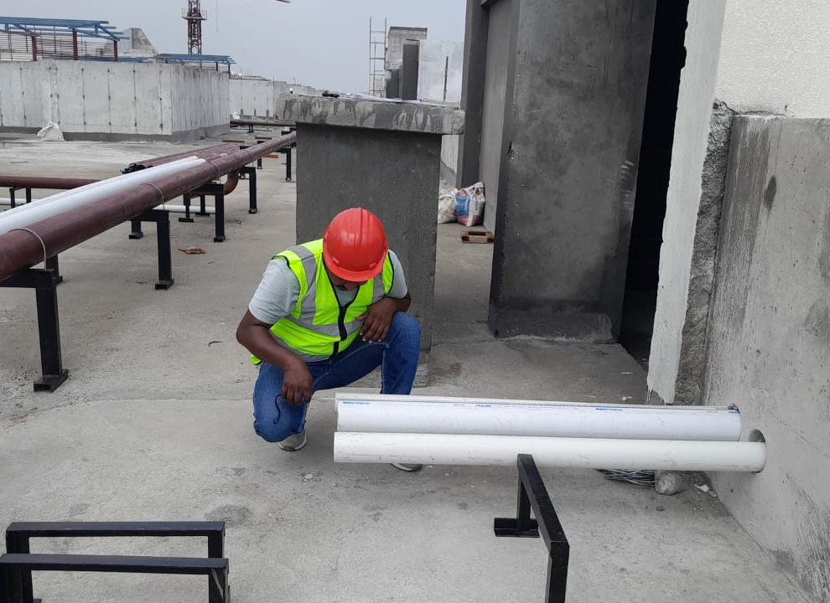
WAVE CITY, Ghaziabad

Slide 14
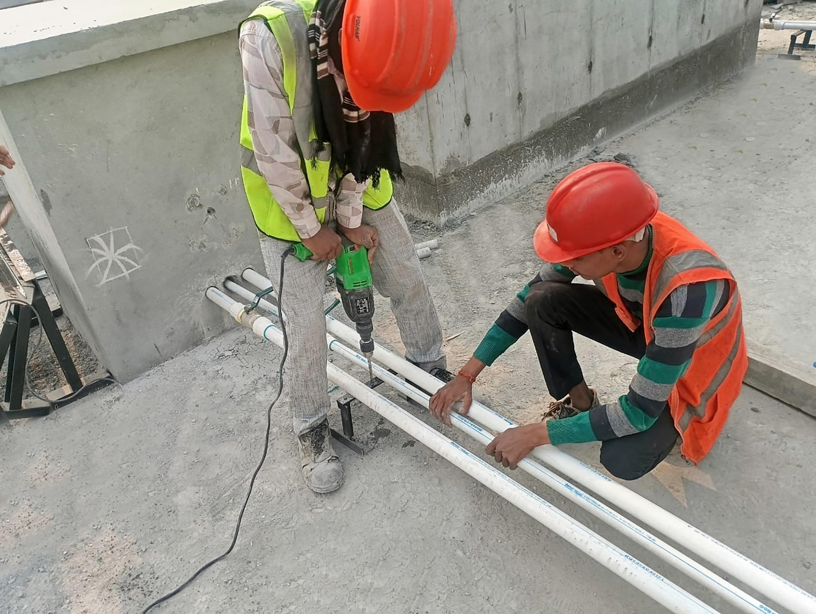
WAVE CITY, Ghaziabad

Slide 15
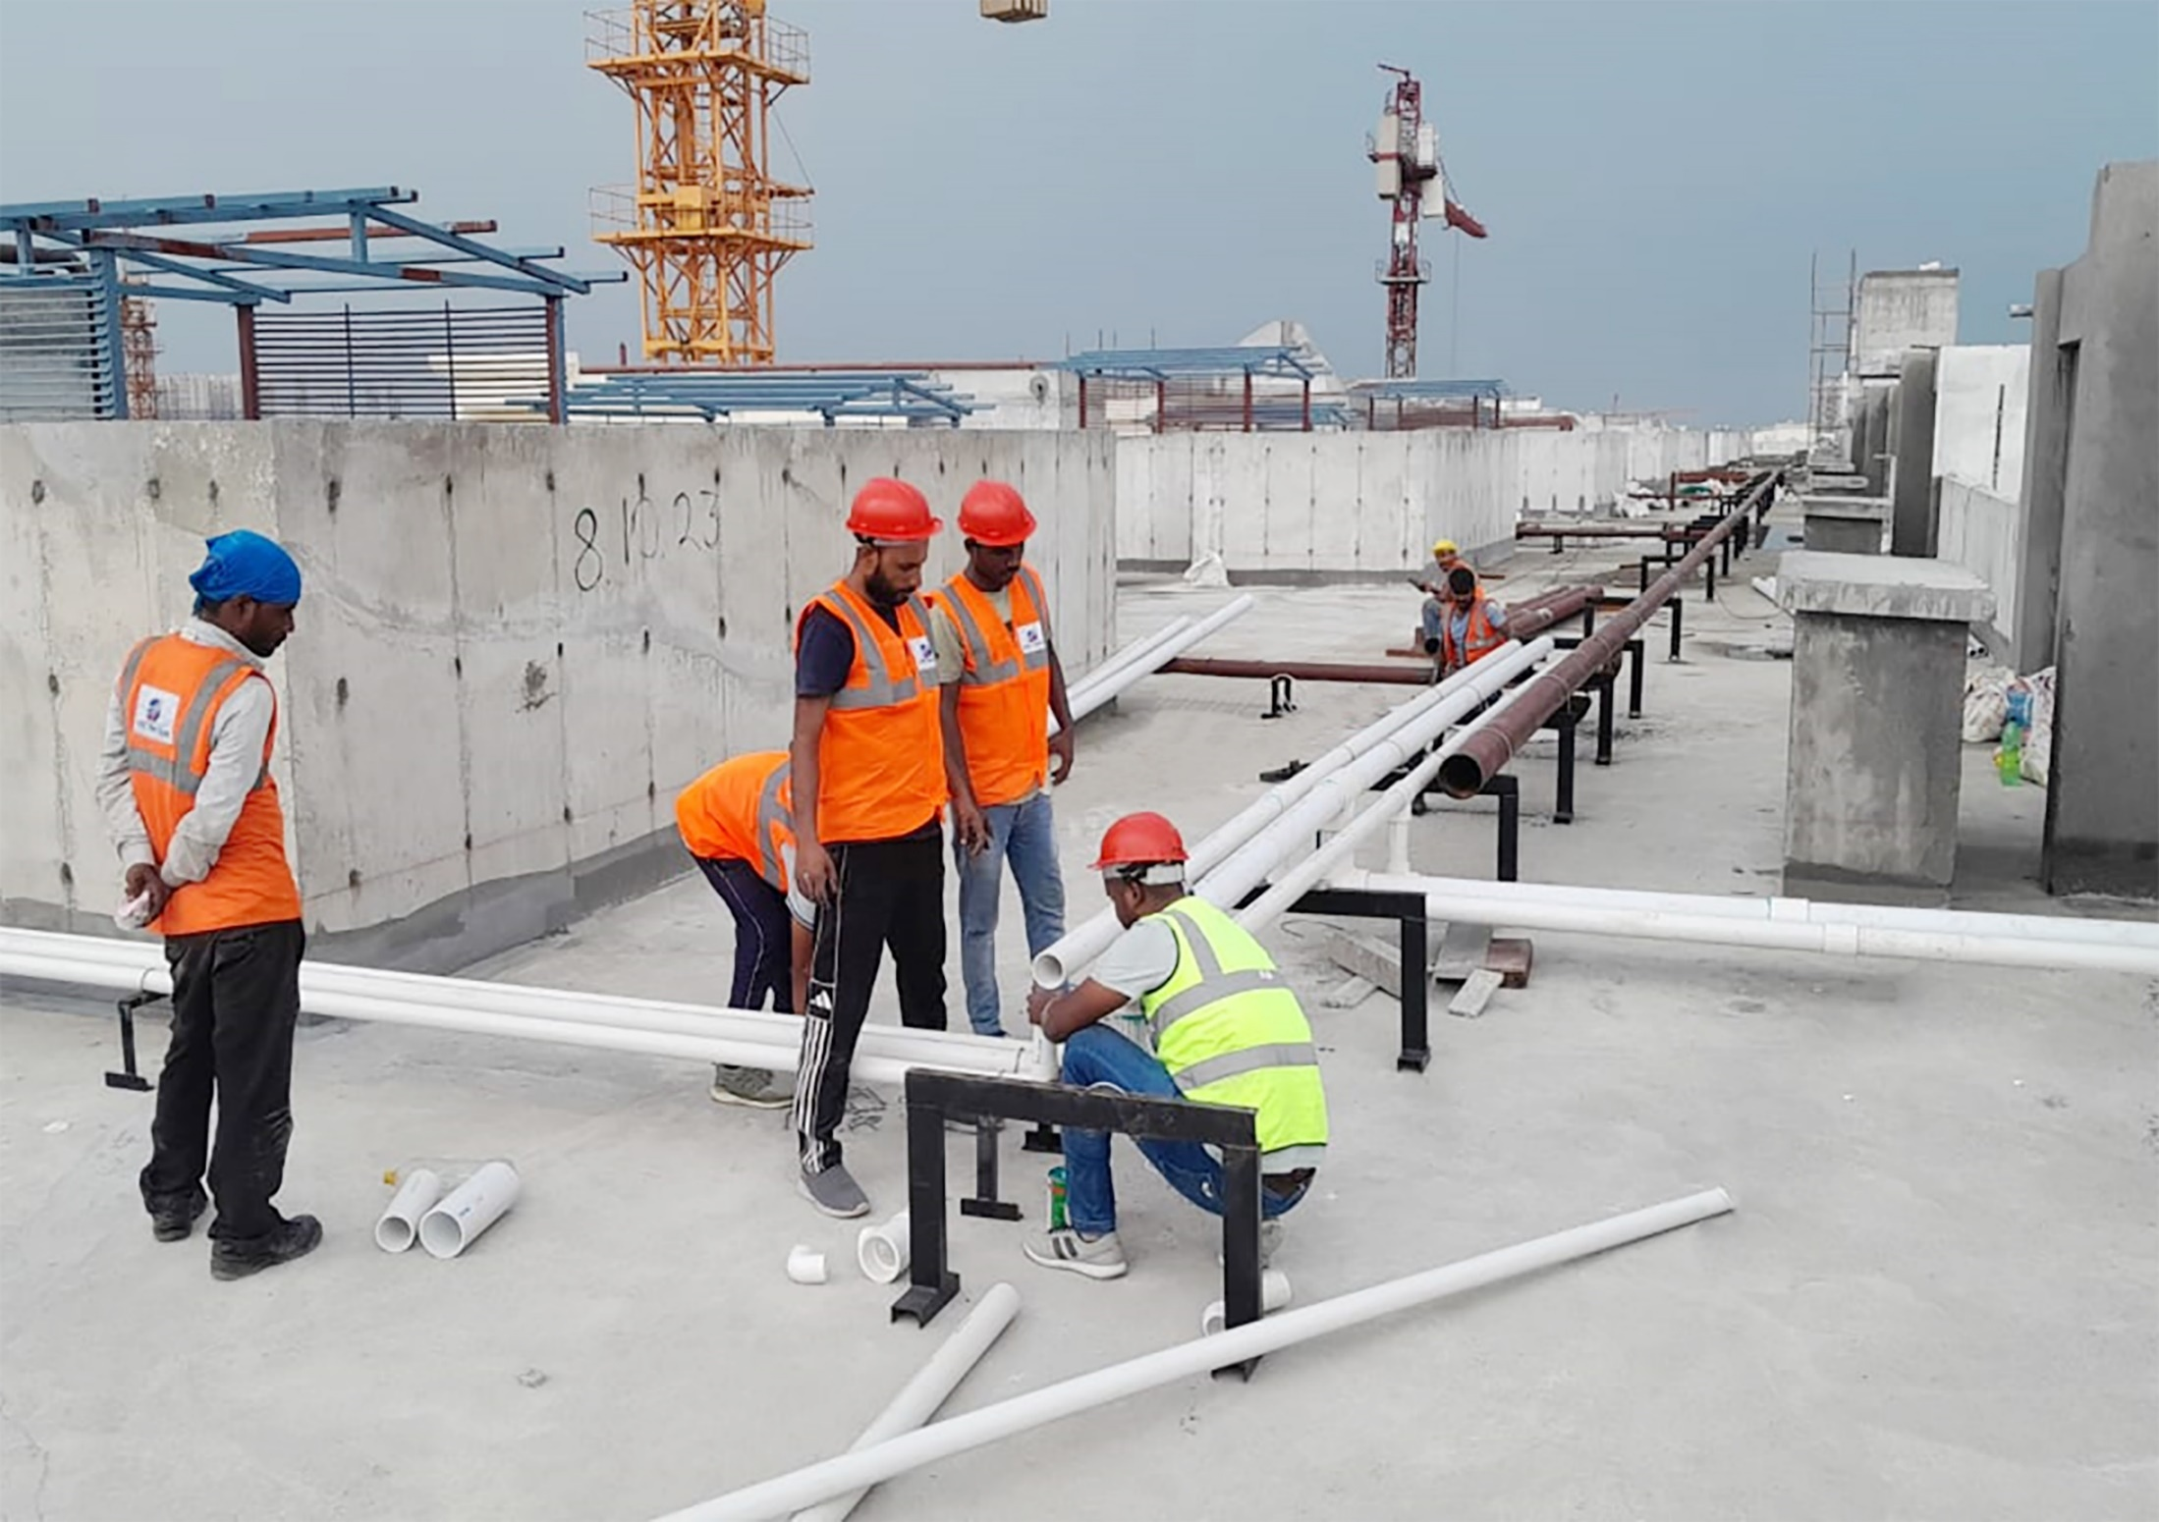
WAVE CITY, Ghaziabad

Slide 16
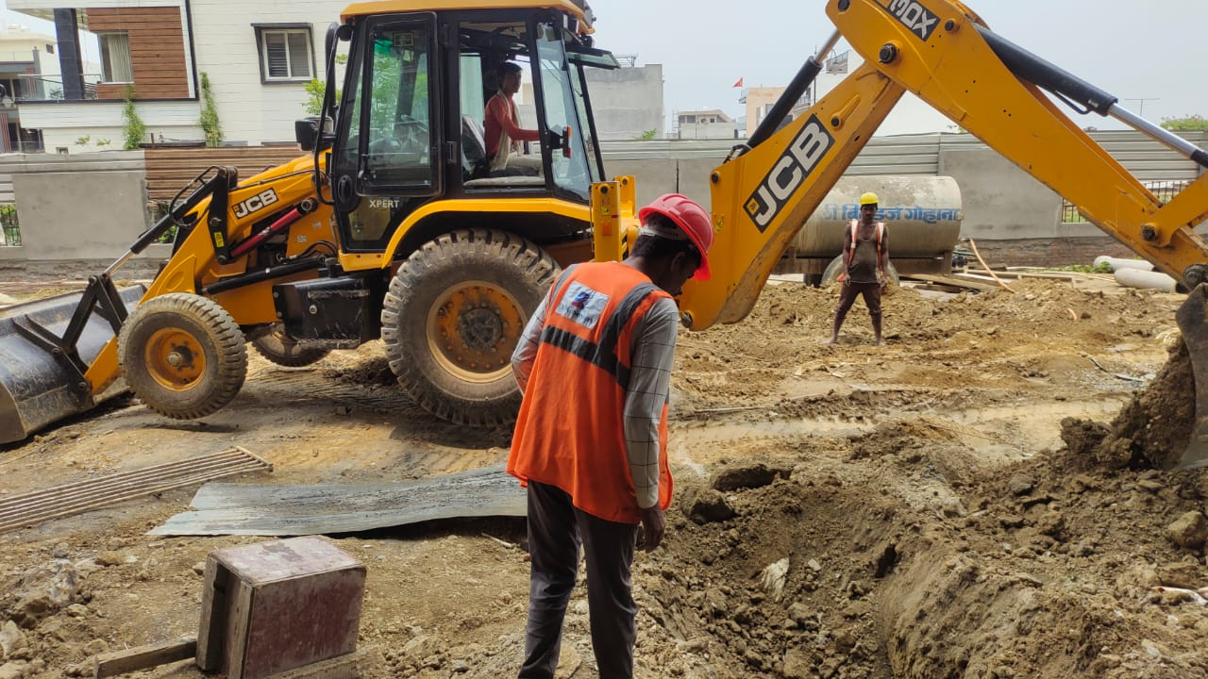
WAVE CITY, Ghaziabad

Slide 17
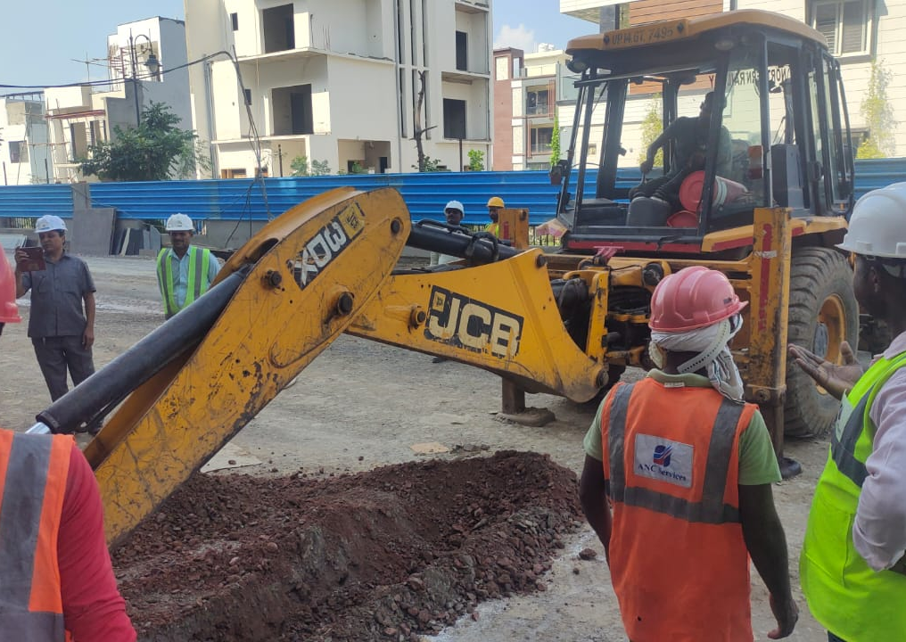
WAVE CITY, Ghaziabad

Slide 18
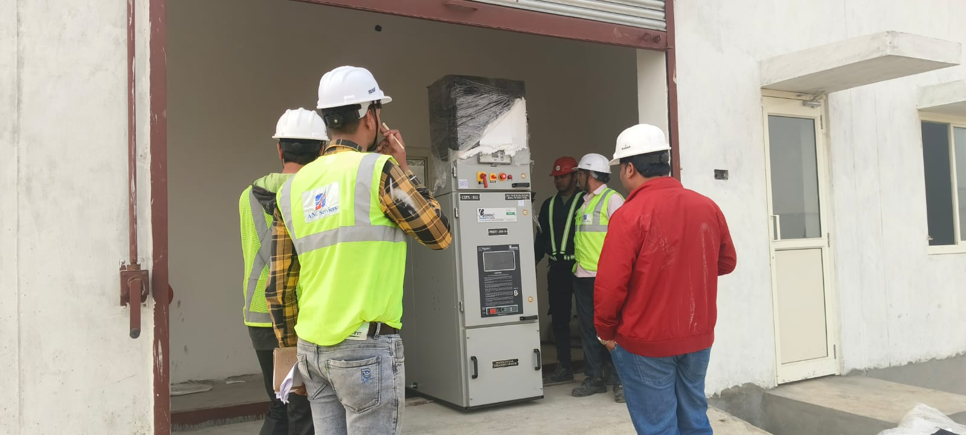
RELIANCE BIO - ENERGY PLANT, Haryana

Slide 19
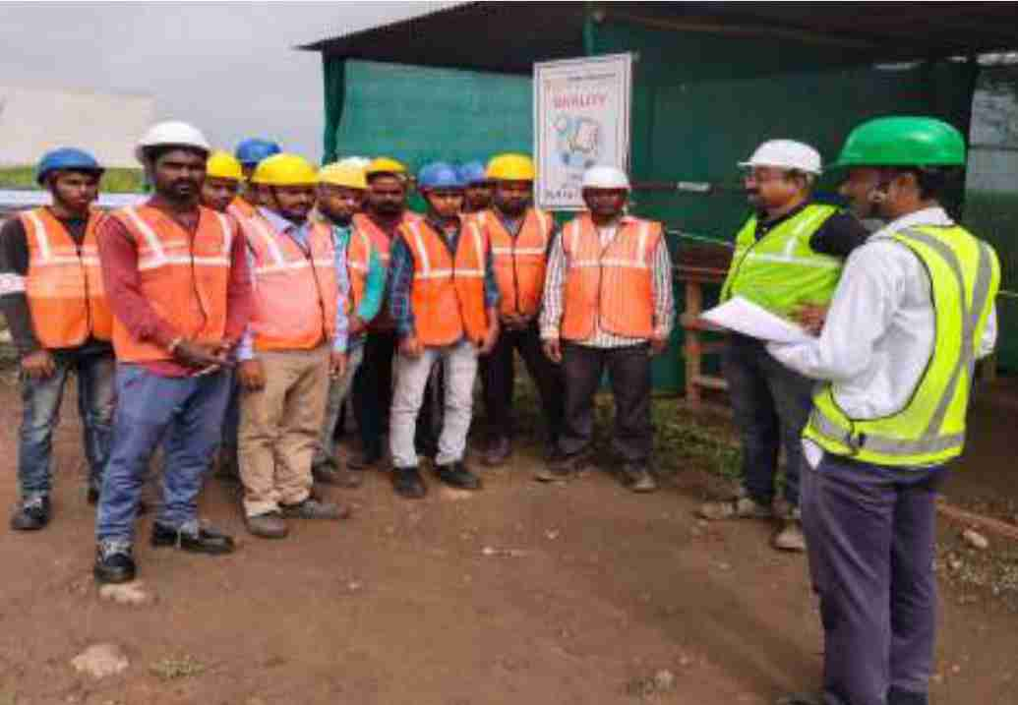
RELIANCE BIO - ENERGY PLANT, Haryana

Slide 20
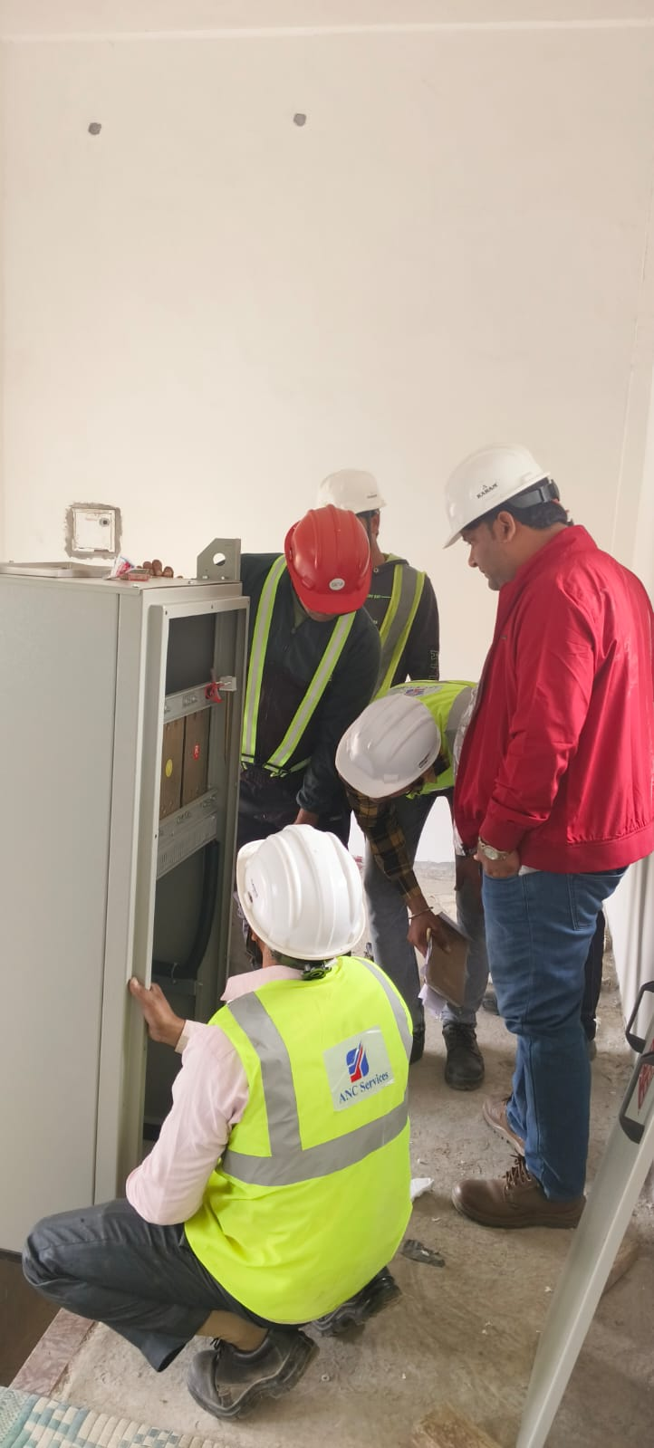
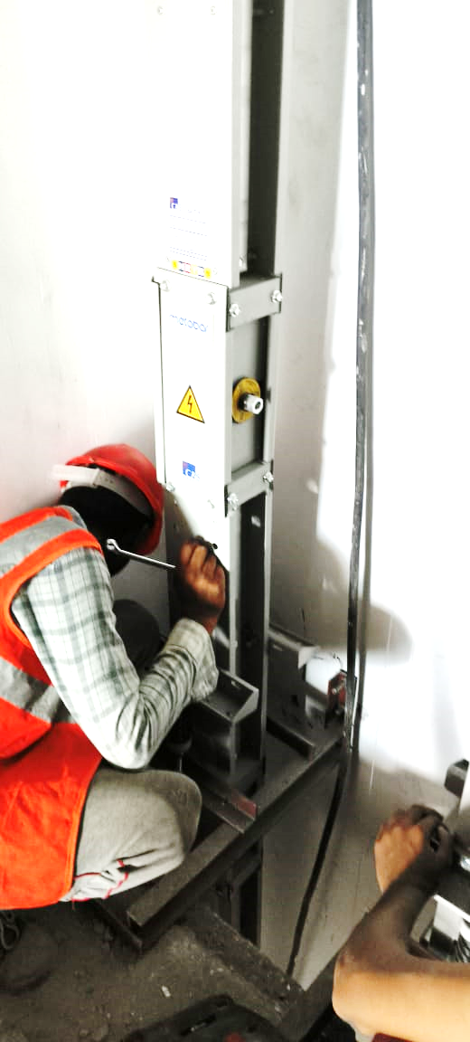
RELIANCE BIO - ENERGY PLANT, Haryana

Slide 21
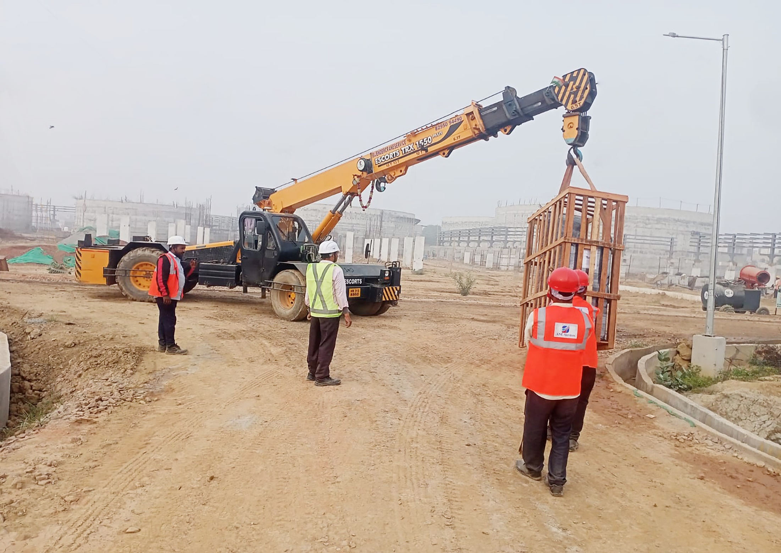
RELIANCE BIO - ENERGY PLANT, Haryana

Slide 22
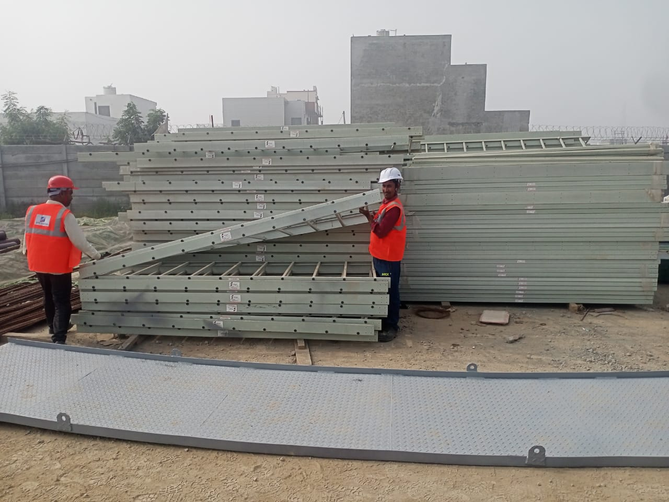
RELIANCE BIO - ENERGY PLANT, Haryana

Slide 23
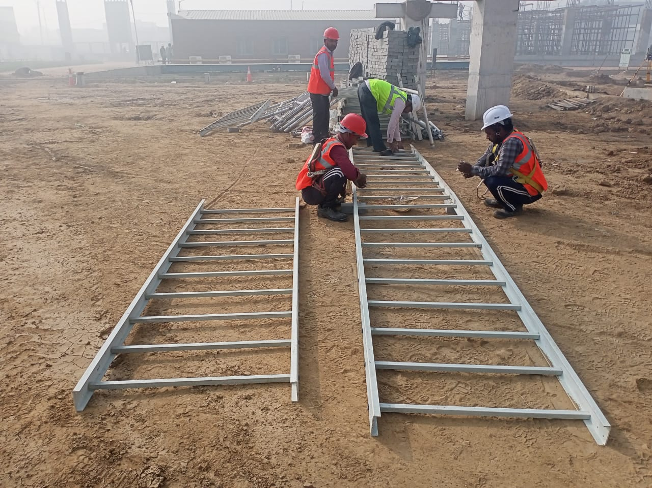
RELIANCE BIO - ENERGY PLANT, Haryana

Slide 24
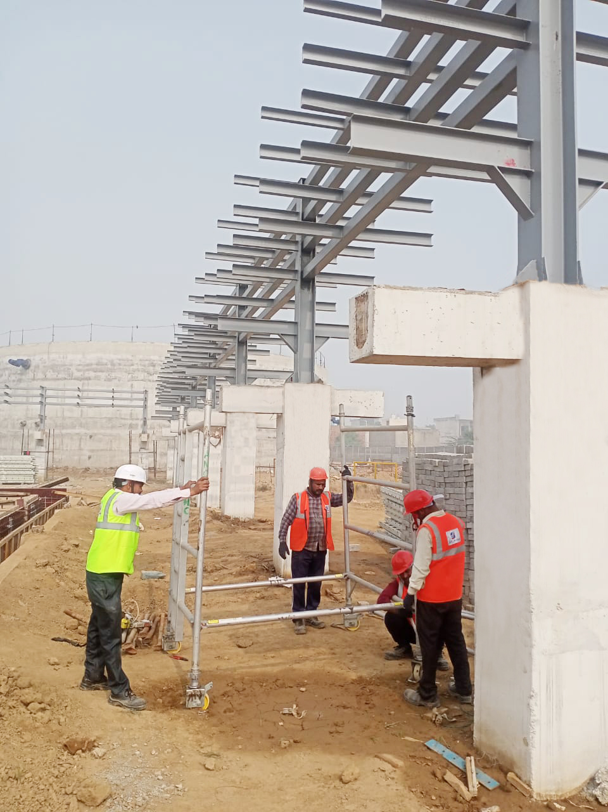
RELIANCE BIO - ENERGY PLANT, Haryana

Slide 25
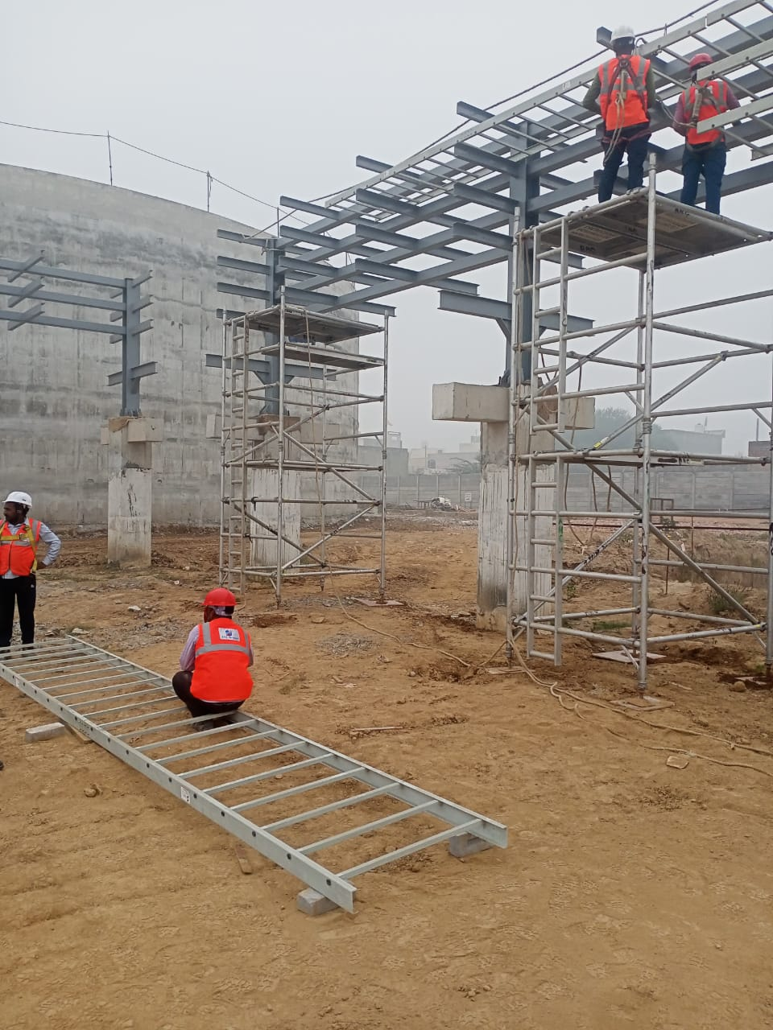
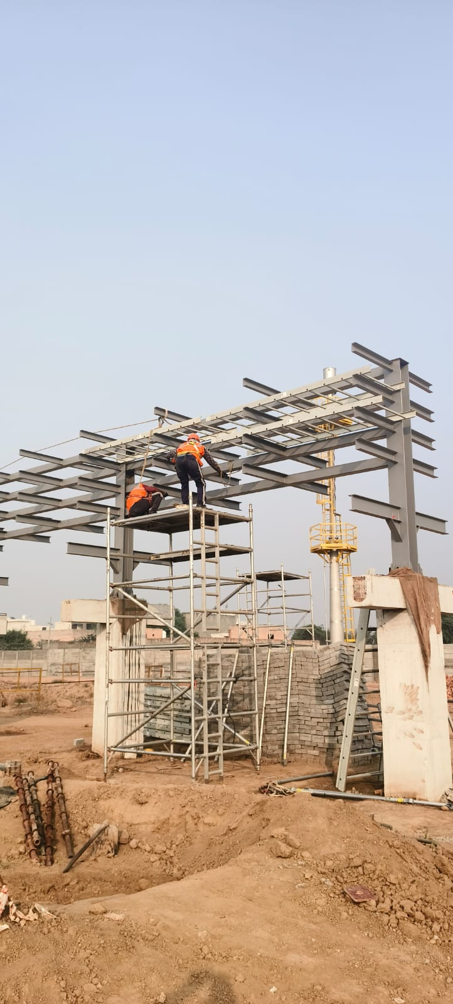
RELIANCE BIO - ENERGY PLANT, Haryana

Slide 26
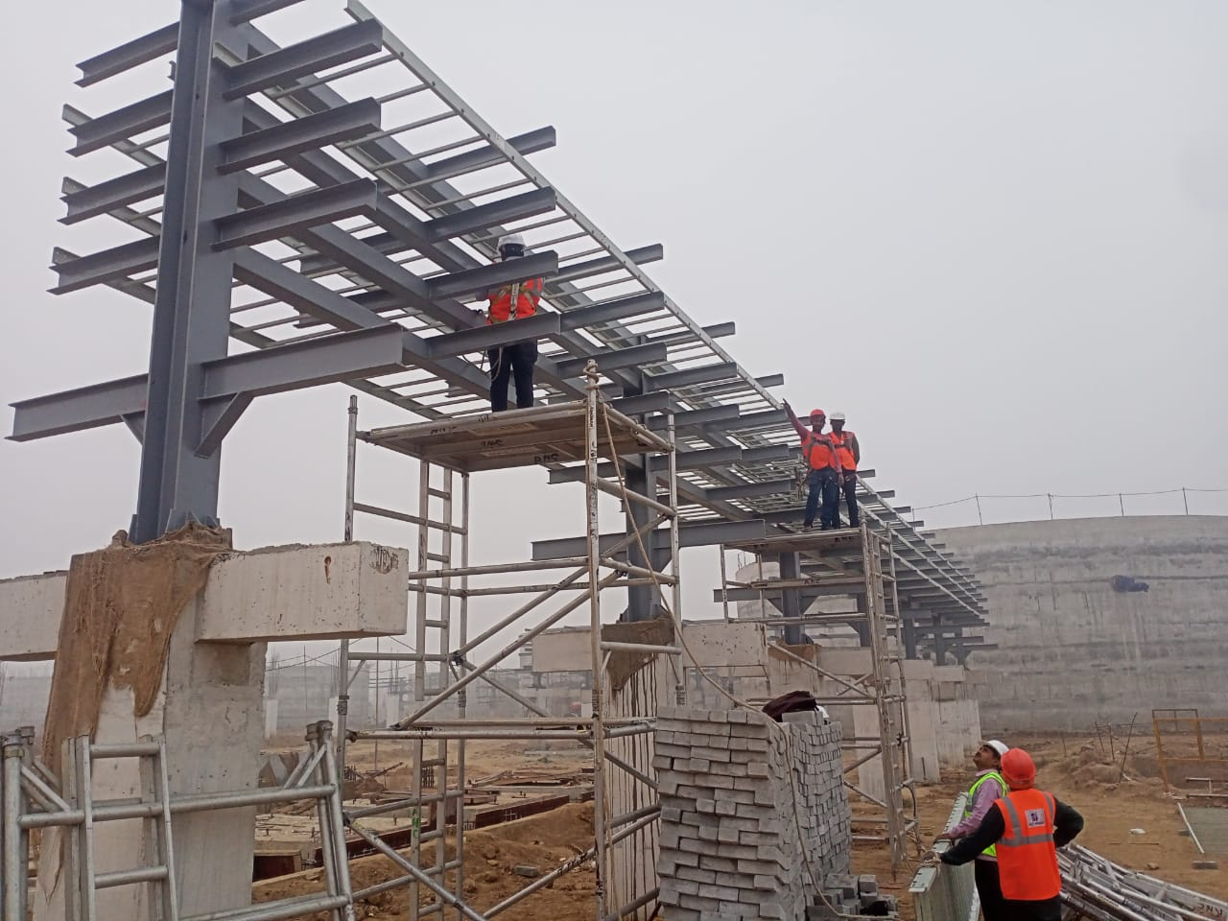
RELIANCE BIO - ENERGY PLANT, Haryana

Slide 27
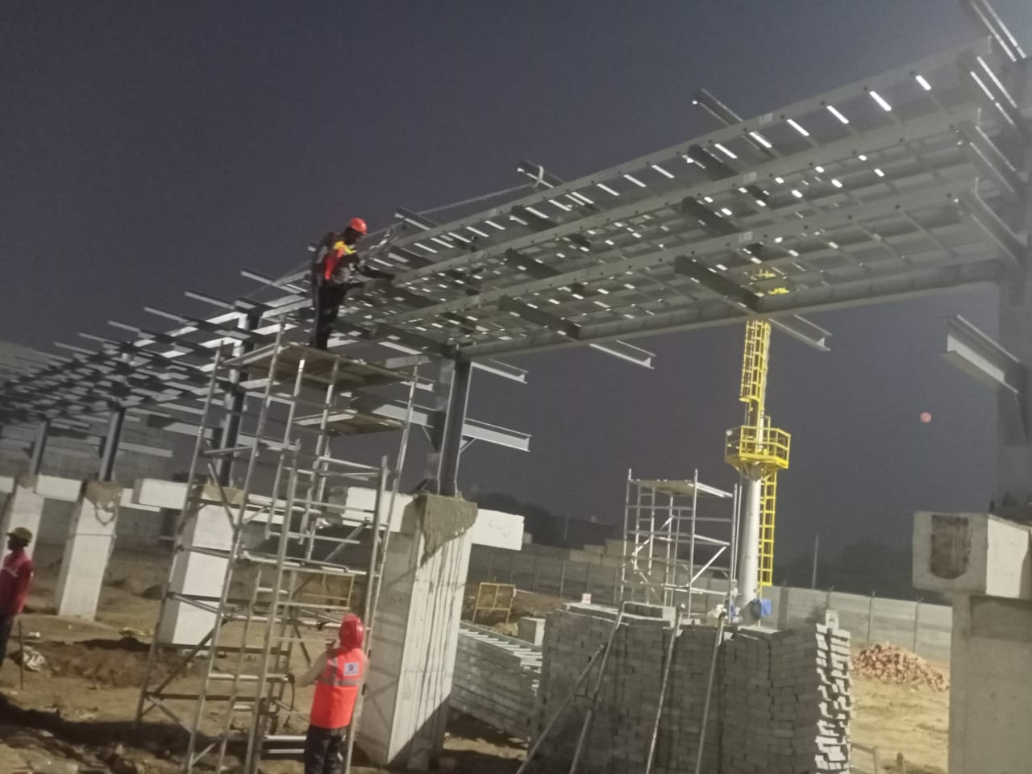
RELIANCE BIO - ENERGY PLANT, Haryana

Slide 28
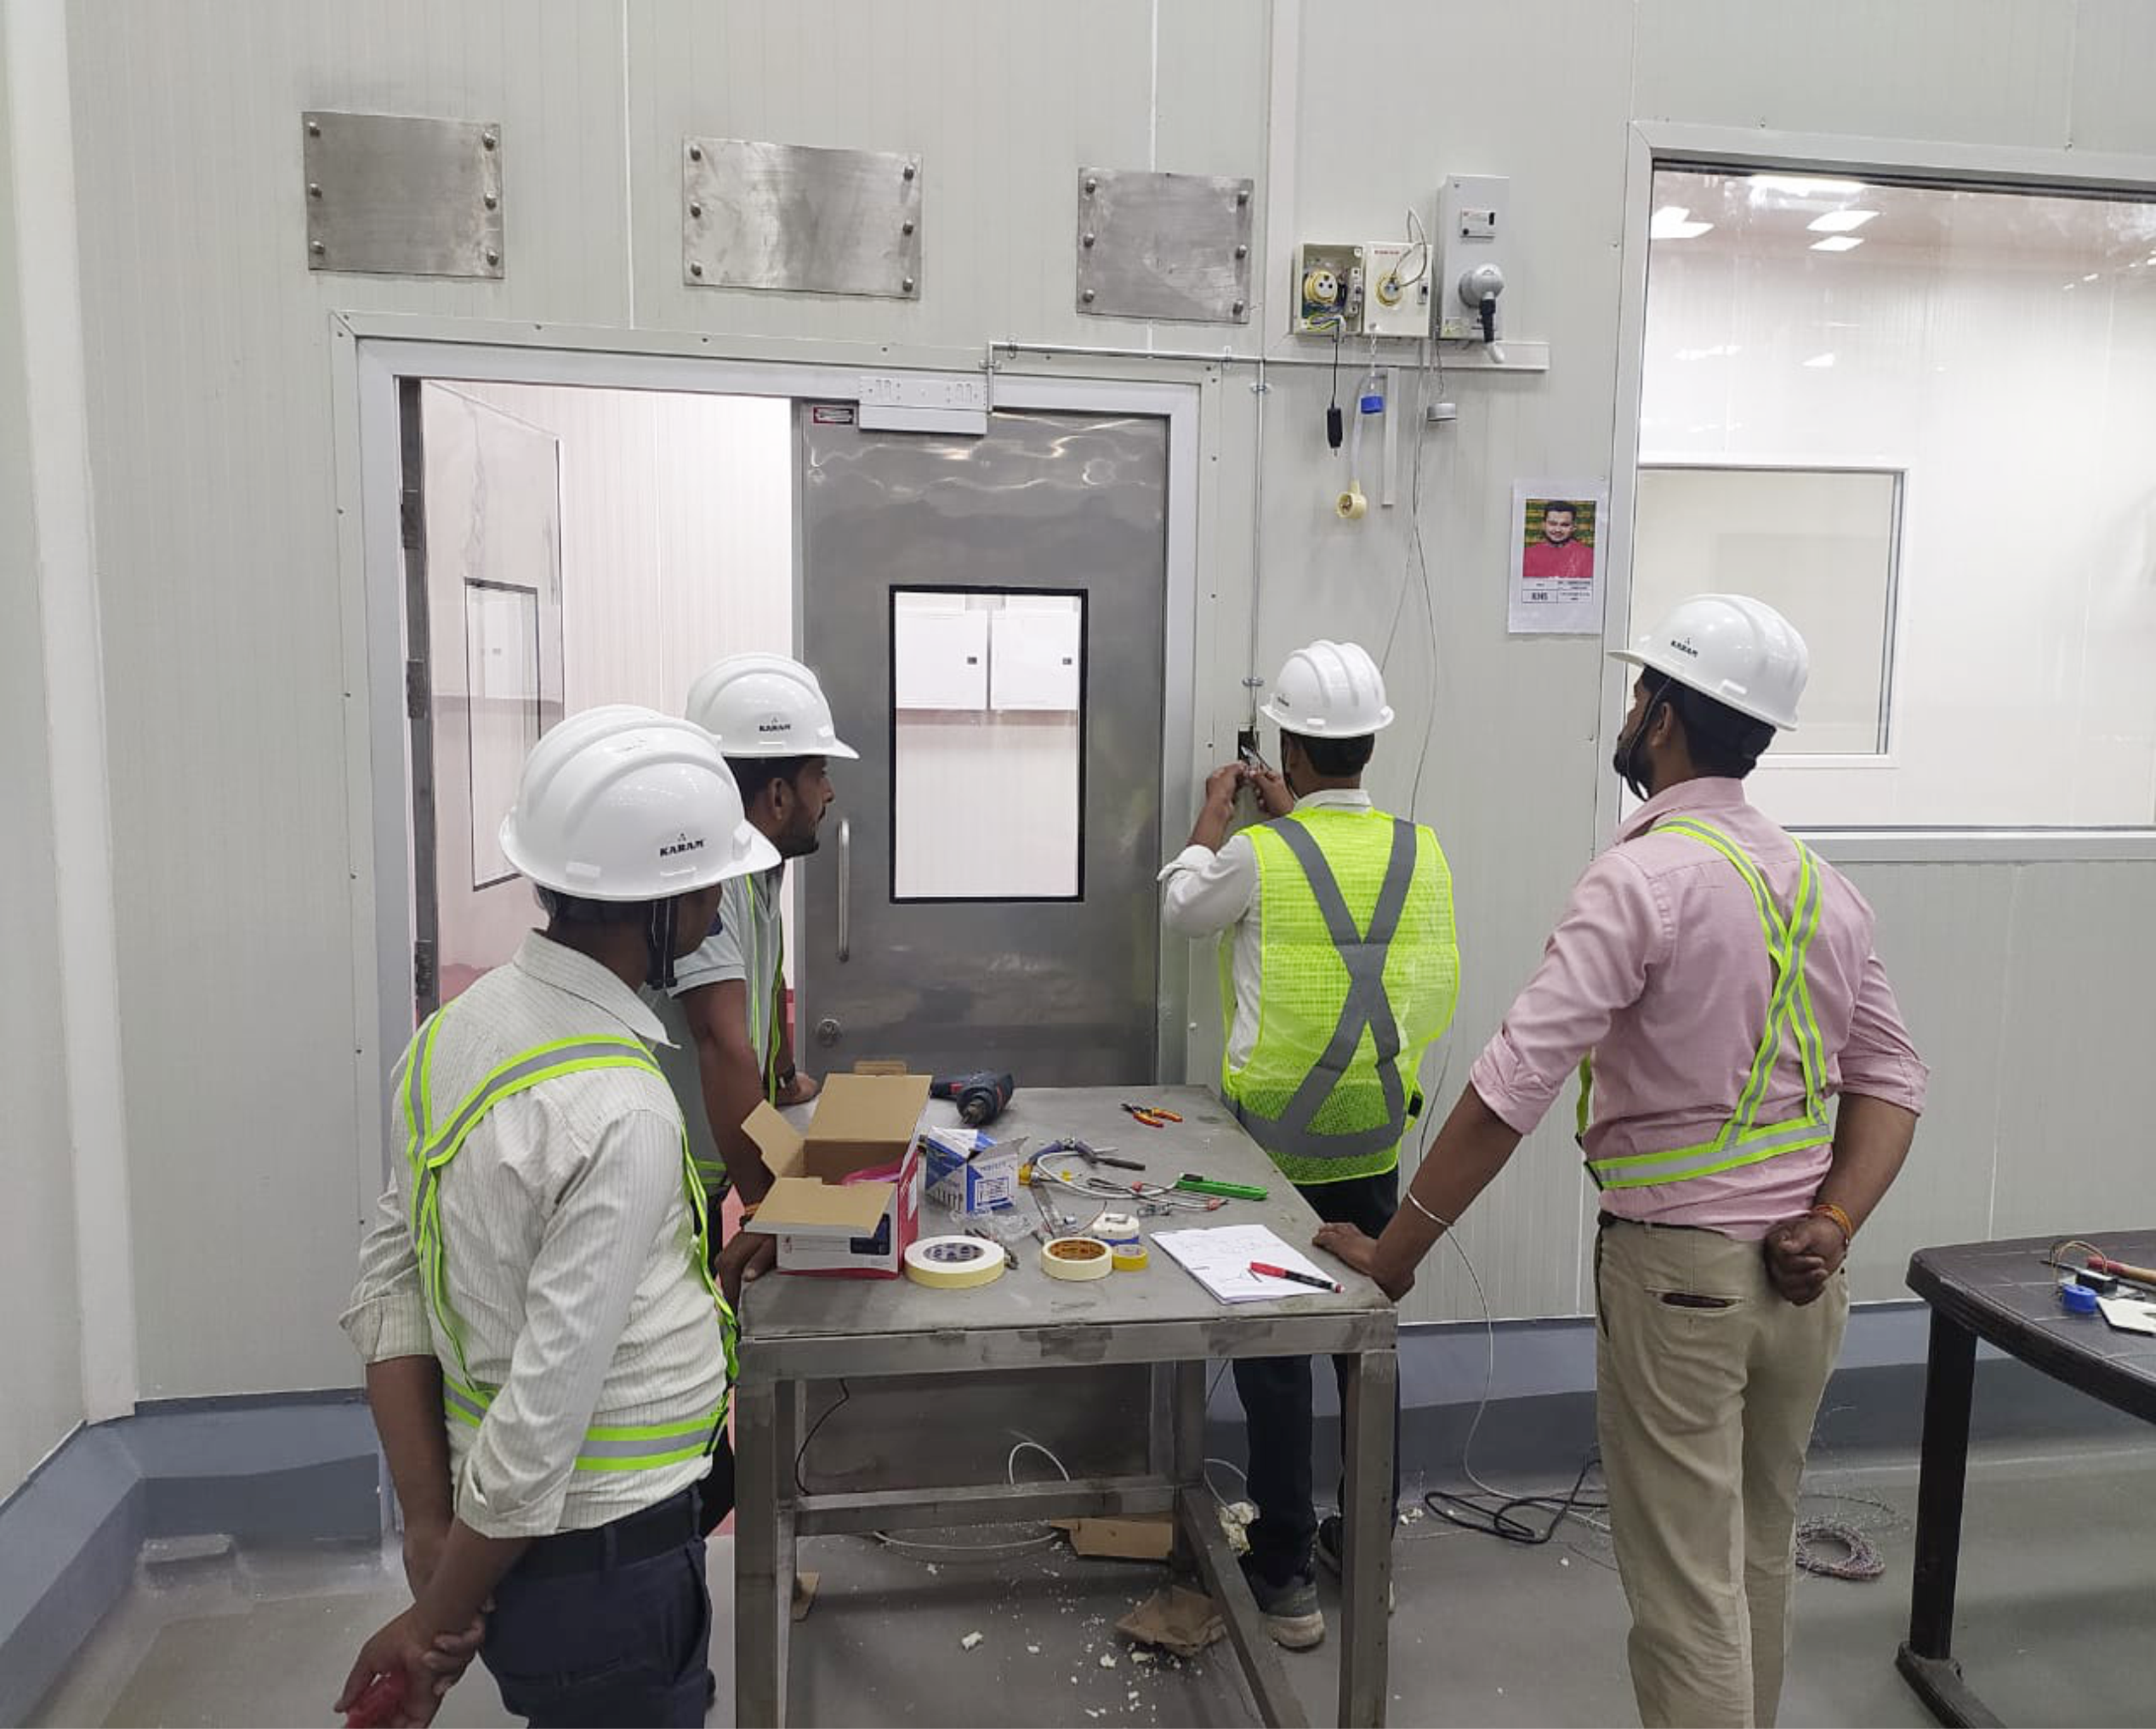
MOON BEVERAGE (COCA-COLA PLANT), Dhaulana

Slide 29
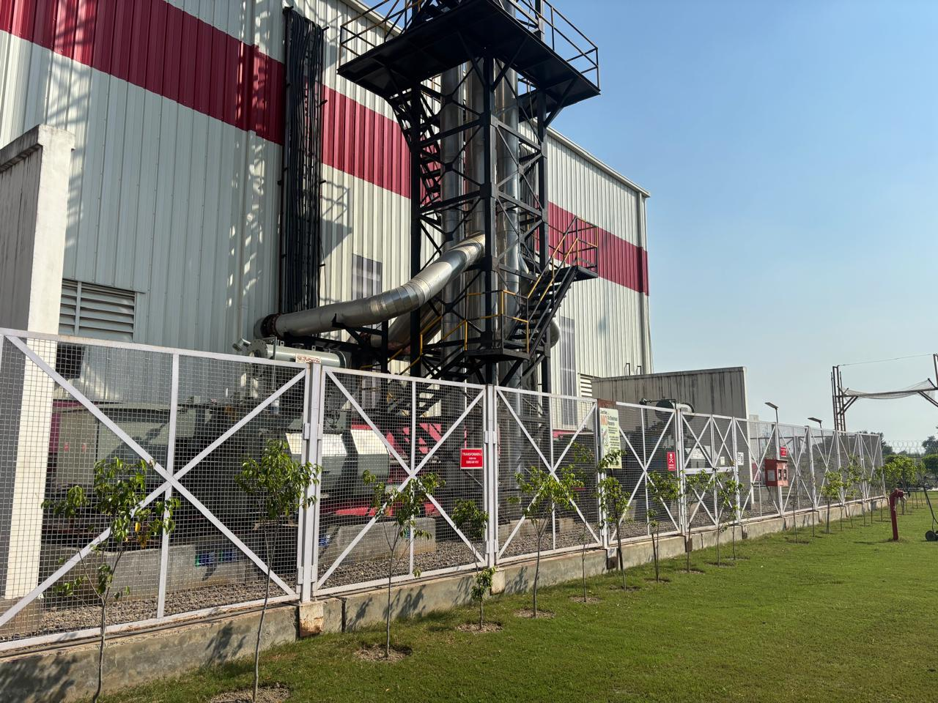
MOON BEVERAGE (COCA-COLA PLANT), Dhaulana

Slide 30
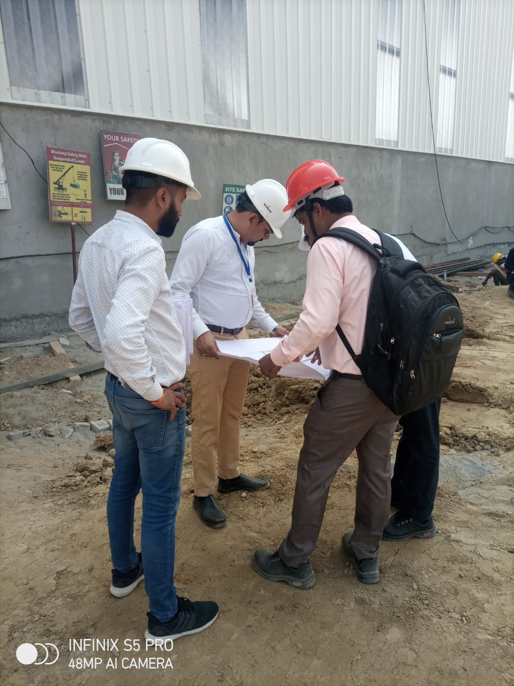
MOON BEVERAGE (COCA-COLA PLANT), Dhaulana

Slide 31
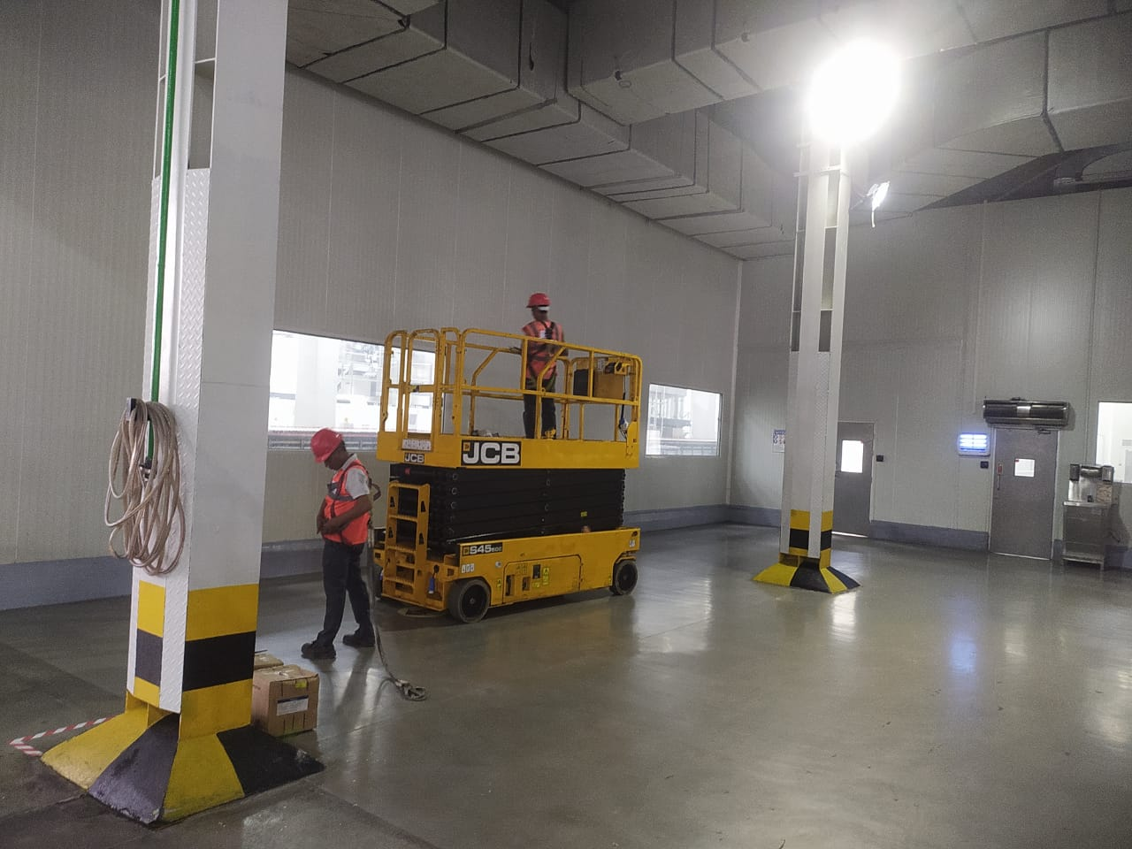
MOON BEVERAGE (COCA-COLA PLANT), Dhaulana

Slide 32
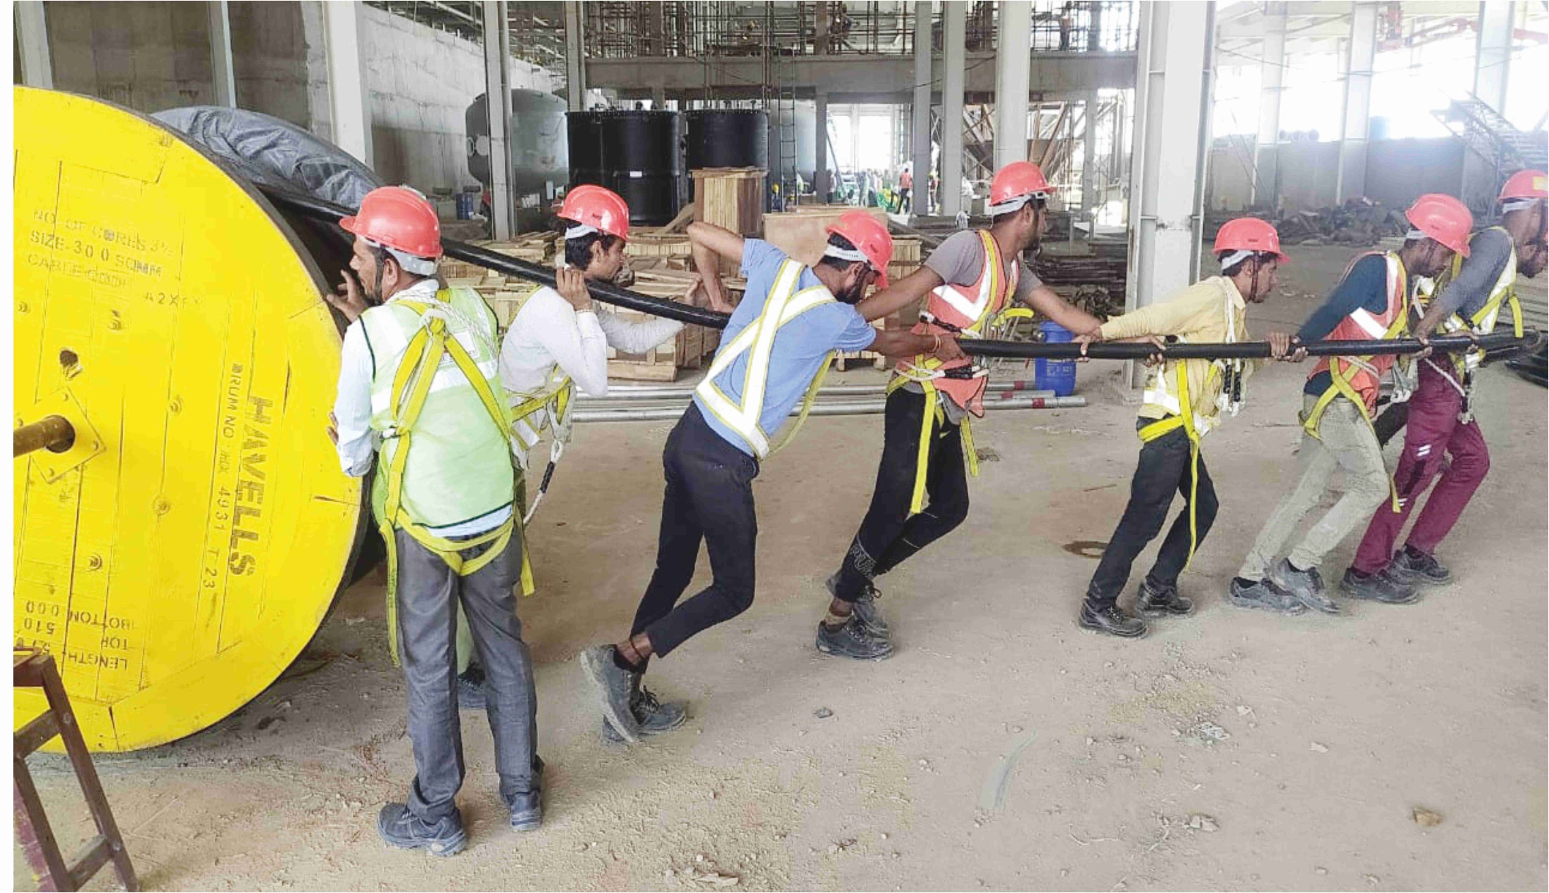
MOON BEVERAGE (COCA-COLA PLANT), Dhaulana

Slide 33
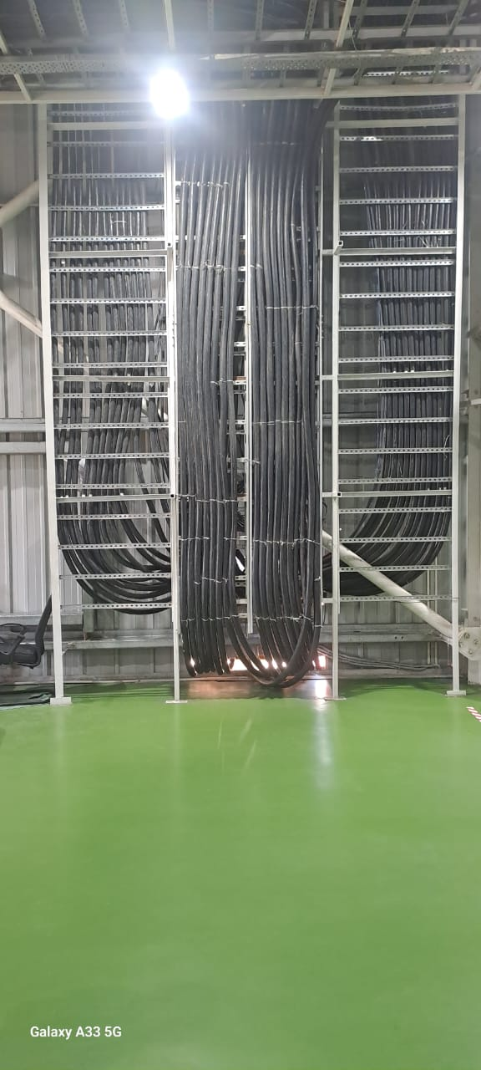
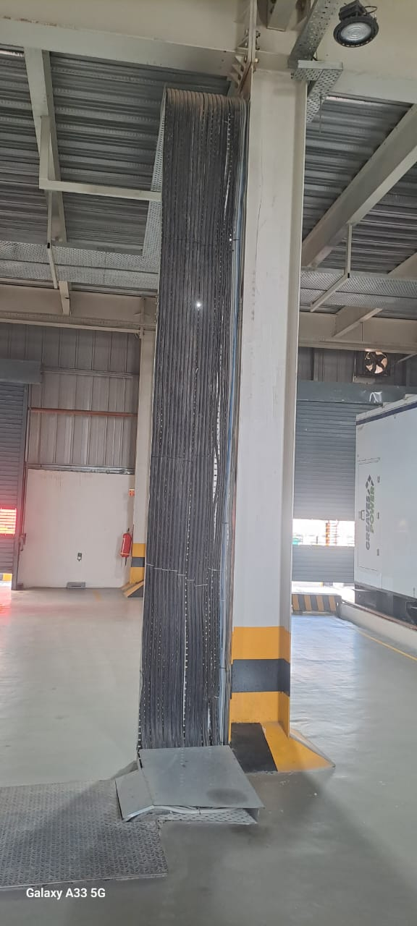
MOON BEVERAGE (COCA-COLA PLANT), Dhaulana

Slide 34
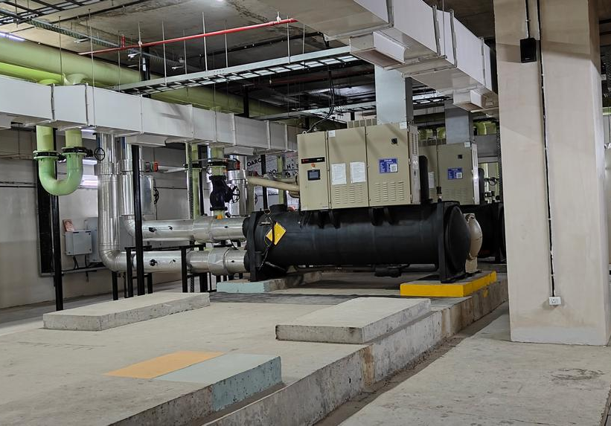
MOON BEVERAGE (COCA-COLA PLANT), Dhaulana

Slide 35
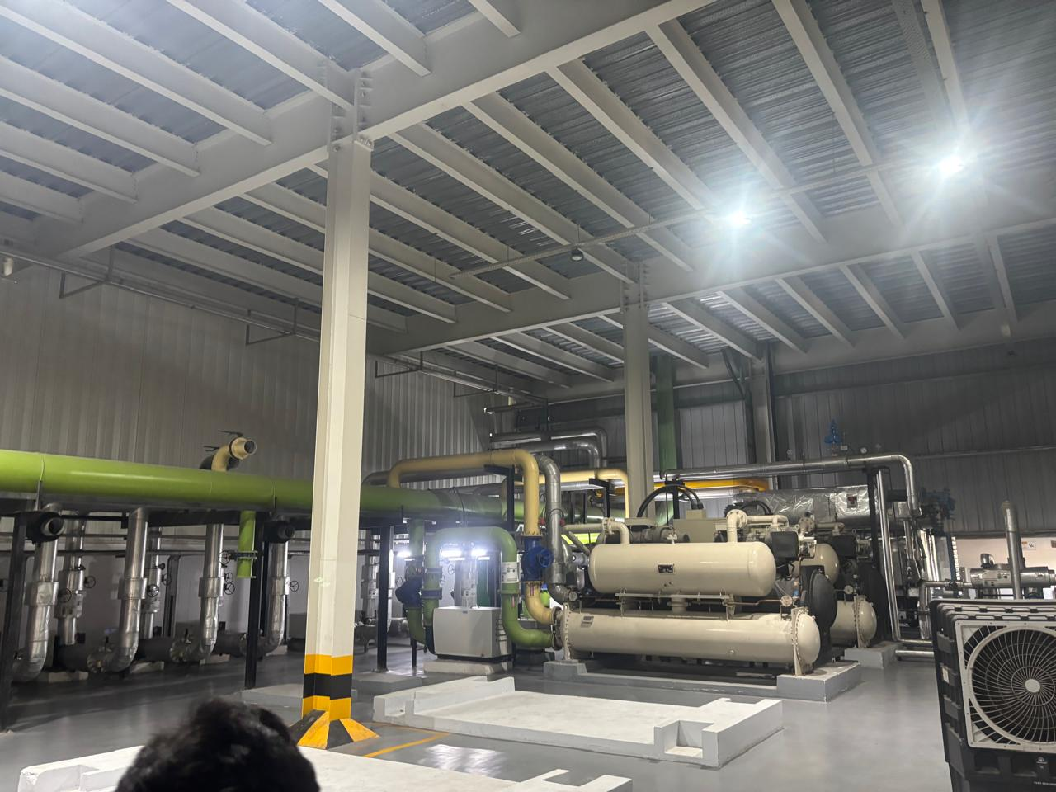
MOON BEVERAGE (COCA-COLA PLANT), Dhaulana

Slide 36
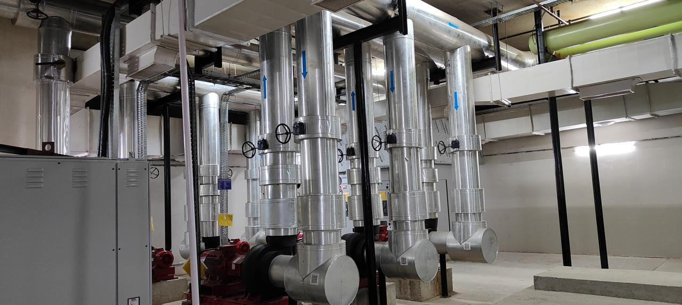
MOON BEVERAGE (COCA-COLA PLANT), Dhaulana

Slide 37
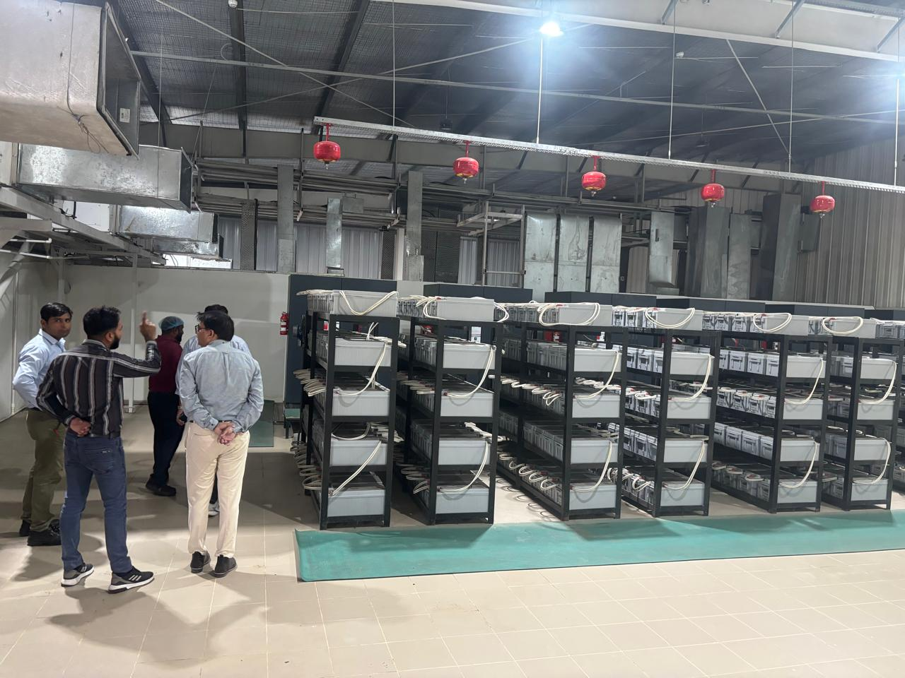
MOON BEVERAGE (COCA-COLA PLANT), Dhaulana

Slide 38
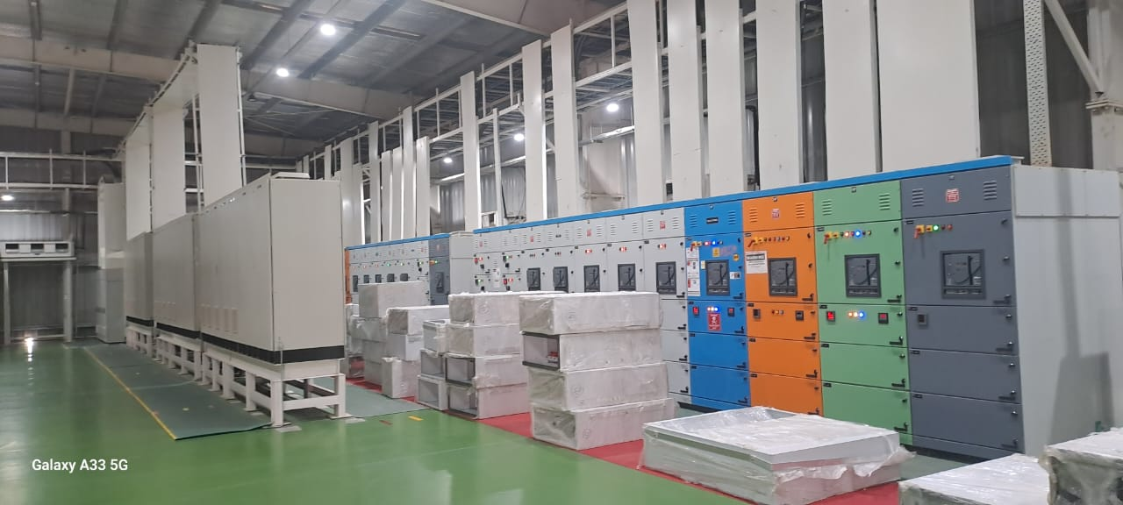
MOON BEVERAGE (COCA-COLA PLANT), Dhaulana

Slide 39
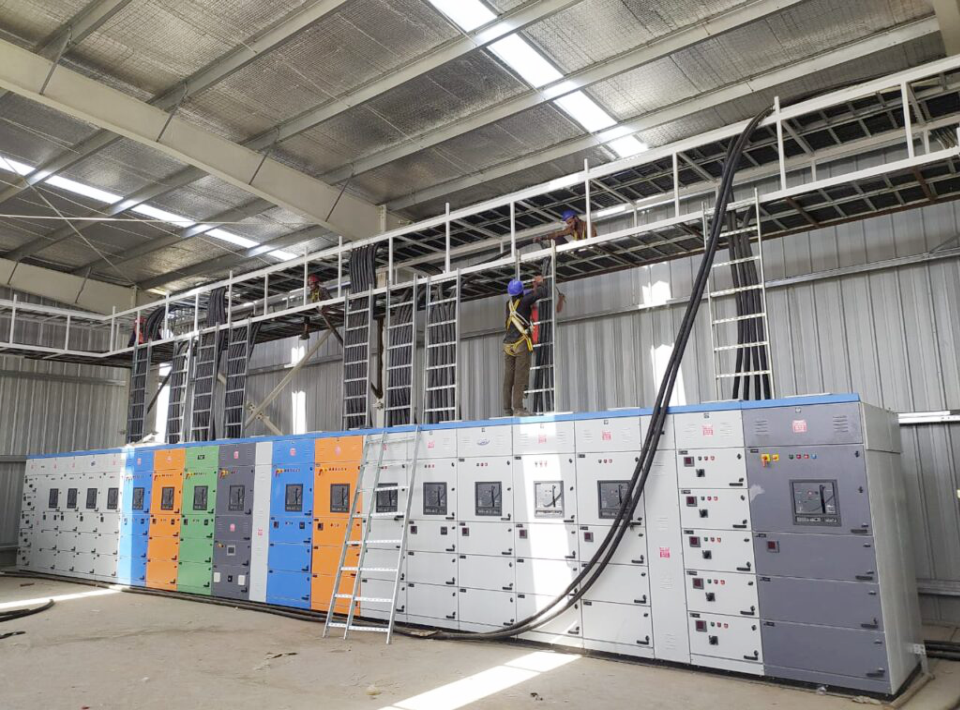
MOON BEVERAGE (COCA-COLA PLANT), Dhaulana

Slide 40
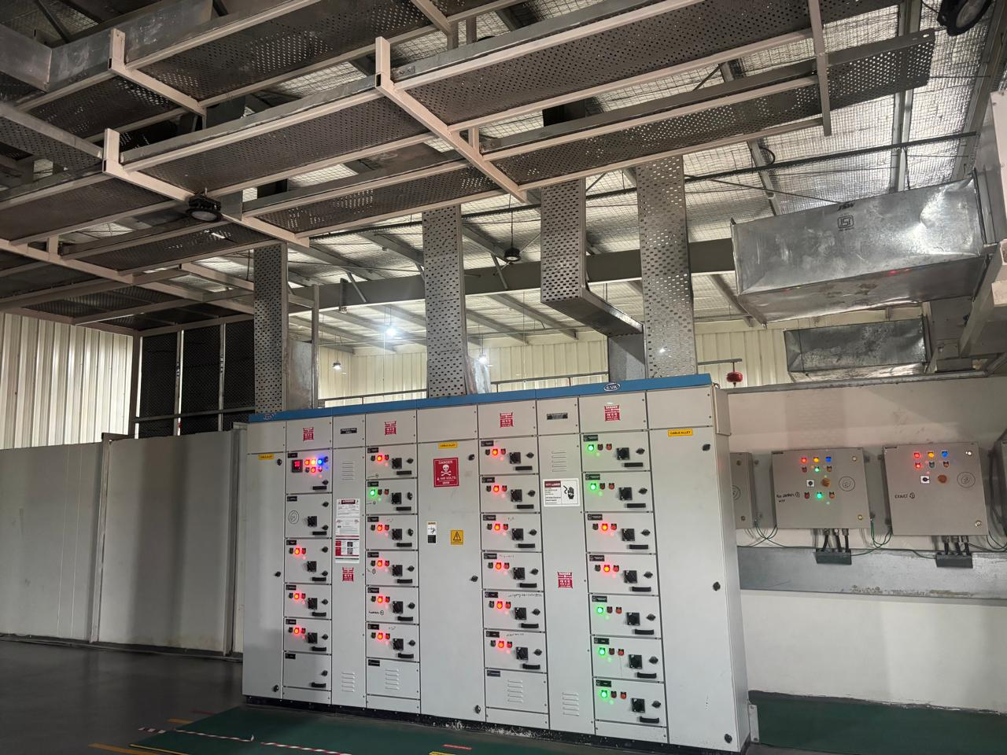
MOON BEVERAGE (COCA-COLA PLANT), Dhaulana

Slide 41
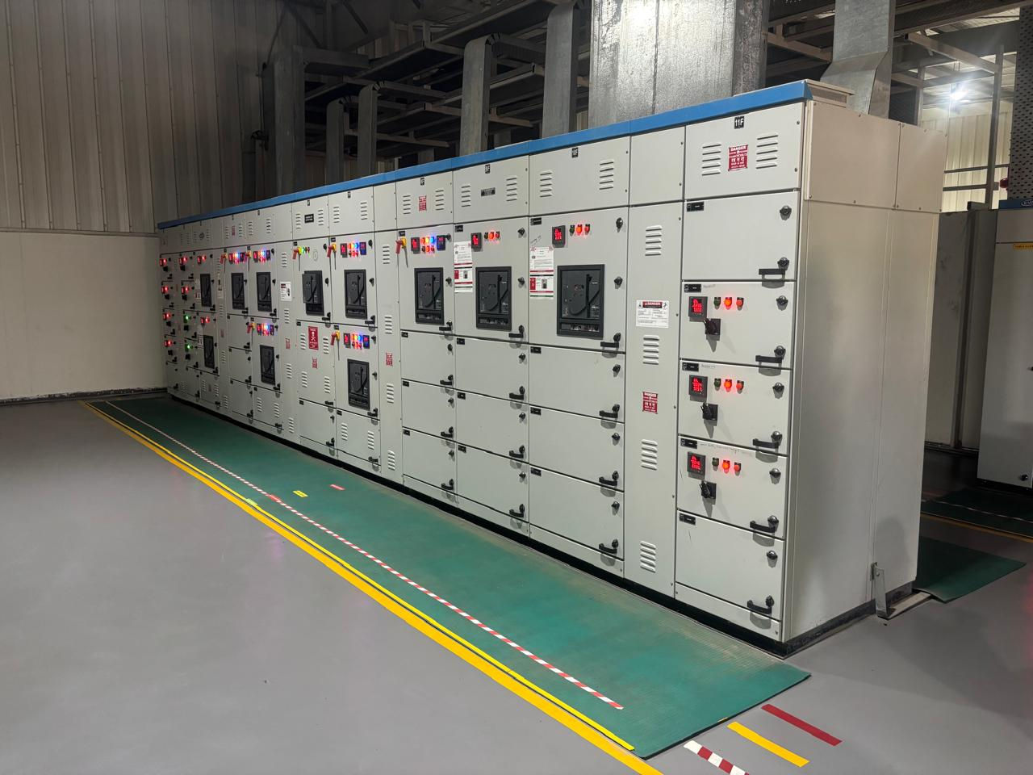
MOON BEVERAGE (COCA-COLA PLANT), Dhaulana

Slide 42
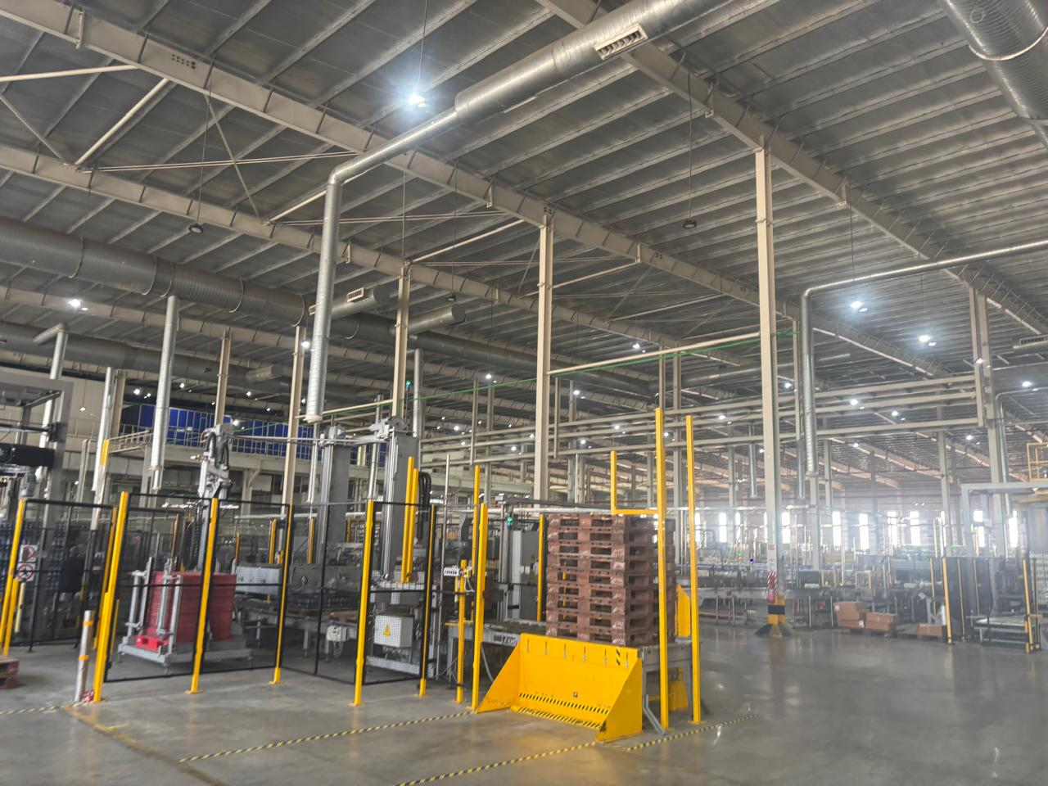
MOON BEVERAGE (COCA-COLA PLANT), Dhaulana

Slide 43
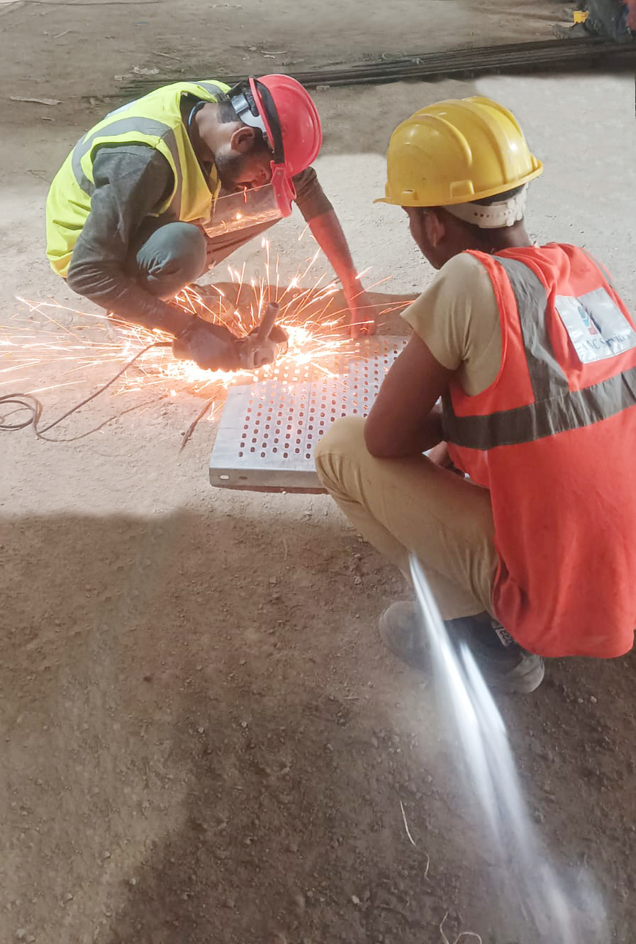
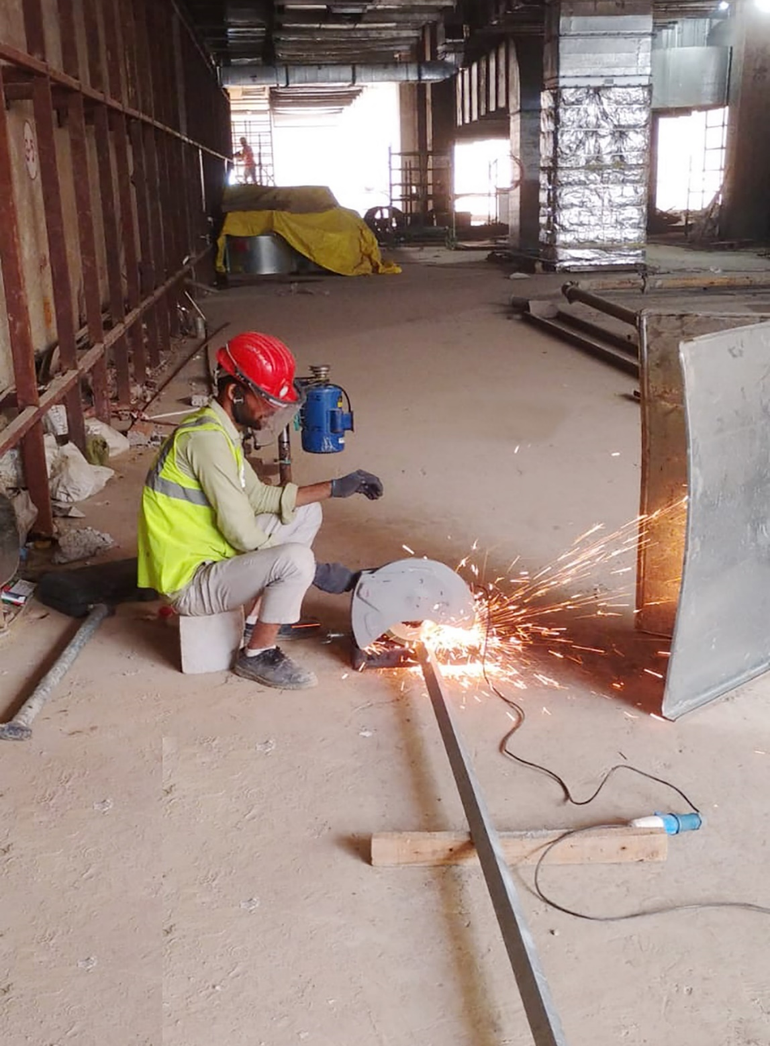
AGRA METRO RAIL CORPORATION

Slide 44
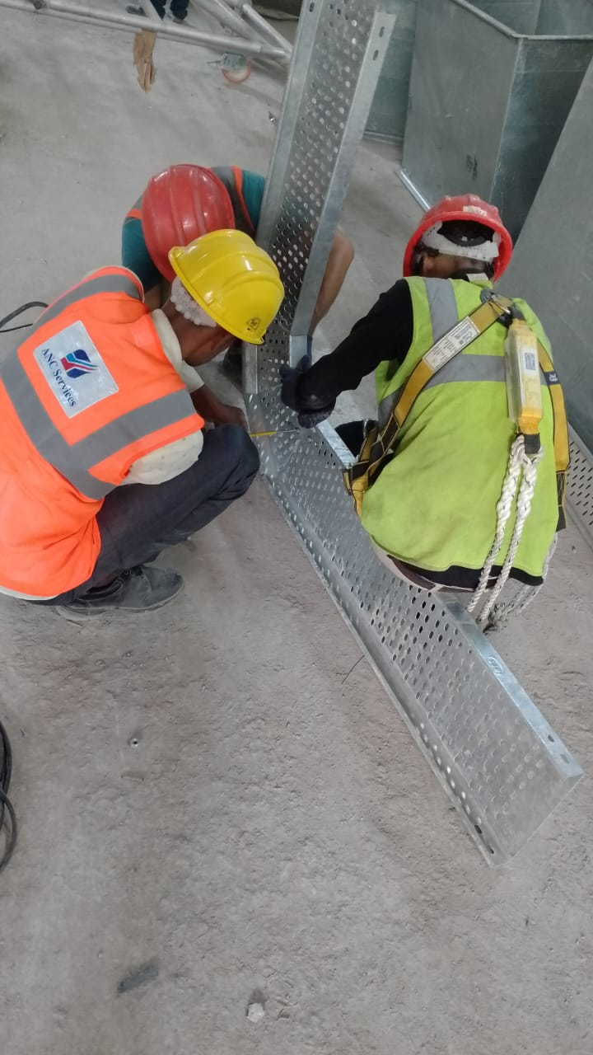
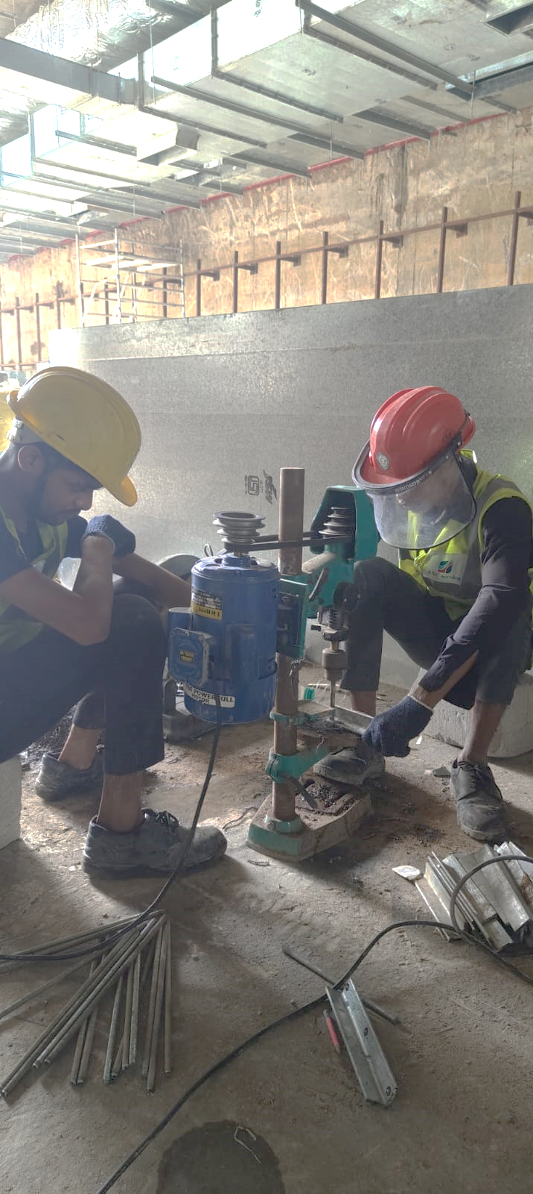
AGRA METRO RAIL CORPORATION

Slide 45

AGRO FARM VENTURE, Shimla

Slide 46

AGRO FARM VENTURE, Shimla

Slide 47





